Slide 1
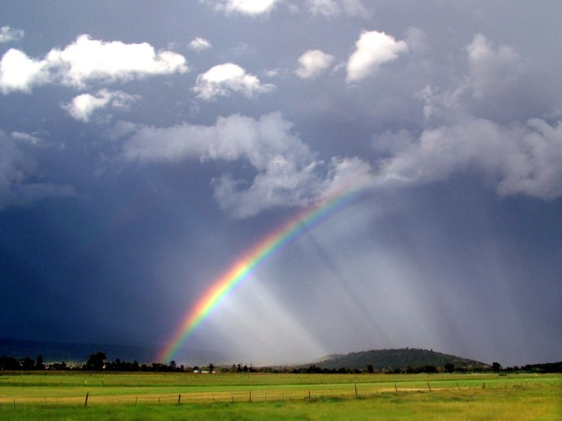
FRAMEWORKS FOR SUCCESS: manage the volunteer experience
© 2014 Paul Katz Consulting
Organizational momentum through deep staff and volunteer engagement
413.575.1568 www.paulkatzconsulting.com

Slide 2



Frameworks
Frameworks guide people how to act.
Frameworks allow for creativity.
Rule books tell people what to do.
Rule books insist on discipline.
Simon Sinek
February 1, 2013

Slide 3

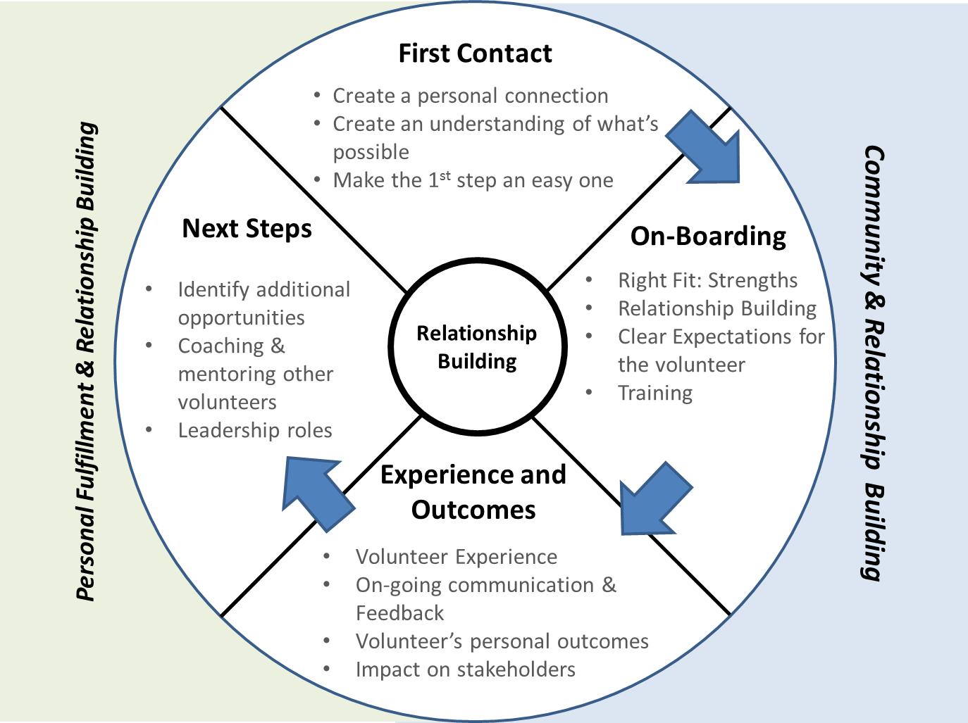
Overview

Slide 4

Anatomy of a Framework
Headline: What Volunteers say they need
Leading Practice
What great leaders do to help Volunteers feel successful

Slide 5



First Contact: What Works
“Connect with me personally, in a timely fashion”
“Help me understand the opportunities and impact I’ll make”
“Make it easy for me to take the first step”
DO THIS:
Fully leverage your appreciation, be welcoming and hopeful.
Personally contact the potential volunteer within 24-48 hours.
Set up a face-to-face meeting (working with the volunteer’s schedule) within one week of initial contact.
DO THIS:
Briefly share how their interests align with your organization’s mission .
Give them inspirational and informative materials
Let him/her know we will customize their experience based on his/her interests & strengths.
DO THIS:
Invite them to commit to a next step, and schedule an on-boarding session, if appropriate.
Follow-up with an email or phone call clearly outlining next steps to get the volunteer started.

Slide 6




On-Boarding Volunteers: What Works
“Place me where I belong & give me clear expectations”
“Help me understand the Impact I will make”
“Set me up from the start and support me along the way”
“Help me feel connected to staff and other volunteers”
DO THIS:
Use an Interview Guide with open-ended questions to help determine a match between the Volunteer’s interests and opportunity for impact.
Write a Volunteer Service Description that includes expectations of time, area of focus, and expected impact they will have.
Review the Service Description before they accept the role
DO THIS:
Use printed, video, and electronic marketing pieces to help new volunteers gain a deeper understanding of the organization.
Share Impact Stories
Encourage other volunteers to share their impact stories
Show real life examples of impact on those served by the organization
DO THIS:
Prepare the volunteer before they start with details (time to arrive, uniform if appropriate, responsibilities, introductions)
Keep them informed with updates via e-mail, phone, and/or visits to stay connected
Pair a seasoned, successful volunteer and/or staff person with each new volunteer
DO THIS:
Connect by phone and e-mail regularly to check in; recognize their birthday, anniversaries, etc.
Invite volunteers to events and trainings
Offer social events outside of meetings for volunteers to build relationships with each other
Connect them to social and training events

Slide 7
Experience & Outcomes : What Works
“Place me where I belong & give me clear expectations”
“Help me understand the Impact I will make”
“Set me up from the start and support me along the way”
“Help me feel connected to staff and other volunteers”
DO THIS:
Ensure the Service Description is reviewed with Volunteer again, prior to the beginning of their experience
Have an up-front conversation that provides the volunteer a graceful exit if the experience does not work out as planned
Schedule regular opportunities to touch base with the volunteer to ensure continued clarity
DO THIS:
Connect the volunteer experience to the mission of the organization regularly
Plan a communication strategy to share appropriate data with the volunteer to help them see outcomes of their efforts
Utilize impact stories and/or program visits to educate volunteers
DO THIS:
Ensure staff understand volunteers’ roles and are trained to positively engage them
Plan for ongoing appreciation/recognition
Give volunteers regular, timely feedback about their service and performance
Create an opportunity for volunteers to evaluate their current placement and consider next steps
DO THIS:
Communicate leadership opportunities for volunteers as they express interest
Continue the connection opportunities that began during onboarding
Offer a celebration/fellowship opportunity that fosters sharing broad range of volunteer experiences

Slide 8
Next Steps: What Works
“Place me where I belong & give me clear expectations”
“Help me understand the Impact I will make”
“Set me up from the start and support me along the way”
“Help me feel connected to staff and other volunteers”
Identify those volunteers who are truly ready to take the next step and engage them in a one or two stage conversation that touches on all four aspects of the Frameworks, with sensitivity to volunteer burnout
DO THIS:
Assess the experience and impact through evaluations and feedback
Explore & offer appropriate growth opportunities inside and/or outside the organization
Clarify pathway to other leadership opportunities, if appropriate
DO THIS:
Acknowledge their impact and explore possibilities for next steps
Empower “successful” volunteers to recruit other volunteers
DO THIS:
When there are clear next steps, move into On-Boarding experiences
For volunteers who are, or are approaching, burn-out, provide a graceful and celebrated exit
DO THIS:
Maintain appropriate connection with Volunteers, even if there is no next step
Provide intentional networking experiences with other volunteers
Identify the opportunity for the volunteer to mentor a potential successor

