Slide 2
Succession Planning for Local Offices
Mission
The mission of the American Camp Association is enriching the lives of children, youth, and adults through the camp experience.
Values
Contribution We believe that the camp experience is essential to every child’s growth and education.
People We believe in all the children and adults who come to our camps.
The World We believe that each of us plays an important role in the stewardship of our environment — both natural and manmade.
Vision
Enriching Lives, Changing the World

Slide 3
Tenure Terms Found in the the Field Office Operations Guide
LCOL Chair - 3 year term, can serve 2 consecutive terms for 6 years total.
Accreditation and Standards Leader - 3 year term, can serve 2 consecutive terms for 6 years total.
Other LCOL Leaders – 2 year term, can serve 3 consecutive terms for 6 years total.
Other considerations:
LCOL leaders providing 6 consecutive years of LCOL leadership will rotate off the LCOL for at least 1 year, unless selected to serve as the LCOL chair.
A 1 year extension may be added to an LCOL leader or chair’s term in extenuating circumstances, with the approval of the majority of the LCOL.
After serving as LCOL chair, the individual may be asked by the incoming LCOL chair to stay involved for six (6) months. After the six (6) months pass, the immediate past LCOL chair is required to step down as an LCOL leader for at least one year.
Transition of roles will be done with the LCOL, regional team leader and the Volunteer Engagement Committee liaison.
Terms will be staggered to avoid a full roll off of the LCOL.
For consistency, terms should start before fall trainings provided by ACA, Inc. to ensure the incoming volunteer is attending those trainings.

Slide 4
Using the Volunteer Center and Service Descriptions
The Volunteer Center has a place for volunteer opportunities to be posted for members to learn more
Service Descriptions are templates to customize to outline the responsibilities around the opportunities in your LCOL

Slide 5
Using a Selection or Nominating Committee
Adds a layer of transparency and impartiality for LCOL member selection
Checks and balance for LCOL
Helps to spread the work of identifying LCOL members
Another volunteer position keeping more people engaged in ACA

Slide 6
Using a Selection or Nominating Committee

Slide 7
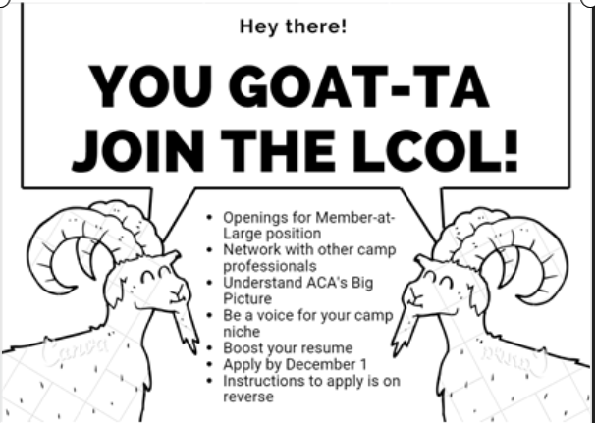
Promotion of LCOL Positions

Slide 8
Promotion of LCOL Positions
Custom stickers to give away at events
Postcards to send with visitors to hand out at camps
1:1 chats with potential volunteers- in person or on phone

Slide 10
Where to Find Resources
Field Office Resources
ACA Connect
Fellow LCOL Chairs
Volunteer Engagement Committee Liaison
ACA staff

Slide 11
Continuing the Learning
Upcoming Trainings:
Volunteer engagement and development
Strategic planning
Using Committees, task forces and work groups

Slide 12
Questions? Comments?

Slide 13
Thank you!
This slide deck will be posted on the ACA Field Offices Resource Page

