Slide 1
January 2019
Standards Chair
Meeting
Notes:
Before we get started – THANKS to everyone for joining and welcome to Danielle Pinney, the new Director of Accreditation. We’ll be overlapping as we transition between now and Feb. 28.

Slide 2
AGENDA
What’s New…
NSC Update
AAR Update
National Conference
Remember…
Questions?

Slide 3
We know our goal!
Notes:
I snow shoe when I have the opportunity and often see it as a metaphor for things in life. One of those areas was working towards our goal of revising the standards and parts of the accreditation process. We knew our goal yet – at times, it was difficult to know which way to go.

Slide 4
Sometimes you can sort of see the path.
Notes:
In snowshoeing (as in life), if you look hard, you can see a potential path. It was this way with the NSC as we review the standards from a variety of ways (through mandatory standards, through standards that had posed challenges, through comments we heard, etc.)

Slide 5
Sometimes you get off track!
Notes:
So – we worked hard to find that path yet at times – strayed. And, we knew that pretty quick as we were up to our knees in yuck.

Slide 6
Finally, the path becomes clear.
Notes:
After much work, the path became clear and we finished the APG, developed the training, and are providing that support. As a general rule, we’ve managed to stay “on the path”.

Slide 7
Our Goal
Notes:
The end result – the 2019 APG

Slide 8
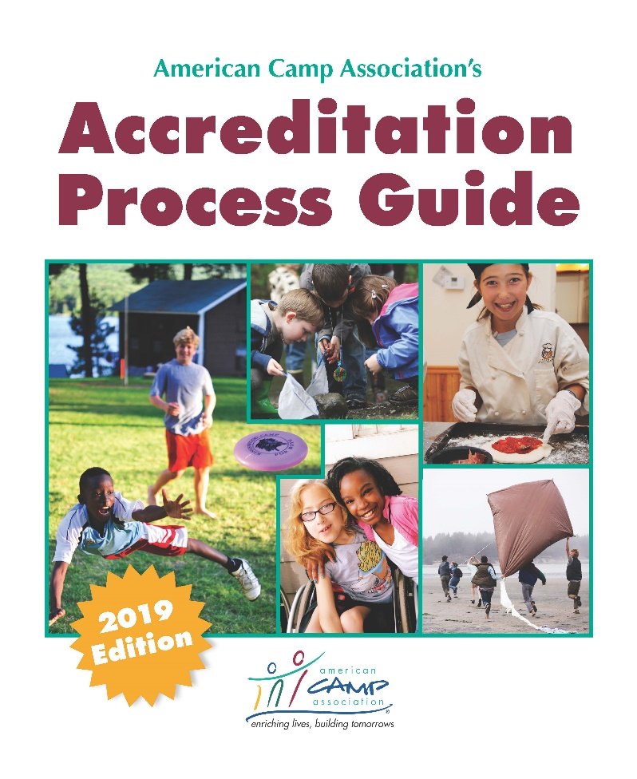
New Sections of Standards
Core Foundational
Administration
Facilities
Health and Wellness
Staff Qualifications, Training, & Supervision
Program
Program Aquatics
Notes:
Core/foundational standards include the goals and outcomes of the camp, respect for campers and staff, camper development, and general
condition of facilities.
Administrative standards include policies and procedures for which key administrative staff are responsible for writing and distributing. Topics
include transportation, risk management, emergency procedures, policies related to camp staff and various program areas.
Facilities standards include provision of adequate sleeping quarters in resident camps, safe playgrounds, storage of hazardous materials, and food service.
Health and wellness standards include availability of first-aid equipment and personnel, the use of health histories and health examination forms, and the use of recommended treatment procedures.
Staff qualifications, training, and supervision standards include qualifications for various staff roles, required staff training, supervision of camp staff, and camper-to-staff supervision ratios.
Program standards include safety regulations and procedures for conducting both general and specialized activities, such as aquatics, horseback riding, challenge and adventure activities, and trip and travel camping programs.

Slide 9
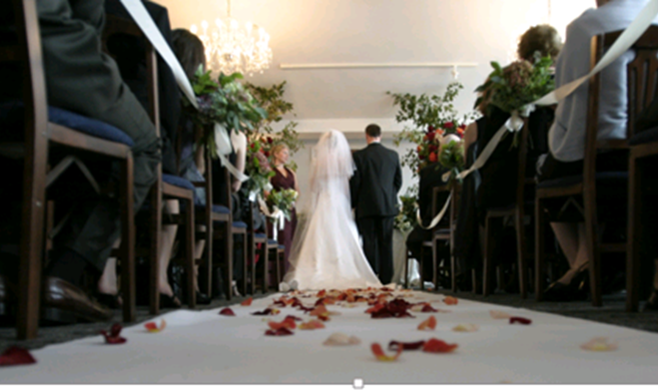
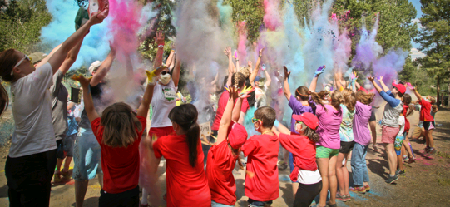
Clarified Who ACA Accredits
U.S.-based camps with at least one program that occurs in the United States or its territories.
Programs with a primary audience of campers five years and older.
Program sessions of at least three days in length, with a specific purpose and goals.
Notes:
(NOTE: Many camps offer programs that serve some three- or
four-year-old campers. If this is the camp’s primary audience,
accreditation or licensure through a different organization is
most appropriate.)

Slide 10
Clarified Modes
Resident Camp
Day Camp
Short-term camp
Resident (family camp generally included here for HW purposes)
Day
Rents to others
Notes:
In the transition of standards and moving of standards from section to section, we realized it was not clear where “family camps” should be scored. For purposes of HW, they will generally be scored in Short-term resident mode.

Slide 11
What’s New in the Standards?
Some Standards Combined
Aquatic Certification and Skills Verification are now in the same standard
All types of vendor-provided activities are now in one standard
Some Wording Changes
Camp Security and Active Threats
Transportation accident procedures are for both campers and staff (not just campers)!
Qualifications for activity supervisor now specify “18 years of age” instead of “adult” or “21 years of age.”
THREE New Mandatory Standards
Notes:
A full (and we hope complete) list of standards that have been combined and have wording changes that might “catch” currently accredited camps off-guard is posted on the Standards Chair webpage www.acacamps.org/about/leadership/volunteers/standards-chairs (cut and paste link) as well as on the Accreditation Information and Forms page www.acacamps.org/staff-professionals/accreditation-standards/tools-resources-camps/accreditation-information-forms. This list is for currently accredited camps as camps new to accreditation don’t realize any differences.

Slide 12
What’s New About the Process?
Multi-camp operations scoring (sort of new)
Customized score forms
Health Dept. reviews
Allows some DNAs for camps using non-accredited sites
CSA is now WDR
Basic Standards Course is now Accreditation Process Workshop (APW)
Notes:
PROCESSES
Multi-camp operations: Reviewing common documentation 1 time and sharing
Customized score form – for some multi-site camps
Allow some DNAs in facilities when camp uses non-owned, non-accredited sites.
Camp Self-Assessment is now Written Documentation Review
STANDARDS
New sections
Some standards combined
No separate section for trip/travel
Staffed public facilities is now VENDORS – what it really is.
3 “new” mandatory standards (AD.1/SF.3; HW.13/HW.19; AD.44/HW.28)

Slide 13
National Standards Commission Update
From the 2016 Accreditation Task Force:
Develop a Foundation for Accreditation – CHECK!
Consider Camps on Campus – Do they need a separate mode? CHECK!
Improve Visitor Quality/Technology ONGOING
How do we/can we incorporate program quality? IN PROGRESS
Notes:
The NSC continually reviews the 4 recommendations from the 2016 task force to determine: Where are we. At this point:
Develop a Foundation for Accreditation – CHECK!
Consider Camps on Campus – Do they need a separate mode? CHECK! While the NSC has determined we do not need a separate mode for Camps on Campus, we continue to review the process used to visit their camps. Our first large university is going through a visit this summer. They have 16-20 departments that offer camps and we’ll visit each department’s camp. All common documentation will be reviewed one time. This will help inform us for future camps on campus visits.
Improve Visitor Quality/Technology ONGOING
How do we/can we incorporate program quality? IN PROGRESS This was a topic of the NSC meeting.

Slide 14
National Standards Commission Update, cont. (NSC just met!)
One appeal – camp remains accredited, with follow-up
Discussion related to visiting camps on campuses
Records Retention – for protection of volunteers
Substantial discussion related to program quality
Discussed overall “health” of program w/staff transitions
Notes:
OVERVIEW of MEETING
One appeal – camp remains accredited, with follow-up (additional documentation has to be submitted prior to May 1)
Discussion related to visiting camps on campuses - see notes in prior slide
Records Retention – for protection of volunteers. The NSC reviewed and discussed the retention policy related to all accreditation documents. Stressed the importance of all volunteers deleting emails, sending documents to ACA, Inc., etc. ACA isn’t immune to lawsuits and we don’t want visitors “caught” (although ACA would be there with them should this very unlikely situation occur).
Substantial discussion related to program quality. They reviewed what other youth organizations did/required of their camps (varied), reviewed what ACA already offers (C-PQA tool, etc.) and reviewed the ACA standards with this lens. We discussed how the ACA standards are the foundation on which program quality/program quality improvement could be based. This is an ongoing conversation.
Discussed overall “health” of program w/staff transitions. All Field office/affiliate offices have met the 90% of camps visited and 90% of visits with 2 people the past several years. This is different from 5-7 years ago. We attribute this to strong volunteers and the staffing structure currently in place. We’re in a good place.

Slide 15
AAR Update
As of January 31, 2019, 10 a.m.
1300 of 1936 AARs have been submitted!

Slide 16
Join Us in Nashville
Standards Chair Roundtable
Wednesday (20th), 7 – 8:15 a.m.
Visitor Thank You Reception
Wednesday (20th), 8:30 p.m.
Instructor Gathering
Thursday (21st), 7 a.m.
Notes:
In addition to what’s on the slide, we’ll be hosting 3 Accreditation Process workshops and 3 Visitor Updates. One of each on Monday afternoon and 2 of each on Tuesday morning. Thanks to the instructors who have volunteered to instruct!

Slide 17
Reminders
Updated SAM on the ACA website, standards chair page
Make sure to post to/read the ACA Connect Standards Chair Community
Standards staff have the links for online courses
Guided follow-up discussion is a required part of any online course.
Notes:
We distributed an updated version of the Standards Administration Manual at Standards Chair training in Indianapolis. During the training (and upon review after the training), we found some inadvertent errors and omissions. A page of corrections can be found on the standards Chair webpage at: https://www.acacamps.org/about/leadership/volunteers/standards-chairs
We will post/distribute information specific for standards chair on their page on the ACA website as well as through ACA Connect Community for Standards Chairs. Make sure to check it when you receive that “email.”
The online courses for the Accreditation Process Workshop and Visitor Update are now available. The standards staff have the registration link for each of the courses. Please work with them to determine how the registration link will be distributed. As we know the learner needs access to the Accreditation Process Guide v 2019, we have posted a PDF of the APG from My Accreditation. Learners will be sent an APG when we have confirmed their registration (and verified they or their camp hasn’t already received one).
As a reminder, a guided discussion is required for all individuals who complete the online course. ACA, Inc. has set up times for several webinars, they can be hosted by a Field/Affiliate office, they can occur 1:1, etc. Basically – the discussion needs to be held. A Discussion Guide for each course can be found on the Standards Chair webpage and on the ACA webpage for instructors www.acacamps.org/about/leadership/volunteers/standards-instructors

Slide 18
Questions?

