Slide 1
Technology Update

Slide 2
Standards Chair Web Portal

Slide 3
How to Find
Monthly Reminder Email From ACA
10th of the month
Direct link
Sign-in required with ACA username and password
Volunteer Standards Chair Page on ACA Website
Sign-in required with ACA username and password
http://www.acacamps.org/

Slide 4
ACA Website

Slide 5
Current ACA Website
Accreditation Menu
Basics of Accreditation
Standards at a Glance
Statement of Compliance
Accreditation Resources Tools
Resources by Section of Standards
Find My Accreditation and My Visits links
Visitor Resources
Recognized Certifications
http://www.acacamps.org/
New ACA Website

Slide 6
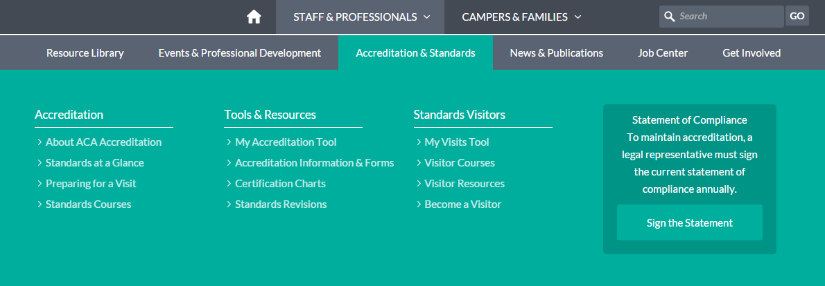

Slide 7
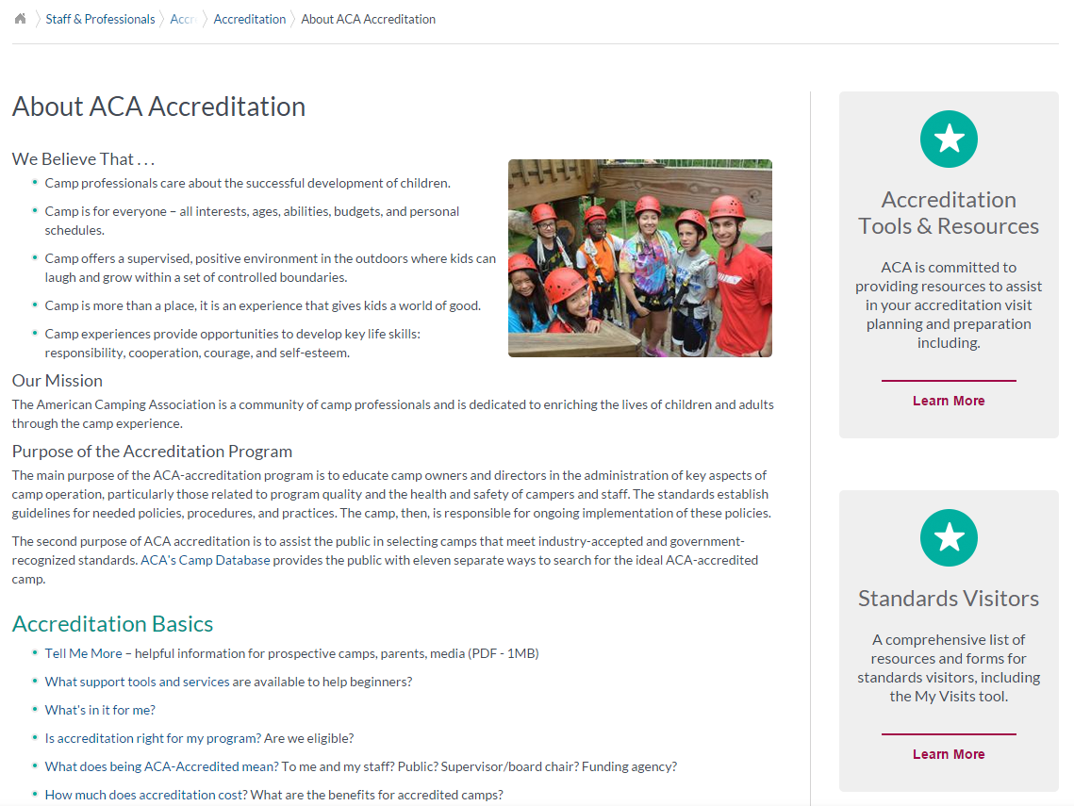

Slide 8
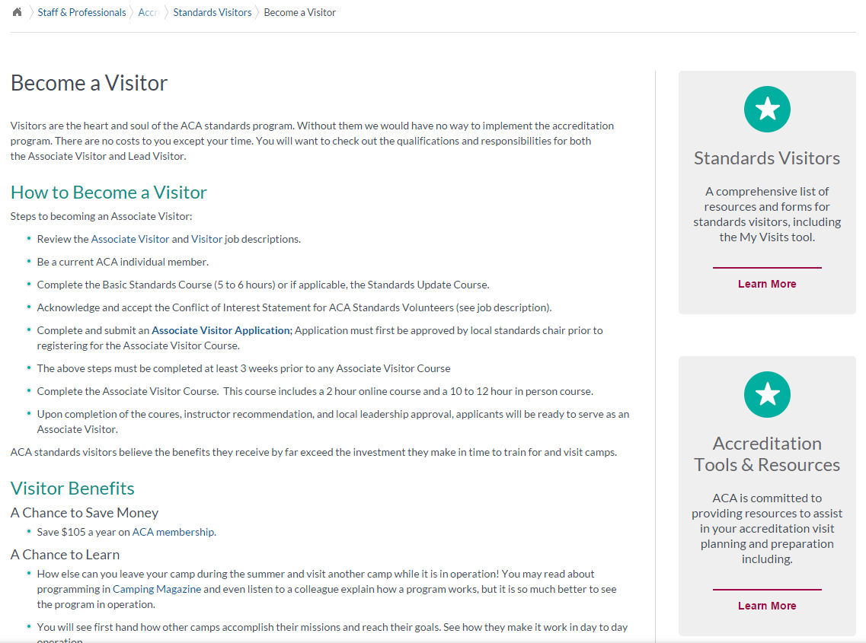

Slide 9
My Accreditation and My Visits

Slide 10
My Accreditation and My Visits
Access through Resources/Tools page (current); from Accreditation and Standards section (new website)
Watch the tutorials
Don’t have a camp and want to experience the tool/app? Use our fake camp - Camp ACA
Username: Trainer
Password: 12345
Download PDF version of APG copy
Ability to use as a method of completing and reviewing Camp Self Assessment
Camp Information Form could be uploaded here too
http://www.acacamps.org/standardstool/my-accreditation
http://www.acacamps.org/standardstool/my-visits

Slide 11
Camp Information Form

Slide 12
Annual Accreditation Report

