Slide 1
American Camp Association®
Instructor Update Course
Fall 2014
Notes:
Welcome and Overview
Have slide up on the screen.
For in-person courses…
As participants are coming in the door…
Give them the Participant Handout packet if in person
Have them make a name card tent that will sit on the table in front of them.
Welcome the group
Introduce yourselves
Go over housekeeping items
Identify locations of restrooms, smoking areas, snacks, etc.
Ask if everyone has had a chance to sign in for the course and pass the sheet around again if necessary.
Conduct a short icebreaker that encourages the group to begin to network.
For webinar versions of course….
Do a quick roll call and introductions

Slide 2
Course Objectives
Learn “what’s new” that impacts Standards Courses
Learn of recent revisions to the standards
Overview of the 2014 courses highlighting “What’s New/Different”
Refresh skills
Share concerns
Notes:
Review the Instructor Update course objectives for today.
Highlight “What’s New” in the Standards Course
Overview of revisions to the standards
Help you to teach revised courses
Refresh skills
Share concerns
Trainers Note
Some of the slides you’ll see in this course are the very same slides you’ll see in one or more of the other standards courses.

Slide 3
Main Purpose of ACA Accreditation
Director’s best evidence
Establishes guidelines
Industry-accepted and government-recognized standards
Voluntary
Educational in nature and design.
Notes:
Review the Purpose of the ACA Accreditation Program
Before sharing slide content discuss…
When did YOU last help a camp director with an AH-HA moment? (Capture responses on flip chart)
How have you helped a camp experience a successful visit? (Capture responses)
So, with these things in mind — from an INSTRUCTOR’s point of view
What does education look like?
What does it sound like?
How do we, as instructors, facilitate education?
Slide content…
The main purpose of the ACA Accreditation Program is to educate camp owners and directors in the administration of key aspects of camp operation.
Related to program quality and the health and safety of campers and staff.
Establishes guidelines for implementing policies, procedures, and practices.
Assists the public in selecting camps that meet industry-accepted and government-recognized standards.
ACA accreditation is voluntary.
The visit process is educational in nature and design.
Optional
If time permits and/or if needed review the “Purpose” section on page 12 in the Accreditation Process Guide (APG)
The main purpose of the ACA Accreditation Program is to educate camp owners and directors in the administration of key aspects of camp operation, particularly those related to program quality and the health and safety of campers and staff (APG, p.12).
The standards establish guidelines for implementing policies, procedures, and practices. The camp, then, is responsible for implementing and ensuring policies are followed (APG, p.12)
Another purpose of ACA accreditation is to assist the public in selecting camps that meet industry-accepted and government-recognized standards (APG, p.12).
Accreditation does, however, indicate to the public that the camp administration has voluntarily allowed its practices to be compared with the standards established by professionals in the camp industry (APG, p.12). (continued)
Accreditation focuses on education and evaluation of camp operations, using standards that often go beyond the minimum requirements of licensing (APG, p.12).

Slide 4
ACA Accreditation Is…
Commitment
Accountability
Credibility
Solid Proof of Your
Notes:
Remind Participants
Accreditation is PROOF of your …
Commitment to having a safe program — Participation is voluntary.
Accountability — It’s a third-party verification of your commitment and part of your overall risk management.
Credibility — It’s your camp’s best evidence of wanting to do it correctly.
Accreditation is a nationwide program administered at the local level primarily by volunteers. Volunteers serve as the visitors, make visitor assignments, are involved in the review process if a review due to a failed visit is requested, and approve the accreditation status of camps.

Slide 5

ACA Accreditation Means…
You have established a standard of care – using prudence.
Notes:
ACA accreditation means you have established a standard of care – using prudence.

Slide 6

Prudence
pru·dence • noun \ˈprü-dən(t)s\ : careful good judgment that allows someone to avoid danger or risks.
Full definition:
The ability to govern and discipline oneself by the use of reason
Sagacity or shrewdness in the management of affairs
Skill and good judgment in the use of resources
Caution or circumspection as to danger or risk
Notes:
Discuss Concept of “using prudence” with Group
What is prudence? Is this something you have ever considered as an accredited camp?
pru·dence • noun \ˈprü-dən(t)s\ : careful good judgment that allows someone to avoid danger or risks.
Full definition:
The ability to govern and discipline oneself by the use of reason
Sagacity or shrewdness in the management of affairs
Skill and good judgment in the use of resources
Caution or circumspection as to danger or risk
"Prudence." Merriam-Webster.com. Merriam-Webster, n.d. Web. 21 Aug. 2014. <www.merriam-webster.com/dictionary/prudence>.
How do you use prudence at your camp?

Slide 7

What’s New and Different in 2012
2014 Revisions
to the Standards
Notes:
Articulate What’s New and Different with the 2014 Revisions to the Standards
Share
In this next section we are going to discuss the pertinent changes that ALL Instructors need to know.
Note to ALL: Despite the changes to the standards — camps will follow the standards under which they were last visited — until they are due a visit.
EXCEPT — ALL camps regardless of applicability of new standards are REQUIRED to comply with ALL CURRENT MANDATORY standards.
General Note:
Notification of Updates/Revisions to Standards was shared in the following manner:
Week of September 8, 2014
Tuesday, September 9
Article in ACA Now
Website updated
My Visits/My Accreditation updated
Wednesday, September 10
Email sent to all primary contacts
Thursday, September 11
Email sent to all Visitors, Instructors, and Trainers

Slide 8
Updates to APG
It is ACA’s responsibility to notify you of revisions
It is your responsibility to have the updates
Revisions will be in effect starting with the
2015 visit season
Three ways to update your current book
  Download updates from website
  My Accreditation
  Request a printed packet
Notes:
Review
Let’s review the process of how standards are revised/introduced.
The National Standards Commission’s key responsibility is oversight of ACA’s Accreditation Program. Its members are selected according to defined criteria and operate within specific guidelines and procedures approved by the ACA National Board of Directors.
The National Standards Commission, or the NSC, is responsible for the development and introduction of standards using a defined and approved process. That process includes the following steps:
Following ACA decision-making protocol used to determine suitability of standards
Engaging in periodic environmental scans and literature reviews
Consulting with subject matter experts
Initiating legal review
Gathering input and field comments from stakeholders (internal and external at various times)
Sharing proposals with the ACA National Board of Directors (when specified criteria is met)
Making revisions as necessary
Securing final legal review
Requesting approval of the Board in some cases (such as if the NSC recommends a change where specified criteria is met, for example, a change that involves risk exposure to association)
This is the process that has been used during this review/revision/reformatting of the standards.
Updates to APG are effective for summer 2015.
It is…
ACA’s responsibility to notify you of revisions (via emails, newsletters, local leadership, etc.)
The camp’s responsibility to make sure it is using the most up to date standards (current updates plus all updates since October 2012 and January 2012)
ACA’s responsibility to share notices of updates and make them readily available
Updates can be obtain in three ways:
Website link www.acacamps.org/accreditation/resources-tools
Through My Accreditation, you can request a report that is a copy of the actual standards – fully updated
Request a printed packet of the updates

Slide 9
Revisions:
Health & Wellness Standards
Revisions include:
Clarification and/or addition to Contextual Education
No change to intent of these standards
HW.5 – Camper Health History
HW.14 – Special Medical Needs
HW.19 – Medication Storage and Administration
HW.24 – Health Screening
Notes:
Note to Instructor – Please review each of these changes in the APGs with participants.
Please Note: These changes are indicated on the APG pages with a double dagger (‡). However, changes/revisions of standards on PDFs from My Accreditation and/or My Visits are not denoted in any manner.
Health and Wellness (HW) Standards revisions include clarification and/or additions to contextual education. There is NO change to intent of standards.
HW.5 – Camper Health History − Clarify what is acceptable to meet the standard related to immunizations.
HW.14 – Special Medical Needs − Add “of Participants” to title of standard.
HW.19 – Medication Storage and Administration − Add information to Contextual Education.
HW.24 – Health Screening − Delete HW.24.1-B-3, the requirement for healthcare staff to collect staff medication.

Slide 10
Revisions:
Operational Management Standards
Revisions include:
Clarification and/or addition to Contextual Education
No change to intent of these standards
OM.6 – Firearms Control
OM.8 – Emergency Plan and Rehearsal
OM.13 – Camper Security
Notes:
Note to Instructor – Please review each of these changes in the APGs with participants.
Operational Management (OM) Standards revisions include clarification and/or addition to contextual education. There is NO change to intent of standards.
OM.6 – Firearms Control − Change the word “guns” to “firearms” in Contextual Education.
OM.8 – Emergency Plan and Rehearsal − Change in wording of the standard and additional information added to Contextual Education.
No change to the intent of the standard.
OM.13 – Camper Security − Clarify what is required for OM.13.2.
Again, these changes are noted on the APG pages with a double dagger (‡).

Slide 11

Revisions:
Program Design & Activity Standards
PD.25 – Archery Safety
ALL parts of standard (PD.25.1, PD.25.2, and PD.25.3) are now MANDATORY
PD.25.3 archery equipment must be locked when stored
Notes:
Note to Instructor – Please review each of these changes in the APGs with participants.
These changes are noted on the actual APG pages with a double dagger (‡).
Program Design and Activities (PD) Standards revisions include:
PD.25 – Archery Safety
ALL parts of standard (PD.25.1, PD.25.2, and PD.25.3) are now MANDATORY.
PD.25.3 archery equipment must be locked when stored.

Slide 12
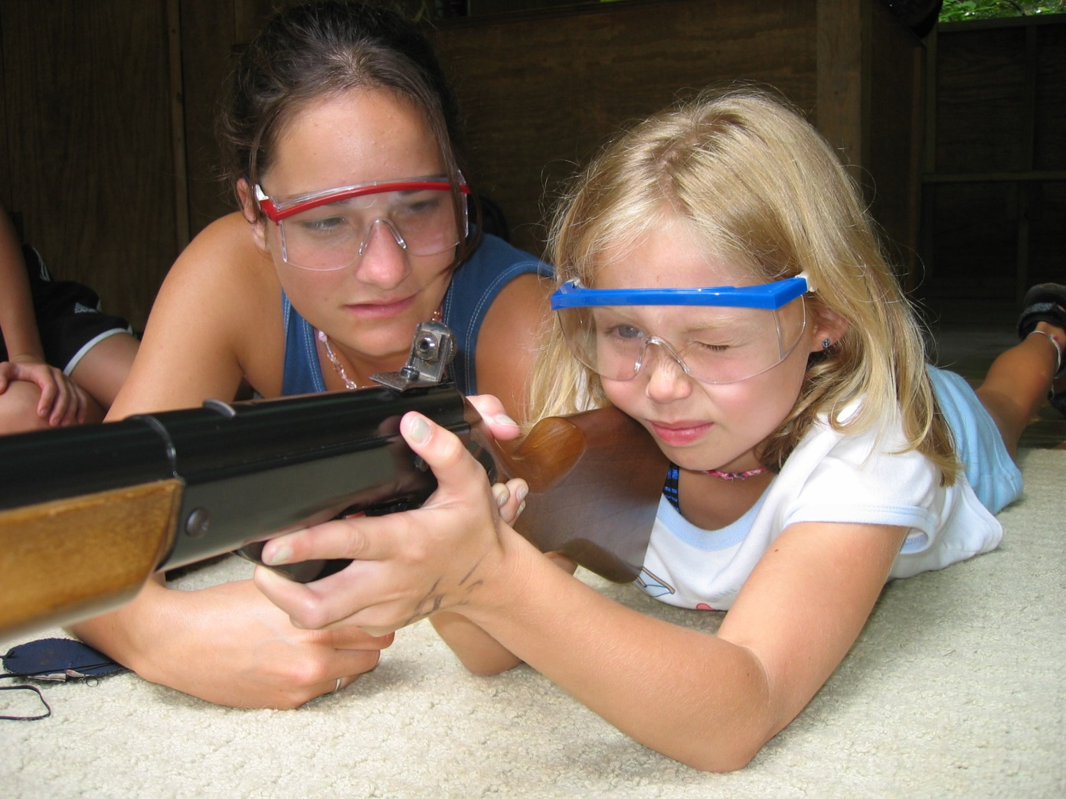
Revisions:
Program Design & Activity Standards
PD.26 – Riflery Safety
ALL parts of standard (PD.26.1, PD.26.2, and PD.26.3) are now MANDATORY
Notes:
Note to Instructor – Please review each of these changes in the APGs with participants.
These changes are noted on the actual APG pages with a double dagger (‡).
Program Design and Activities (PD) Standards revisions include:
PD.26 – Riflery Safety
ALL parts of standard (PD.26.1, PD.26.2, and PD.26.3) are now MANDATORY.

Slide 13

Revisions:
Human Resources Standards
HR.3 -- Hiring Policies
HR3.3 is now MANDATORY and
Requires year-round camp staff have a criminal background check at least every five years
Notes:
Note to Instructor – Please review each of these changes in the APGs with participants.
These changes are noted on the APG pages with a double dagger (‡).
Human Resources (HR) Standards revisions include clarification and/or addition to contextual education. There is NO change to intent of standards.
HR.3 – Hiring Policies
HR3.3 is now MANDATORY, and
Requires year-round camp staff have a criminal background check at least every five years.

Slide 14
Revisions:
Human Resources Standards
HR.4 – Annual Staff Screening
HR.4.3 has been added, which requires ANNUAL criminal background checks for
seasonal staff (returning seasonal staff) MANDATORY
Now applies to Camps that
Rent to Others mode
Notes:
Note to Instructor – Please review each of these changes in the APGs with participants.
These changes are noted on the APG pages with a double dagger (‡).
Human Resources (HR) Standards revisions include clarification and/or addition to contextual education. There is NO change to intent of standards.
HR.4 – Annual Staff Screening
HR.4.3 has been added that requires ANNUAL criminal background checks for seasonal staff (that means, returning seasonal staff) MANDATORY.
Now applies to Camps that Rent to Others mode.

Slide 15
Revisions:
Human Resources Standards
HR.5 – New Staff Screening
  Now applies to Camps that Rent to Others mode
HR.9 – Supervision Ratios Exceptions
  Now includes need to advise rental groups
HR.15 – Camp Staff Responsibilities for General Camp Activities
  Clarification added for when it applies to rental groups
Notes:
Note to Instructor – Please review each of these changes in the APGs with participants.
[animations]
These changes are noted on the APG pages with a double dagger (‡).
Human Resources (HR) Standards revisions include clarification and/or addition to contextual education. There is NO change to intent of standards. [animations]
HR.5 – New Staff Screening
Now applies to Camps that Rent to Others mode
HR.9 – Supervision Ratios Exceptions
Now includes need to advise rental groups
HR.15 – Camp Staff Responsibilities for General Camp Activities
Clarification added for when it applies to rental groups

Slide 16
Finding APG Updates and Revisions
Included in all new APG books from ACA and/or bookstore
Pull and replace pages can be found on Accreditation Resources and Tools page of the ACA website
Generate a custom set of standards from My Accreditation (camps) or My Visits PDF version (visitors)
Notes:
How can you find the updates/revisions?
Discuss
New APG books from ACA and/or bookstore have them included
Pull and replace pages can be found on Accreditation Resources and Tools page of the ACA website www.acacamps.org/accreditation/resources-tools
Generate a custom set of standards from My Accreditation (camps)/My Visits PDF version (visitors)
Request a printed copy
Revisions will be in effect starting with the 2015 visit season.
Three ways to update your current book
Download updates from website
My Accreditation
Request a printed packet

Slide 17

The Courses
Notes:
This section reviews each of the ACA update courses.

Slide 18
For ALL Standards Course
Instructor Do’s
Be prepared
Change the order of modules
When you see [animation] pay attention
REVIEW the presentation as a “slide show” prior to teaching (each time)
Know and be familiar with your content
Engage the audience!
Notes:
For All Standards Courses
TAKE TIME TO REVIEW AND PREPARE!
As an Instructor − You may…
Change the order of modules in a course to suit your instructional style. Try it! If you feel you need to change them, that’s okay, HOWEVER, you still need to cover all the material
Make good use of animations. Animations are present and important on some slides watch for “[animation]” prompts. It is very important for you to watch in the slideshow view prior to showing so you can see how they work! Additionally, you may add or delete animations, as you like, to suit your instructional style.
Review the presentation as a “slide show” prior to teaching (each time). Please review and are familiarize yourself with the “Notes” below the slide. They are there to help you. Please use them BUT don’t read them word for word! Know and be familiar with the content.
Engage the audience, whenever possible − even if it is not in the notes/script! If you have other activities that may share/make the same point, use them! (The biggest challenge here is to stay on time).
Some folks have found loading the PDF version of the course on their tablet works well. NOT on Slide
Handouts have been named vs. numbered NOT on Slide
There are some optional activities NOT on Slide
Times are estimated… NOT on Slide

Slide 19
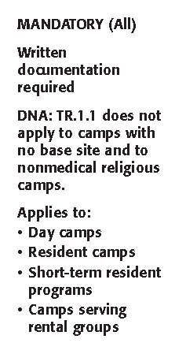
Standard Format — Margin Notes
Sample slide with many [animations]
that all need to
come in “on cue”
Mandatory Indicator
Written Documentation
Required Indicator
DNA Indicator
Modes of Operation
Notes:
Some slides have multiple animations – here is a sample slide from the Standards Course
THE CONTENT BELOW IS COPIED RIGHT FORM THE STANDARDS COURSE - it goes with the slide illustrating the animations
Introducing the APG — Standard Format
Instructor Note: [animations] Arrows appear on mouse click.
Continue Reviewing Standard Format and TR.1, p. 54; use this slide for the final component.
Margin Notes — There are notes in the margins of the page for each standard. These notes indicate the following things: [animations here on mouse click for each bullet]
Mandatory — Indicates whether and which parts are mandatory.
Written Documentation Required — Indicates something is required in WRITING. Make sure to look at the Compliance Demonstration to determine what documentation is acceptable. WRITTEN DOCUMENTATION means WRITTEN. It does not always say “written” in the actual standard, however it is clearly indicated in the margin notes and in the Compliance Demonstration.
DNA — Means “Does Not Apply” and indicates in what situations the standard does not apply.
Modes of Operation — This margin note begins with “Applies to:” and indicates which modes of operation the standard applies to.
Day camp
Resident camp
Short-term resident programs
Camps serving rental groups
Included in Self-Assessment — Lastly, it is not shown on this slide but margin notes also indicate when the standard is included in the camp self-assessment.

Slide 20

Who’s Responsible?
Notes:
Here is a sample slide without much on the slide itself − but has a fair amount of content to cover (from Standards Course)
Click to NEXT slide to show notes view of slide.

Slide 21
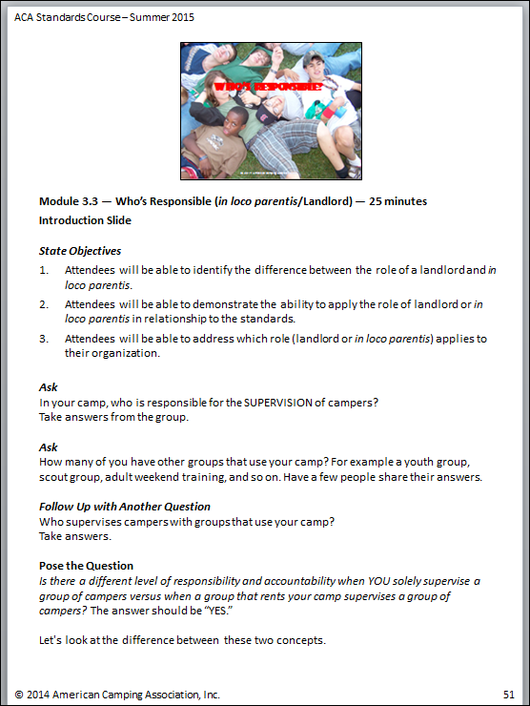
Notes:
Screen shot of content that goes with slide prior to this one

Slide 22
Standards Course
For those NEW to the ACA Accreditation process
Required to be completed prior to the visit
5 to 6 hours in length
  Earn 6 ACA Continuing Education Credits
Purpose is to prepare individuals from camps for their accreditation visits
Required for those taking an AV course
Notes:
Share
The ACA Standards Course…
Is for those NEW to the ACA accreditation process − those with experience will find it boring and will complain!
5 to 6 hours in length (Earn 6 ACA Continuing Education Credits)
Purpose is to prepare camp directors and administrators for their accreditation visits
Serves as an introduction to the standards program for persons interested in becoming visitors.

Slide 23
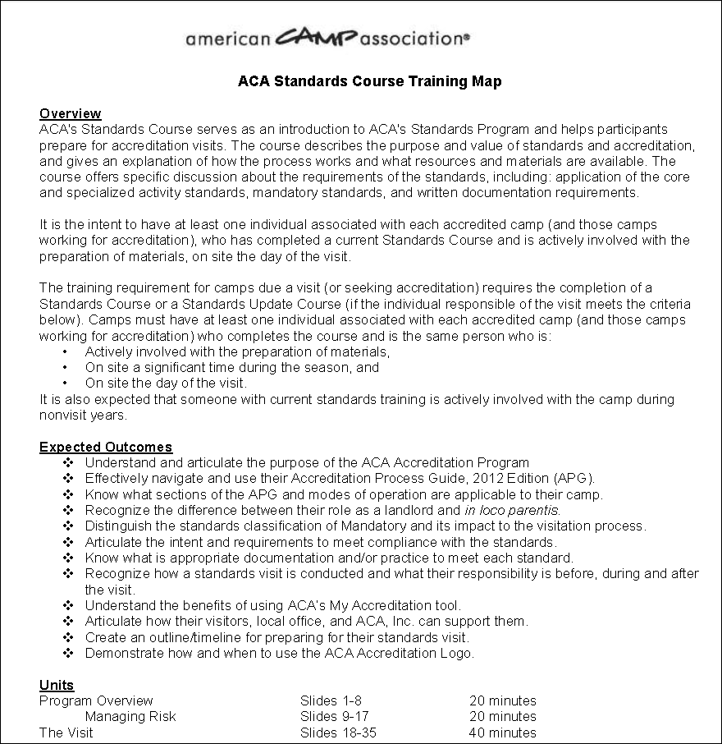
Notes:
Activity
Review the Training Map Handouts for the Standards Course (both courses have a training map).
As you look at the Standards Course Training Map handout point out that the order of the Standards Course elements is different than previous iterations.
Additional notes from Standards Course Training Map
As we continue to try to make the course more “user friendly”, not all the text that needs to be covered is on the slide. Hence, the importance of making sure you are familiar with and have reviewed the text notes.
Some of the topics covered include optional activities and, if you have a favorite one from the past that shares the intent, feel free to use it!
Be creative and share appropriate stories as time allows – pay attention to time.
Discuss other observations you or the participants notice.
Answer any questions that participants may have related to this handout.

Slide 24
Standards Update Course
For those “experienced” individuals
About 1.5 hours in length
  Earn 1.5 ACA Continuing Education Credits
Purpose - to update currently trained individuals on changes in standards and procedures as a result of a standards revision
Learn from others “mistakes”
Notes:
Share
Standards Update Course
Truly an update with a focus toward an “experienced” individual: someone who previously been through the accreditation process in the past 3 years.
About 1.5 hours in length (Earn 1.5 ACA Continuing Education Credits)
Purpose is to update currently trained standards personnel and/or camp directors on changes in standards and procedures as a result of a standards revision.
Learn from others “mistakes”

Slide 25
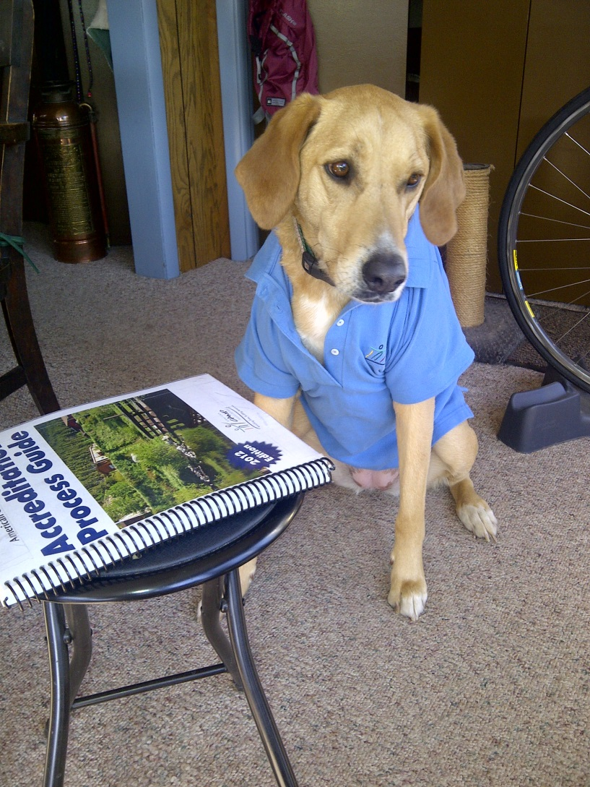
Standards Update Includes…
Overview of revisions
Accreditation Timeline
Importance of the Camp Information Form
Review of the Camp Self-Assessment
ICAs and 72 Hour Rule
Visit reminders and review
Notes:
Review…
Elements Specific to Standards Update Course
Overview of standards revisions released Sept. 2014.
FYI: An email was sent to the primary contact for all camps sharing news of these revisions as well as letting them know how to access the revisions for inclusion in their APG.
Currently accredited camps WILL NO LONGER get a NEW APG each visit cycle. If they need one (because of a hardship), we’ll work with them.
Accreditation Timeline − Remind participants that while their camp SHOULD have the majority of documentation in place, it is recommended they review everything to confirm compliance as well as method of compliance
Importance of the Camp Information Form − Information regarding this form is covered in all the courses. More on it later
Camp Self-Assessment − Again, information on the CSA is shared in all the courses. More to come
ICAs and 72 Hour Rule − A brief overview of these two critical areas
Things to remember about the visit − Overview of the visit itself
Activity
Look at the Standards Update Course Training Map handout (Trainers please “walk “ through this document with the participants).
Discuss any questions that participants may have related to this handout.

Slide 26
Visitor Update Course
Required for all current visitors
1 to 1.5 hours in length
  Earn 1.5 ACA Continuing Education Credits
Purpose is to serve as a refresher for all associate visitors and visitors
Highlights changes to the standards
Addresses issues and concerns
Notes:
Share
Visitor Update Course
Required for all current visitors
1 to 1.5 hours in length
Probably closer to the 1.5 when offered in person and might go a little longer with rich discussion ☺
Earn 1.5 ACA Continuing Education Credits
Purpose is to serve as a refresher for all associate visitors and visitors. It is required of all personnel at least once every three years and/or after major standards changes in order to maintain active status as a visitor or as directed by the NSC.

Slide 27

Visitor Update Includes…
Standards Revisions
Camp Information Form
Camp Self-Assessment
ICA and 72 Hour Rule
Importance of Visitor Communication
Overview of the Visit
Notes:
The ACA Visitor Update Includes
Overview of standards revisions released September 2014. FYI − An email was sent to all visitors sharing news of these revisions as well as letting them know how to access the revisions for inclusion in their APG.
Timeline - remind participants that while their camp SHOULD have the majority of documentation in place, it is recommended they review everything to confirm compliance as well as method of compliance
Importance of the Camp Information Form − Information regarding this form is covered in all the courses. More on it later
Thoughts on the Camp Self-Assessment − Again, information on the CSA is shared in all the courses. More to come
ICAs and 72 Hour Rule − Basically, this includes a brief overview of these two critical areas
Things to remember about the visit: Overview of the visit itself
Activity
Look at the Visitor Update Course Training Map handout (Trainers please “walk“ through this document with the participants).
Be sure to spend some time with the role and expectation of the visitor [introduces next slide]
Conflict of Interest
Confidentiality
Commitment
Example of complaints we’ve heard
Discuss any questions that participants may have related to this handout.

Slide 28

Visitor Update Also Includes…
Conflict of Interest
Confidentiality
Commitment
Complaints
Notes:
The Visitor Update includes a full section called “Roles and Expectations” and covers these four areas:
Conflict of Interest − provides examples of what might constitute a conflict of interest (example: visiting a camp you used to work for, visiting a camp for which you served as a primary MENTOR (vs. the visitor mentor)
Confidentiality − It is very important for all visitors to understand that…like Vegas: What happens at the visit, STAYS at the visit!
Commitment − We continue to hear about visitors who “don’t show up, can’t make it” and want to stress how this impacts everyone
Complaints − Several RECENT complaints are shared.
ACTIVITY
When you discuss these areas, invite the visitors to add examples and, within reason, share their situations. CAUTION: Don’t let this turn into a “gripe fest” or
one–upmanship.

Slide 29
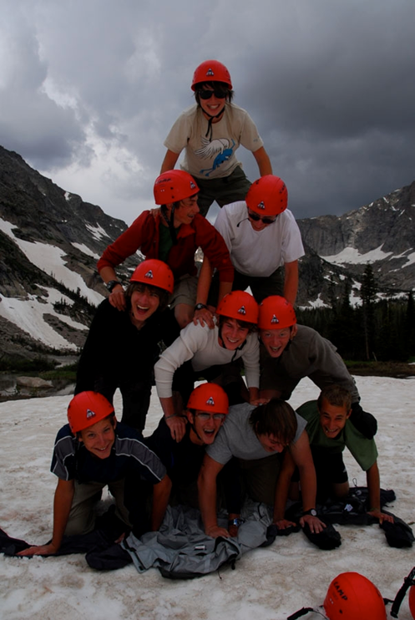
Associate Visitor Course
Also being updated/revised
Includes pieces from the Visitor Update Course – Roles and Expectations
Will have online course pre-requisite element
10-12 hours
Notes:
The Associate Visitor Course is still in the process of being revised yet…
Will include the portion from the Update course on the role and expectation of the visitor
Will be somewhat similar to current course EXCEPT will have an online pre-requisite component
In person time frame 10-12 hours
This will be done by mid-October and posted to the Instructor’s webpage

Slide 30

Resources and Reminders

Slide 31
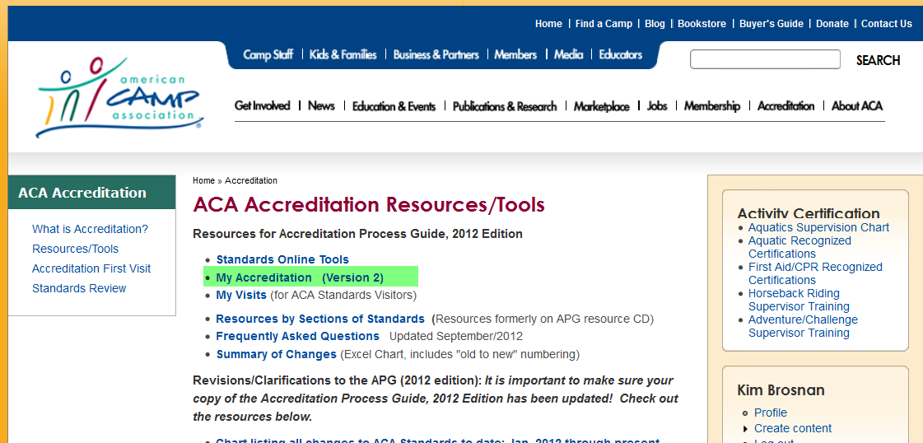
My Accreditation
Visit www.acacamps.org/accreditation/resources-tools
To go to the My Accreditation page
Notes:
[animation]
A fabulous resource for CAMPS to use to prepare for their visit is My Accreditation — an easy-to-use web-based app, created by ACA for camp directors and staff.
You can access the app from the Accreditation Resources and Tools page from the ACA website [animation, arrow flies in]
Current fee-paying ACA camps can access the standards online because My Accreditation allows a camp the ability to customize and generate a report/file of ACA standards that are applicable to their camp's program so they can prepare for their visit. A camp’s assigned visitors have limited access to their assigned camp's customization and written documentation (i.e., they have read-only capabilities for documents so they can make helpful comments) through a separate app called My Visits. This is one method Visitors can use to conduct the review of the Camp Self-Assessment.
Some of the main features/functions of My Accreditation include:
Ability to generate a customized set of standards based on the programming and modes of the user's camp.
Ability to sort/filter the standards by predetermined areas (e.g., you can filter to see only mandatory standards, etc.).
Ability to upload camp documents and written documentation to the site (standard by standard).
Ability to print a variety of checklists to assist in your preparations that show comments and perceived compliance status.
Ability to share with visitors, to complete the Camp Self-Assessment, and to save and share any other written documentation.
All Instructors should be familiar with the accreditation resources-tools web page in order to navigate it efficiently.

Slide 32
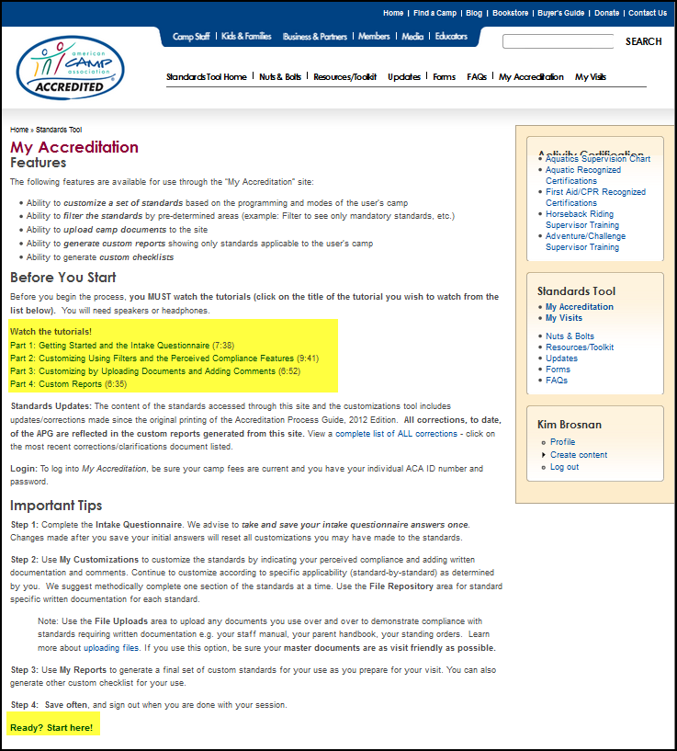
My Accreditation
Notes:
[animation]
On the My Accreditation information page, you can read more about the features and access some important tips for its use. Please read everything carefully.
Most importantly, before beginning to use My Accreditation please watch the instructional tutorials that will help navigating the system.
[animation, arrow flies in]
All instructors are asked to complete the tutorials for the My Accreditation prior to teaching a standards course or standards update course AND the tutorials for My Visits prior to teaching an Associate Visitor or Visitor Update course so you are somewhat familiar with the benefits of these tools. We are directing camps/visitors to these sites to obtain a fully updated APG.

Slide 33
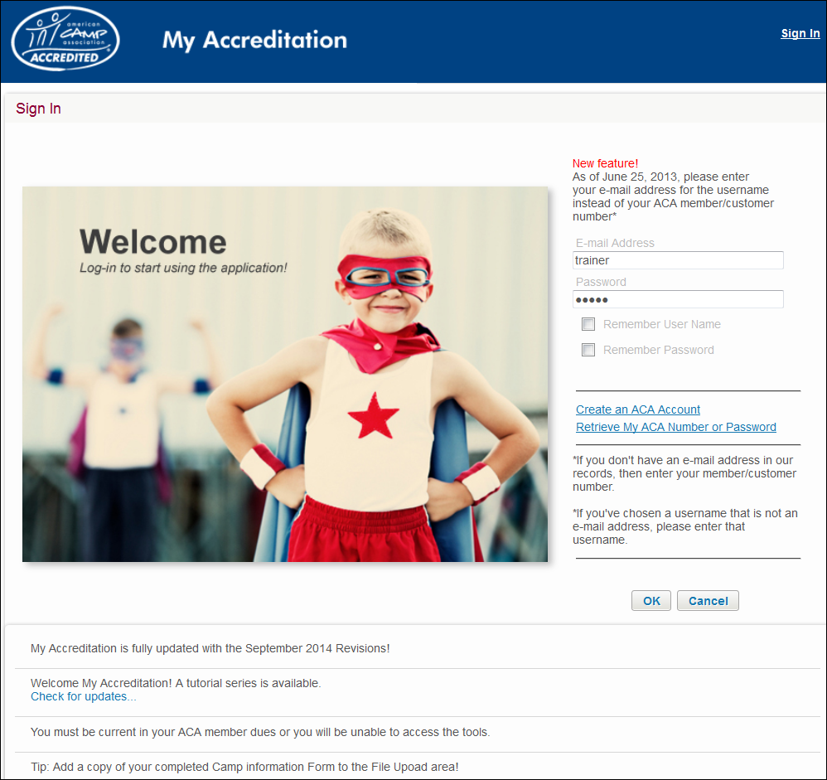
My Accreditation
Notes:
This is a screenshot of the sign-in page of My Accreditation. Let’s look at the different areas highlighted/boxed in green. We are going to demonstrate some of the features.
Note to Instructor: Share that there is no way participants will master the nuances of My Accreditation by the quick demo they will provide. Prompt participants (more than once) to please be sure to watch the tutorials before ever logging in to this app. The tutorials will help navigate the system.
Note to Instructors: To launch the app and log in to demo the look and feel of the app, you will need to have watched these tutorials yourself and be familiar with the technology.
Note to Instructor: While demonstrating the app you can show your own camp, if you’d like, OR you can use a generic log-in/password combo for ACA’s fake camp “Camp ACA”
Login: Trainer (instead of email address)
Password: 12345
Note to Instructor: Please Demonstrate
My Intake Questionnaire is a set of 19 questions to help filter to generate a custom set of standards for your camp. Most of the questions on the intake questionnaire are the same as those you have already answered today on your Camp Information Form. They cover things like modes, activities, services provided to renters, etc.
My Customization page is where you can _________________(INCLUDING the filter button)
Show how easy it is to use the filter buttons.
Show how easy it is to upload a document.
Show how to add comments.
continued
Show where to see visitor comments.
Show how to adjust the number of standards on a page.
Show how to adjust their perceived compliance with a standard.
File Uploads area
Explain this is to be use for larger documents that are repeatedly referenced.
Explain that if they use this option, be sure your master documents are as visit friendly as possible.

Slide 34
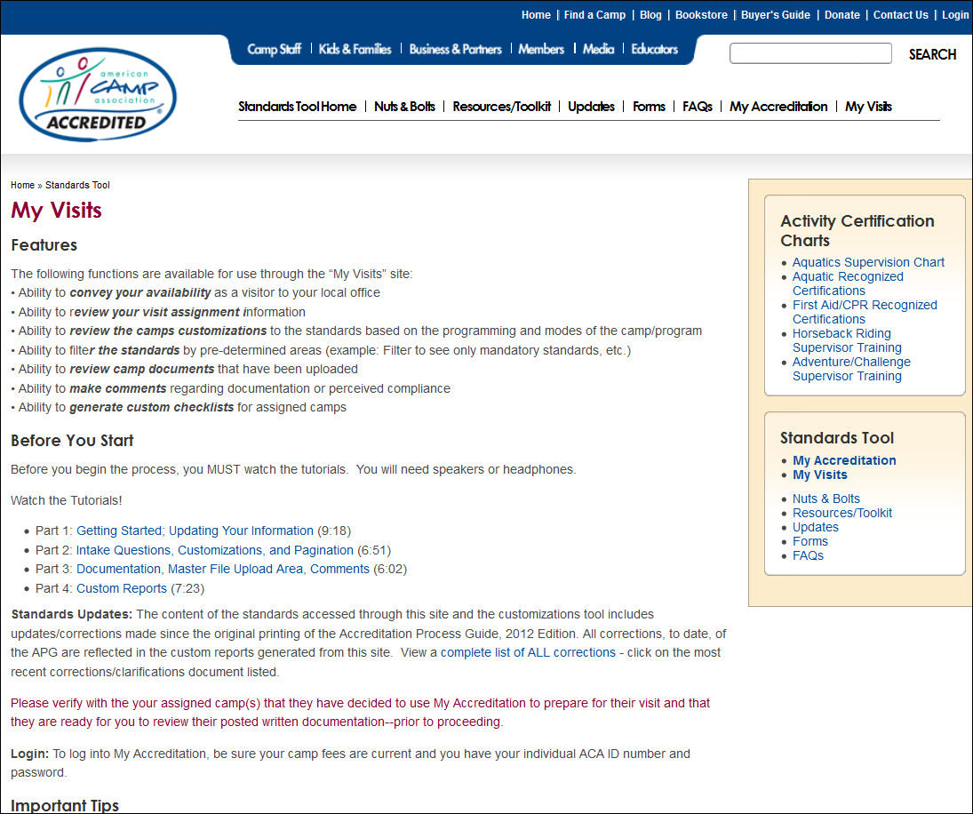

My Visits
Notes:
Another fabulous resource for VISITORS to use to help prepare assigned camps for their visit is My Visits — an easy-to-use web-based app, created by ACA for standards volunteer visitors. [animation, arrow flies in]
Current fee-paying ACA Visitors can access the standards online and generate a PDF version of the ACA standards. My Visits gives visitors limited access to their assigned camp's customizations and written documentation (i.e., they have read-only capabilities for documents so they can make helpful comments) This is one method that a visitor can use to conduct the “official” review of a Camp Self-Assessment.
Main features of My Visits
Ability to convey your availability as a visitor to your local office
Ability to review your visit assignment information
Ability to review the camps customizations to the standards based on the programming and modes of the camp/program
Ability to sort/filter the standards by pre-determined areas (example: Filter to see only mandatory standards, etc.)
Ability review camp documents that have been uploaded
Ability to make comments regarding documentation or perceived compliance
Ability to generate custom checklists for assigned camps
[animation] Access My Visits from the accreditation resources and tools page from the ACA website (same place you start when accessing My Accreditation -go back to same slide as My Accreditation access, if necessary to illustrate).
[animation] Watch the tutorials! This will help visitors better understand the nuances of the apps
All instructors are asked to complete the tutorials for the My Accreditation prior to teaching a standards course or standards update course AND the tutorials for My Visits prior to teaching an Associate Visitor or Visitor Update course so you are somewhat familiar with the benefits of these tools. We are directly camps/visitors to these sites to obtain a fully updated APG.
Good Common Sense – and Lots of Communication
Use your common sense and work with your assigned camps well before the day of the visit to verify the applicable areas of their camp program. Completing the camp self-assessment and being able to review other written documentation as early as possible will help everyone better understand applicability of questionable areas or standards. Your area standards chair and ACA, Inc. can also help if you have difficulty in determining applicability.

Slide 35
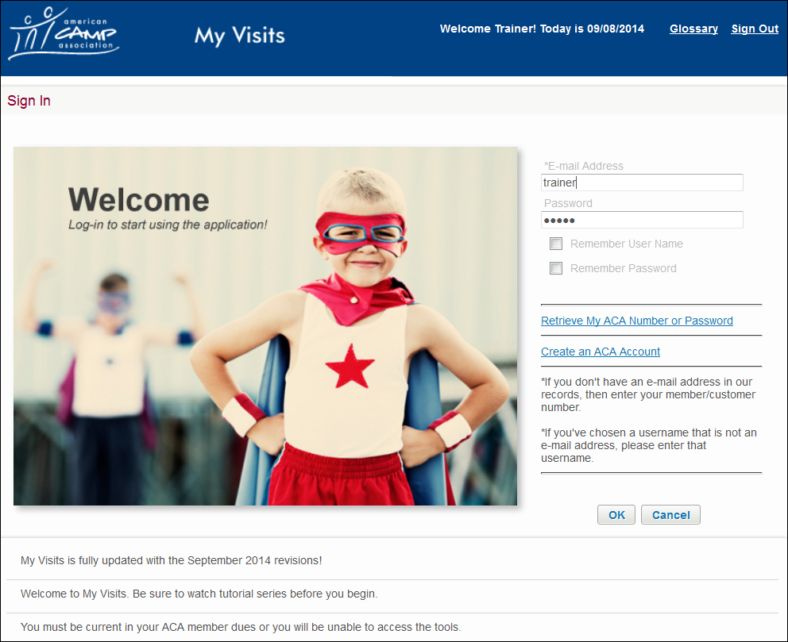
Notes:
The Log-in pages of My Accreditation and My Visits are VERY similar – make sure you are using the correct app (because they look alike – it could be confusing)
[animation] My Visits shows Visitor is at the right place
[animation] Sign-in
Instructor Note: If you have internet access, log onto the ACA website and walk through the process. BE AWARE OF TIME! Keep any demos short and sweet
Username= Trainer
Password = 12345

Slide 36
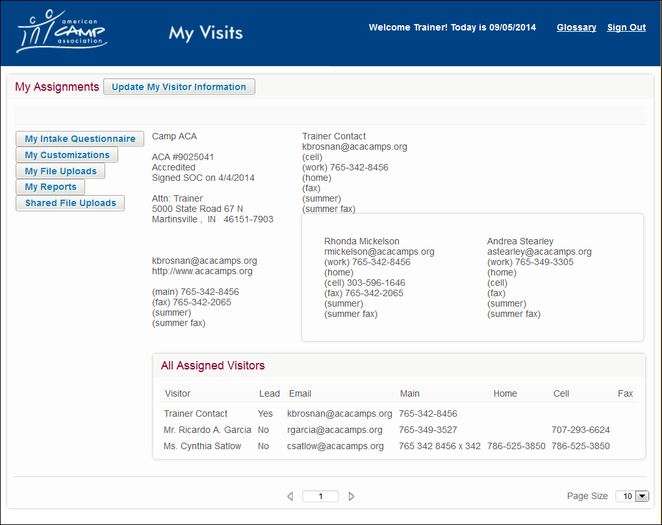
Notes:
Once you are logged in you have some options.
If you would like a pdf version of all the standards with the same copy as the APG
Visit the “Update my Visitor Information” [animation]
Agree to the following statement “I understand the PDF document of the APG from the My Accreditation tool has all inclusive revisions to date and is for my personal use ONLY and is not to be shared with others.” by clicking the button
Check your email of record for the file
To start to review content that your assigned camp had completed and/or updated use the navigation buttons provided. [animation]

Slide 37
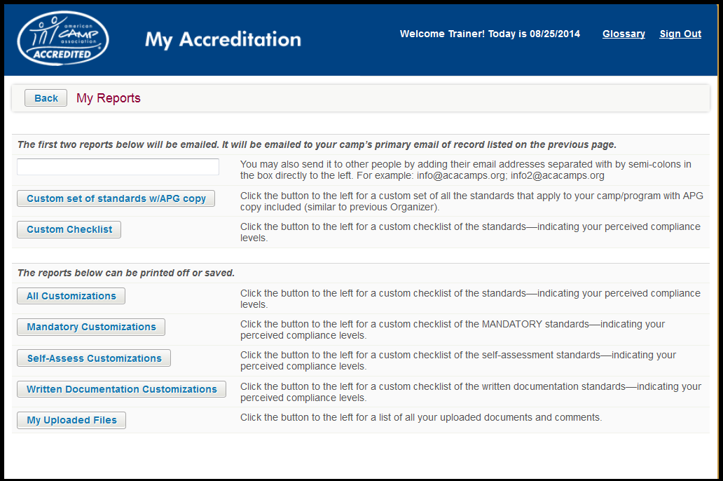
Custom Reports
Add your email address
Notes:
Note to Instructor: The Custom Reports –My Reports page looks and acts the same way in both apps! Please show the My Reports page and highlight the following.
My Reports is the final feature we are going to demonstrate. It’s one of the best features of My Accreditation is My Reports.
Show how to obtain a copy of the standards that has the APG content via email. [animation] Emailed reports automatically go to the camp’s primary contact. Add additional addresses in the space provided. [animation]
Explain that the custom checklist [animation] is a checklist of all the standards. Checklist shows any perceived compliance decisions you have added and automatically DNAs any sections of standards that do not apply to your operation based upon the intake questionnaire. (For example, if you do not offer any trips, the PT section of this checklist will have all the possible responses blacked out.)
Show some of the other custom reports, especially the All Customizations Checklist and the Camp Self-Assessment Checklist (open these up and show how they can save and/or print).
Discuss that the Camp Self-Assessment Checklist [animation] could indeed suffice for the actual review of the Camp Self-Assessment if you and the visitor agree to go that route. Especially, because the visitor comments will show.
Finally, discuss how applicability misunderstandings can affect the accuracy of the custom set of standards.

Slide 38
Customization Tools Reminders
Educational resource
No assurance of a successful outcome
Use your own professional judgment in determining applicability
The camp is responsible for any and all standards that apply to your program, regardless of results of customization efforts.
Notes:
Remind camps to use their common sense and work with assigned visitors well before the day of the visit to verify the applicable areas of thier program. Completing the Camp Self-Assessment and allowing the visitor to review other written documentation as early as possible will help you better understand applicability of questionable areas or standards. Your local standards chair and ACA, Inc. can also help if you have difficulty in determining applicability.
However, we do need to be sure you understand the following information (disclaimer).
Note to Instructor: Please read this to the group word for word.
ACA, Inc. has designed the standards online tool primarily as an educational resource for camp professionals.
The ACA, Inc. makes no claim that use of this published informational tool will assure a successful outcome.
In determining the applicability of any specific standard, the camp professional should apply his or her own professional judgment to the specific circumstances presented by the particular information/situation.
If using the site to determine what standards will be applicable to obtain accreditation, the user is responsible for scoring any and all standards applicable to their program, whether gathered through the customized version of standards website or not.

Slide 39

Accessing My Accreditation and
My Visits
Go to the Accreditation Resource/Tools page on the ACA website
Choose the app you want and go
to its information page
Watch the tutorials then launch
the app
Check the information we have for
you and/or your camp –
UPDATE if necessary
Log-in and get started
Notes:
Overview of Information Applicable to both My Accreditation and My Visits
Camps go to www.acacamps.org/accreditation/resources-tools and
Choose My Accreditation or My Visits
Watch the TUTORIALS – proceed to the customization portal
Log in as yourself (an individual). The system will know who you are and what camp you are with and/or assigned to - from your member information.
Note: ACA, Inc. may need to “give permission” to camp staff members that are non-ACA members and/or not affiliated with the camp. A simple phone call will take care of the matter and the phone number is posted.
Check your info and update if necessary
Custom Reports (see next slide)
Get working ☺

Slide 40
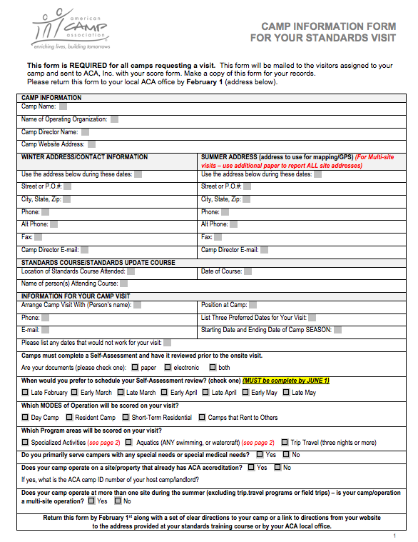
Camp Information Form
Notes:
Using the Camp Information Form
Review the importance and the need for the Camp Information Form(NOTE: Again, this information needs to be shared with both groups (Camps and visitors) – from the perspective of the group!
Review
The Camp Information Form
There is copy of this form in the handout packet for both standards courses as well as the Visitor Courses. Have everyone look at the form. Point out the different elements and discuss the value of having this information (see below).
NOTE: It is important to make sure to discuss this information from the viewpoint of the audience – camp director in the standards courses and the visitor in the visitor courses. YET, both groups need to hear the same message! COMPLETE IT, DISCUSS IT, USE IT!
The Camp Information Form is
A helpful tool for both the camp and the visitor
Shows the visitors which modes of operation and what activities are to be scored for a camp
Used to show what sections of the standards apply to a camp.
Is used as a conversation starter between the visitor and the camp
Camp personnel and the visitor should discuss this form IN DEPTH in order to make sure everyone is on the same page on the day of the visit!
Reminder…
The Camp Information Form is completed and collected during the Basic and Updated Standards Courses.
Visitors will be given a copy and/or a link to the form to download.
All Camp Information Forms are sent to ACA, Inc. with score form at the end of the visit. ACA, Inc. uses this form to verify that the camp has been scored as accurately as possible.
IT is Critical that ALL Instructors collect these forms at the end of each course and turn them in to ACA as soon as possible!
Side 1 — The front of the form asks for important information that will assist a standards chair and visitor in planning for the camp’s on-site visit. Visitors use this form to help understand their assigned camp’s operation and which modes of operation need to be considered when scoring.
Side 2 — The back of the form allows you to identify those activities that you offer as part of your program. It will be used to help visitors know which activities they need to observe on the tour of the camp. Look at the back of the form.
Includes specialized activities offered
List of aquatics activities.
List other activities (activities you offer that are not included on one of the other lists)

Slide 41

Camp Self-Assessment
Notes:
Review the importance and the need for the Camp Self-Assessment (NOTE: Again, this information needs to be shared with both groups (Camps and visitors) – from the perspective of the group!
The Camp Self-Assessment is a required review of the written documentation for 20 pre-identified standards and must be completed prior to the start of staff training for the summer season (generally, it is to be reviewed by the visitors before the end of May).
The required Camp Self-Assessment is designed as an educational tool for camp staff and visitors alike. Using this tool, as designed, will help directors have a successful visit.
Directors and visitors are not limited to just reviewing the 20 standards in the Camp Self-Assessment. Any or all (most) standards requiring written documentation may be reviewed prior to the camp’s staff training and nothing is scored until the day of the visit. This allows camps time to “fix” any errors or gaps that may be discovered.
Visitor will review the written documentation for each required standard and will mark the Camp Self-Assessment worksheet or use the comments box in “My Visits” as:
Seen, meaning they saw the document and it appears to meet the standard; or they'll mark it as
Not seen, meaning the documentation was not seen or was unavailable at the time of the review; or they’ll mark it as
Needs verification, which means that the visitor saw documentation that appears to be in compliance with the standard but that he/she needs to see verification during the visit.
As referenced above, NEW for summer 2015 -- These same assessments can also be added via the comments boxes using the My Accreditation/My Visits apps. Visitors use My Visits to read the camp’s documentation and other visit prep materials, and they will indicate “seen,” “not seen,” or “needs verification.”
Inquire about how they made the camp self assessment happen (or not) for their last visit.

Slide 42
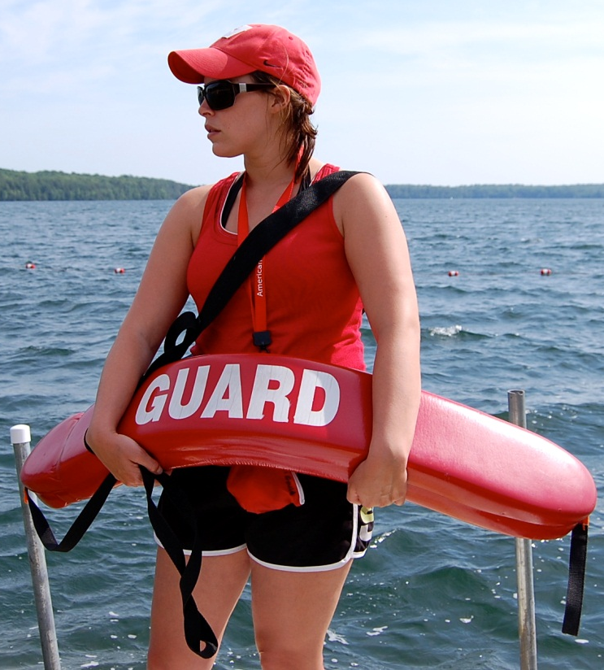
Missed Mandatory Standards
Critical to the health and safety of campers, staff, and participants
Notes:
While we have a very high compliance rate, camps still miss mandatory standards (a list of most missed is included in all courses). Make sure you are fully up to date on these.
Why are mandatory standards important? They are critical to the health and safety of campers, staff, and participants
For the Update Courses (Standards and Visitor) Remind the group that there are four revisions with mandatory components that are new or revised beginning summer 2015. Go back to revisions slides if necessary.

Slide 43
Immediate Corrective Action (ICA)
ICA
ICA MUST be taken for
any and all missed
mandatory standards.
Activity must be stopped
until camp is in compliance with standard.
Visitors will determine compliance and inform director of required correction(s).
Camp has ten days to
submit proof of immediate compliance with the standard.
ALL documentation
is sent to ACA, Inc.
Notes:
QUICK REMINDER…
Immediate Corrective Action for Missed Mandatory Standards
Review the chart
Immediate Corrective Action (ICA) MUST be taken for any and all missed mandatory standards. The ICA process is ONLY for missed mandatory standards — cannot be used for nonmandatory standards.
Activity must be stopped until camp is in compliance with standard. Visitors will determine compliance and inform director of required correction(s) using the ICA notice form.
ALL documentation is sent to ACA, Inc. (who will forward to the visitor for review).
Camp has ten days to submit proof of immediate compliance with the standard.
An ICA form will be completed even if the standard is corrected during the visit. So, a visitor will either send in the documentation for proof of compliance with the score form and the ICA form, or the camp will send proof of compliance within the ten-day limit.

Slide 44
The 72-Hour Rule
72-Hour Rule
Very different from the
ICA process.
May ONLY be used for standards that require written documentation that can be verified to already be in existence.
For some reason the documents are not present at the time of the visit.
A courtesy that may be extended at the VISITOR’S discretion.
Notes:
72-Hour Rule
The 72-hour rule is a courtesy that may be extended at the discretion of the visitor and is VERY different than the ICA process. While it is at the discretion of the visitor, one of the “used” reasons for “overturning” a no to a yes in a review is that the written documentation that was in existence on the day of the visit is provided.
Used only for nonmandatory standards that require written documentation that can be verified to already be in existence at the time of the visit.
Used for written documents that exist elsewhere (i.e., a central office) but for some inexplicable reason are NOT present at camp at the time of the visit.
Examples include insurance policies, certification cards.
If allowed, the camp has 72 hours to secure and forward a copy of the missing document to the lead visitor.
There is NO other paperwork required from the camp director for the 72-hour rule.
At the time of the visit, the visitor will score the standard “NO,” then based on the material forwarded (or not), may change the score to “YES,” and will then send the score form to ACA, Inc.

Slide 45
Scoring
Verify written documentation exists
If written documentation is not complete, the standard must be scored as a “NO”
  Camp staff cannot complete and/or update written documentation on the day of the visit.
All standards scored “NO” must have a written comment.
Notes:
Scoring reminders….
Verify Written Documentation Exists – the role of the visitor is to verify the camp has the written documentation required and that it incorporates all elements asked for/required in the standard. The visitor’s job is not to evaluate the quality of what is written – even if one feels it could be a stronger document. The question the visitor needs to ask is, “Does the written documentation include ALL elements asked by the standard?”
If written documentation is not complete the standard is scored “NO”. It is not appropriate for camps to add to or change documentation during a visit. Visitors need to score the standard based on what is available at the time they are reviewing the standard.
Camp staff cannot complete and/or update written documentation on the day of the visit.
All standards scored “NO” must have a written comment.

Slide 46
Scoring
Check and re-check the score form
Follow the score form instructions that came with your visitor packet
Visitors cannot keep copies of score forms – camp should NOT make a copy of the first page
Make sure all signatures are obtained
Legible (and accurate) emails and phone #s are critical!
Notes:
More Scoring Reminders….
Check and Re-check the score form. A large percentage of all score forms require a phone call or email from ACA, Inc. for correction or clarification from the visitor. Many of these calls/contacts are due to standards that are left blank. Both visitors should review the score form and the camp director as well. Double check that all standards have been scored, and all standards scored “NO” have a corresponding comment written.
As a general rule, please read and follow the score form instructions that are posted online and come with your visitor packet, annually. It is a good reminder of the little things that could prevent a call from ACA to you.
Ask for questions to this point.
Be sure to fill out camp name on each page of form.
Be sure to mark all modes that apply.
Be sure to put comments for NOs
Remind them that PD.10.1 and PD.11.1 do not go with PD.9.1-9.5 DNA.
Do not score in pencil
Be sure to have camp director sign front page
Be aware that we may be contacting them with questions, so have good email and phone number on form. Make sure second visitor can also answer questions if we get down to the wire and cannot find lead.

Slide 47
Course Logistics and Tips
All course materials posted on Volunteer Instructors webpage www.acacamps.org/volunteers/standardsinstructors
  Includes Volunteer reimbursement form (DNA to NY/NJ, New England, and Illinois offices)
Submit course roster to the appropriate staff member
Download PDF of course(s) to your tablet
Download the PDF of APG (completely updated)
Notes:
Course Logistics and Tips
All course materials posted on Instructors webpage www.acacamps.org/volunteers/standardsinstructors
Reimbursement link is also posted on this page
Make sure to submit course roster to the appropriate staff member
Download PDF of course(s) to your tablet instead of printing
Download the APG (completely updated) to your tablet/computer
http://www.acacamps.org/volunteers/standardsinstructors
Printed copy of course to be taught is available upon request at accreditation@acacamps.org

Slide 48
Course Logistics and Tips
Goal is to have all participants attending a Standards Course have their APG PRIOR to the course!
Some loaner APGs will be available (check with support staff)
Typically the printing of hand-outs will be done by staff – double check
Notes:
Course Logistics and Tips
Goal is to have all participants attending a Standards Course have their APG PRIOR to the course! ACA is working on a “Road map to Accreditation” document that will be included in the APG’s sent to “new camps’ starting in early October. This will hopefully help reduce the “OMG” look instructors often get once reality starts to set in.
Some loaner APGs will be available (check with support staff)
Typically the printing of hand-outs will be done by staff – double check
http://www.acacamps.org/volunteers/standardsinstructors
Printed copy of course to be taught is available upon request at accreditation@acacamps.org

Slide 49
Visit Timeline
Train new visitors
Standards Courses for Directors
Camp visit assignments
Self-assessments and visits scheduled
Self-Assessment takes place (before camp opens)
Score Forms sent to ACA, Inc.
Camp requests Review
Visit Occurs
Camps are notified of scores below 80%
Review process occurs
Local leadership votes to approve camps
Camps notified of scores
Notes:
Briefly review the Visit timeline with the participants. ONLY the bold items are on the slide, however, be sure to cover ALL the items in the timeline.
Associate Visitor courses held to train new visitors
Standards courses prepare directors, etc. for visits that year.
Visitors receive camp visitation assignments and eventually visit packets.
Visitor contacts section office if unable to accept an assignment.
Lead Visitor contacts co-Visitor and Camp Director to schedule camp self-assessment review and visit to camp.
Lead Visitor notifies section office about scheduled visit.
Camp self-assessment review takes place in winter or spring and is completed before camp opens (staff training or staff arrival signals opening of camp).
Lead Visitor reconfirms visitation arrangements with co-visitor and camp director.
Visit occurs.
Lead Visitor notifies local office that visit has taken place.
Visitors mail reimbursement forms and visit evaluation forms to section office.
Camp director mails visit evaluation form to section office.
Forms are sent to ACA, Inc. by September 1 for visits that occur late in the summer.
Camp are notified of scores below 80%.
Camp requests review.
Review process occurs.
Review committee’s deadline for a recommendation to the standards chair.
Local Council of Leaders/Affiliate Board’s meet to approve accredited camps and vote on recommendations from review committee.
Camps are notified of their scores.
Standards courses are scheduled.
Associate Visitor courses are scheduled.

Slide 50

QUESTIONS?? CONCERNS??

Slide 51
Contact Us
American Camp Association
5000 State Road 67 North
Martinsville, IN 46151
Phone: 765-342-8456
Toll Free: 800-428-2267
Fax: 765-342-2065
E-mail: accreditation@acacamps.org

