Slide 1

American Camp Association®
Associate Visitor Course
Notes:
Prior to arriving for the course, participants have
• Completed the ACA Visitor Application and submitted it to local standards chair
Completed the online portion of the Associate Visitor Course. This is a prerequisite.
Each participant received an APG sent to them prior to the course. Upon arrival, have participants sign in, create a name tent, and obtain their participant handout packet.
Pre-requisites for the Class
Familiarity with the current standards
Previous attendance at a current Standards Course within the past three years or a current Standards Update Course
At least 21 years old
Current membership in ACA
Completion of Associate Visitor Training online portion of the course
Special note to Instructors – The “Associate Visitor Training Quiz/Knowledge Quiz” was assigned and submitted during the online course. The participants have been asked to bring a copy of their completed quiz to the course. Incorporate the quiz and it’s contents how you best see fit. There is an answer key in your Instructor Resource packet.

Slide 2

Introduction
Notes:
Introduction and Online Course Review
Welcome participants, introduce yourselves
Provide general housekeeping information—bathrooms, check-in procedures, etc.
Provide an overview of the general schedule and course timeline (include phone use expectations)
ACTIVITY
Conduct an icebreaker activity of your choice or share REAL VISIT STORIES.

Slide 3
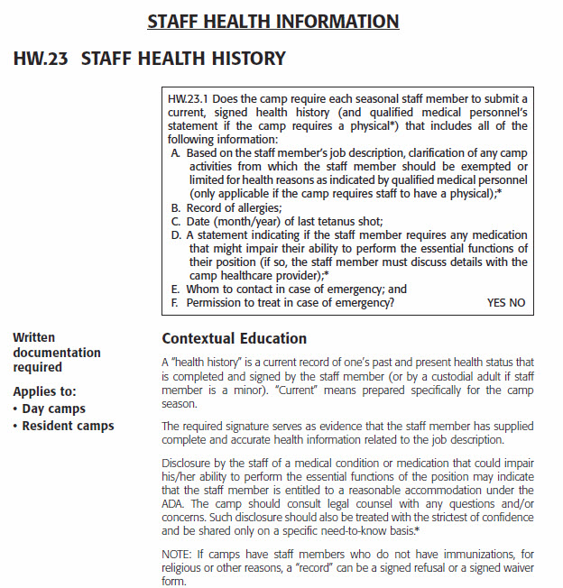
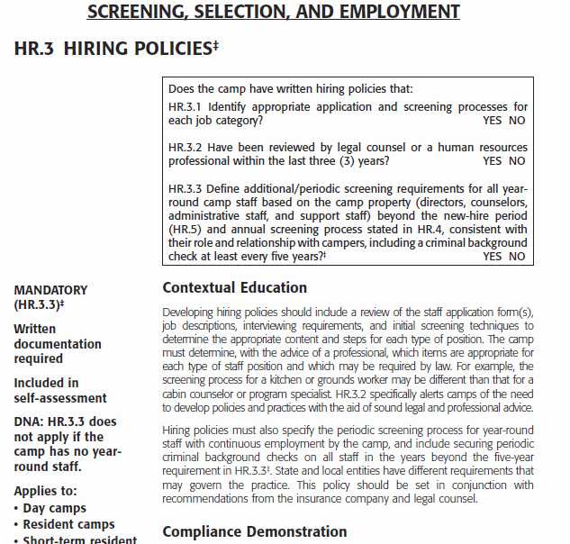
Is your APG up to date?
HW.23 Staff Health History
HR.3 Hiring Policies
Notes:
Housekeeping Task:
Since there have been various updates to the APG, take a minute to ensure that participants have a current APG or have added all the updates.
Put up this slide and have participants check it against their guide
Do these two standards match what is in your APG?
Page 94 HW.23 Staff Health History–
Page 126 HR.3 Hiring Policies – This shows HR.3.3 and includes the mandatory requirement for criminal background checks for year-round staff (every five years).
If anyone needs updates or the filler pages, they are provided as handouts, or go to ACAcamps.org/Staff-professionals
You have been provided handouts of the latest APG updates ( April 2015 – August 2015 – Titled January 2016 List…) to share with participants needing those pages.

Slide 4
Associate Visitor Course Outcomes
Understand the role and responsibilities of a visitor
Promote the educational value of the ACA Accreditation Process
Be a positive representative of ACA
Develop information-gathering skills
Use resources correctly
Make consistent compliance decisions
Notes:
Introduction and Online Course Review
Briefly discuss the expected outcomes for this course.
Become an advocate for ACA Accreditation
Understand the role and responsibilities of a Visitor – and the level of commitment it takes. People are counting on you to follow through with your assignment.
Promote the educational value of accreditation
Become a positive representative of ACA – OFTEN times a visitor is the only person from ACA that someone really meets and talks with. You will make a lasting impression.
Develop information-gathering skills
Use resources correctly
Make consistent compliance decisions

Slide 5
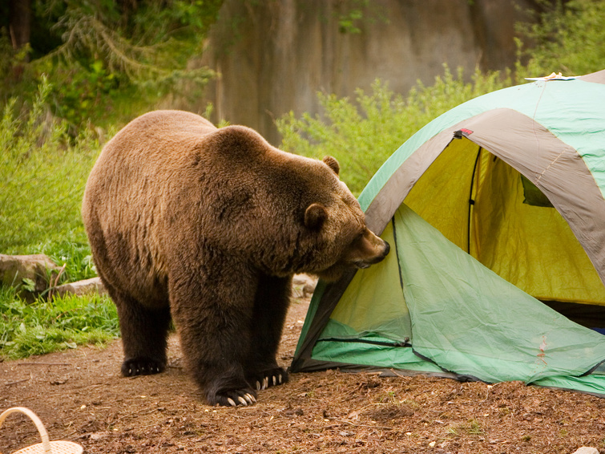
Real Visit Stories!
Notes:
Introduction and Online Course Review
Everyone likes a good story. . . .let’s share some real visit stories!
Allow participants to share visit stories. Note: if necessary, for confidentiality purposes and to honor the integrity of the visitors who may have been involved – especially if controversial or negative, have participants refrain from using actual names of people and/or camps.
Instructor, please capture the general idea of each shared story on the flip chart. . . . since folks tend to lean toward the negative example, you may need to "tease" some positive answers out of the group... for instance, "What drew you to be a visitor?" or "How has a visitor helped you in your professional development?" before asking for some real life examples of positive things that have happened (or that they have heard of) at visits.
Using some of the real scenarios the group generated, assign them to small groups for discussion, and then the group can point out what might be less than helpful about the assigned scenario, and the larger group can discuss how the situation might have been more educational or how it may have been converted to a more positive experience.
Be sure to watch your time in this activity – don’t go too long.

Slide 6

ACA Accreditation Is…
Accountability
Credibility
Commitment
Notes:
Introduction and Online Course Review
Remind Participants
Accreditation is PROOF of a camp’s …
Commitment to having a safe program — Participation is voluntary.
Accountability — It’s a third-party verification of your commitment and part of your overall risk management.
Credibility — It’s your camp’s best evidence of wanting to do it correctly.
Accreditation is a nationwide program administered at the local level, primarily by volunteers. As you know, volunteers serve as the visitors, make visitor assignments, are involved in the review process if a review due to a failed visit is requested, and approve the accreditation status of camps.

Slide 7

Accreditation
Education, Education, Education Education Education
EDUCATION
Notes:
What it all comes down to with accreditation is
EDUCATION, EDUCATION, EDUCATION.
Briefly, Ask — WHY is being a visitor important to you as a professional involved in camp?

Slide 8
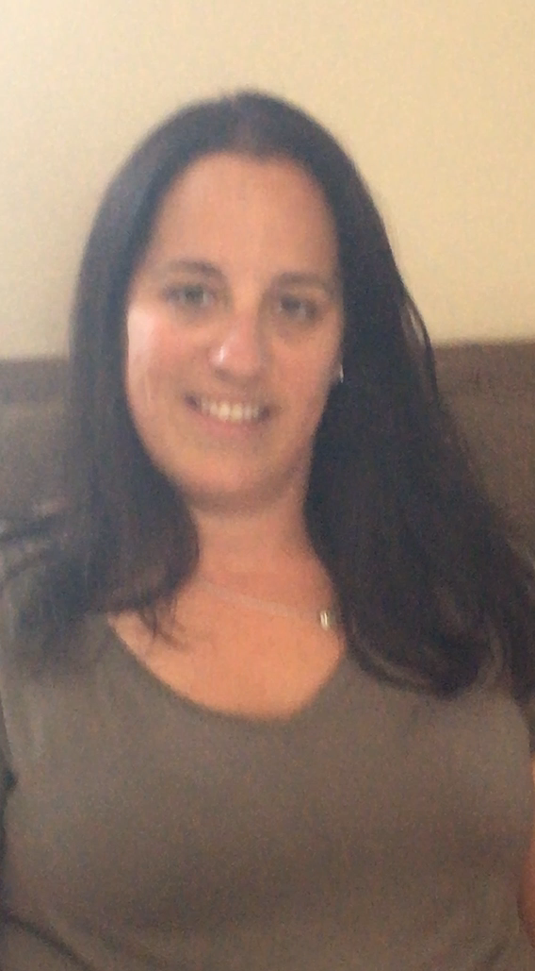
Education
“I like to see what their best practices are and get some good ideas for my camp . . . I love to teach, so I enjoy sharing my ideas. . . ” –Wendy Berliner, ACA Volunteer Visitor
Notes:
VIDEO (28 secs): To play the video, Click a second time.
Play video.
Reinforce that visitors are also professional camp personnel, which is what makes the Accreditation process work so well.
Video can also be downloaded separately from the Instructor’s page
http://www.acacamps.org/about/leadership/volunteers/standards-instructors

Slide 9
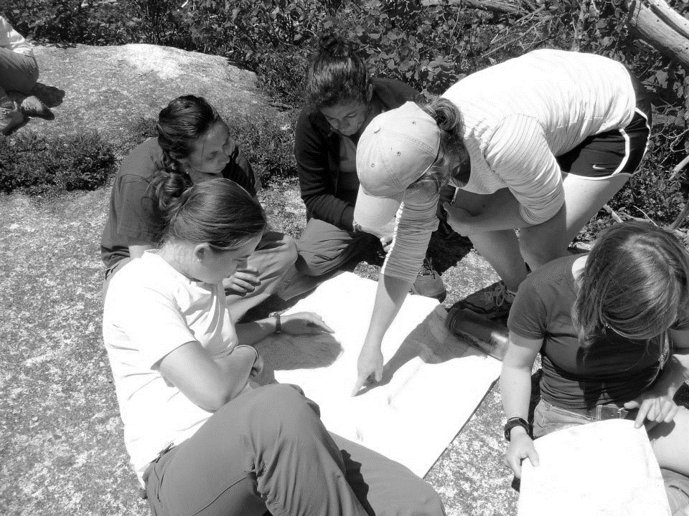
Accreditation Means
You have established a standard of care – using prudence.
Notes:
ACA Accreditation means
You have established a standard of care – using prudence.

Slide 10

Prudence
pru•dence • noun \ˈprü-dən(t)s\ :
careful good judgment that allows
someone to avoid danger or risks.
The ability to govern and discipline oneself by the use of reason
Sagacity or shrewdness in the management of affairs
Skill and good judgment in the use of resources
Caution or circumspection as to danger
or risk
Notes:
Prudence
Discuss Concept of “using prudence” with group
What is prudence? Is this something you have ever considered as part of the accreditation process?
pru·dence • noun \ˈprü-dən(t)s\ : careful good judgment that allows someone to avoid danger or risks.
Full definition:
The ability to govern and discipline oneself by the use of reason
Sagacity or shrewdness in the management of affairs
Skill and good judgment in the use of resources
Caution or circumspection as to danger or risk
"Prudence." Merriam-Webster.com. Merriam-Webster, n.d. Web. 21 Aug. 2014. <www.merriam-webster.com/dictionary/prudence>.

Slide 11
Non-Visit Year Timeline
Accreditation Timeline
11/1 – 10/31
Winter
Camps may attend standards training
Statement of Compliance & Annual Accreditation Report Due Feb 15
Fall
Look for Professional Development Opportunities
Spring
Confirm membership payment
Look for Professional Development Opportunities
Summer
Notes:
Non-Visit Year Timeline
Point out to participants:
Even in years when there is not an on-site visit, camps are responsible for maintaining compliance with the standards. In order to retain accreditation, camps must submit an Annual Accreditation Report and sign an annual Statement of Compliance.
AAR and SOC:
Explain the Annual Accreditation Report (AAR) and be sure to distinguish it from the annual Statement of Compliance (SOC). While the AAR is a series of standards-related questions that ask for a narrative and is completed within MY ACCREDITATION, the SOC requires a signature, a legal document, showing the camp’s continued commitment to compliance. In all local offices and affiliates, in nonvisit years, camps must fill out an AAR and SOC by February 15th.
Purpose of the AAR:
Provide Evidence of quality enhancement/improvement efforts, to be included in the overall five year accreditation cycle
Provide enhanced communications with camps in nonvisit years through the AAR process
Provide confirmation of continual compliance with ACA standards throughout the five-year accreditation cycle
Mention that AARs are reviewed by visitors who train as reviewers. Since reviewers are selected from the pool of experienced visitors, participants in this course who upon successful completion of this course become associate visitors could become eligible to review after they’ve gained field experience.
Camps must keep membership fees current to maintain accreditation
Look to ACA for professional development opportunities

Slide 12
When Standards are Revised
Any changes/revisions to standards (mandatory or not) become effective in the next season.
(In the past, only mandatory standards were
effective immediately. All other changes/
revisions were effective on the camp’s next visit.
As we move to a 5-year visit cycle, waiting up to 5 years for a camp to come into compliance with any standard is too long.
Notes:
Maintaining Accreditation
Effective in 2016, when any change/revisions to standards are made (mandatory or not), the change/revision will become effective in the next season.
In the past, only mandatory standards were effective immediately and all other changes/revisions were effective on the camp’s next visit.
As we move to a 5-year visit cycle, waiting up to 5 years for a camp to come into compliance with any standard is too long.

Slide 13
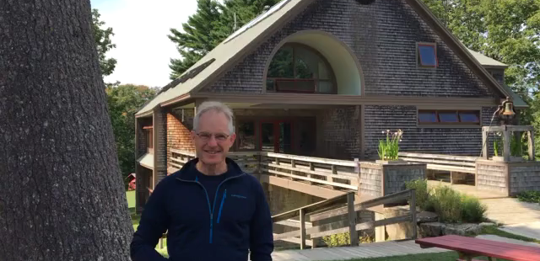
Being a Visitor
Notes:
Play Video. 42 seconds.
Video should play on second click
Video is located on the ACAcamps.org Instructor’s page:
http://www.acacamps.org/sites/default/files/resource_library/video-embed-henry-stupdate.mp4
And can be saved to your computer and then inserted into Power point or played separately.
Play Video. 42 seconds.
Henry Heyburn, Chewonki Foundation.
I feel strongly about the benefits both to me and the world of camp about being an ACA visitor…. I love the opportunity to visit other camps and meet other people, other camp professionals. It’s pretty easy, especially in the summer, to become enwrapped in your world. I think it is really important to see what others do. I know I’ve learned a lot from visits and I have taken ideas and brought them back to Chewonki.
Use this video to reinforce:
Visitors are volunteers.
Visitors are camp professionals.
Visits are about idea sharing and it is a collegial experience.

Slide 14
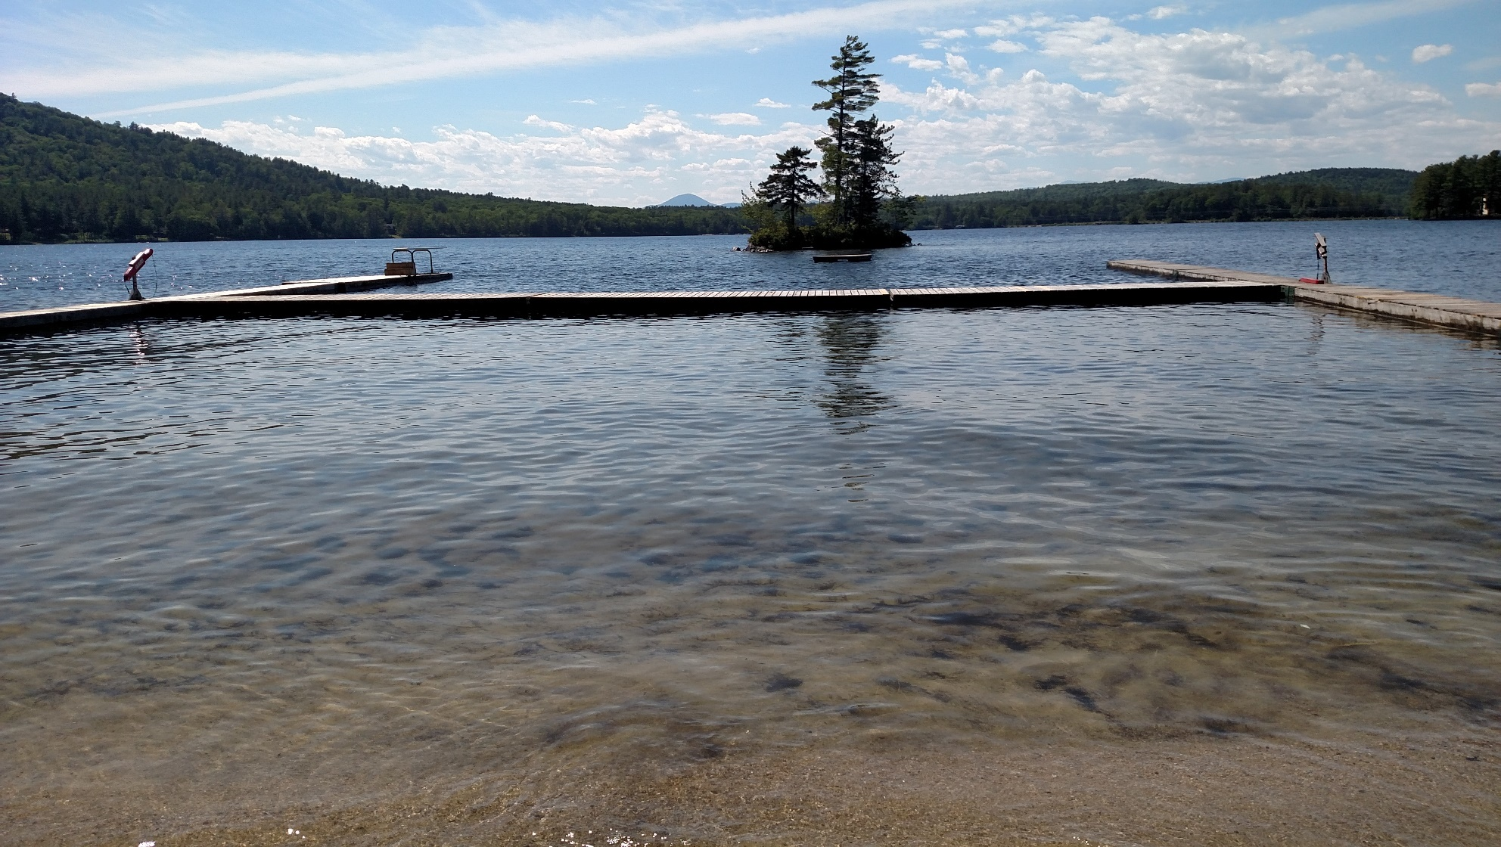
ROLE OF VISITORS
Notes:
Online Course Review
The Role of Visitors was introduced and covered in the online course.
The slides in this section are for review purposes.

Slide 15

The Four C’s
Commitment
Confidentiality
Conflict of Interest
Complaints
Notes:
Introduction and Online Course Review
While this area was covered in the online course, it is critical to cover it again and provide participants with the opportunity to ask questions. As we have heard/learned: Commitment and confidentiality are BIG issues and concerns.
The Four C’s are related to visitor expectations.
Briefly review these now, as they were introduced in the online precourse.
Commitment − We continue to hear about visitors who “don’t show up, can’t make it” and want to stress how this impacts everyone.
If you say you are going to do it – DO IT!
Plan ahead! Backing out at last minute is unfair to all involved.
Take the time to PREPARE days BEFORE you go.
Identify any conflicts of interest early so they can be resolved.
Confidentiality − It is very important for all visitors to understand that…like Vegas: What happens at the visit, STAYS at the visit!
You will respect the confidentiality appropriate to issues of a sensitive nature.
What you see and hear stays private.
Do not share how camp scores or standards missed with ANYONE. (It is acceptable to discuss scoring with ACA standards staff or your local standards chair to assist in fixing scoring errors or to participate in the ICA or review processes.)
No “I visited that camp and it was _____” statements.
Ask if you see something you’d like to adopt.
Conflict of Interest − In your capacity as volunteers,
You must act at all times in ACA’s best interests. You cannot benefit from your role as a volunteer or otherwise act in a manner that harms, or might appear to harm, the association.
You must avoid any situation that might compromise, or appear to compromise, the exercise of your judgment in the best interests of ACA.
Don’t visit camp where you used to work
Don’t visit a camp from your own organization
Don’t visit a camp you visited for their last accreditation visit
Don’t visit a camp where someone you have “issues” with works
Complaints − Several RECENT complaints are shared.
Cell Phone Use: The visitor kept pulling out their cell phone, texting someone and even took a couple calls! We have a “no cell phone use” policy in the sight of campers. This person didn’t even care!
Never Even Talked to Campers or Staff! Most directors want you to engage with their campers and staff – they have let them know what is going on. And, even if they really haven’t, it is by talking with staff that you really learn about the camp! Include campers even if it is to ask them, “What’s your favorite activity?”
PETS: The visitor called and wanted to bring her dog! When I indicated we had a no dogs on camp policy, she wanted to know if it would be okay if she brought it and left it in the car. OF course, that meant she needed to park in the shade and she’d need to go let it out every hour or so! I thought this was an accreditation visit, not a “take your dog to work day” event!
FOOTWEAR: They were wearing sandals and walked into the kitchen! Our food supervisor nearly had a fit!

Slide 16
Role of the Visitor – A Review
Associate Visitor vs. Visitor
Key Aspects of Visitor Role
Inspector vs. Visitor
Accreditation vs. Licensure
Legal Implications
Notes:
Online Course Review
Take time to review these concepts so participants understand them thoroughly.
Associate Visitor vs. Visitor
Associate visitors are those newly trained, with limited visit experience.
Associate visitors may be veterans who choose not to become visitors.
Associate visitors may receive Visitor designation after completing their assigned visits and being approved by local leadership. The Standards Chair makes the recommendation to the LCOL/Affiliate Board based on the Associate Visitor’s performance.
A person remains an associate visitor until s/he is willing and capable of assuming ultimate authority on a visit and performing all the lead visitor responsibilities.
Please make sure that participants fully understand the responsibilities and importance in carrying out these responsibilities. That they need to be serious about making the commitment to this role, because people are counting on them to follow through.
Key Aspects of Visitor Role:
Observe all aspects of camp operation. Assist camp staff/director in improving their own observation skills regarding the camp.
Interpret the standards as related to each camp visited.
Complete the scoring and comment forms accurately and completely, along with the director.
Distribute completed forms as directed to the camp director, the local standards chairperson, and the ACA Administrative office immediately following the visit.
Provide information as needed for any local reviews and/or national appeals.
Attend visitor update/refresher at least once every three years, and conduct a visit at least every other year
Accreditation is a voluntary and educational process. Remind visitors their role is to help camps become better at what they do. The role of the visitor is NOT to inspect or judge but to educate.
Inspector vs. Visitor
Who would you rather have visit your camp? Someone who is trained to be critical of your process (Inspector) or someone who can help you with your process (Visitor)?
Accreditation vs. Licensure
Accreditation
Voluntary participation
Announced visits
Educational focus
No authority to force change (except removal of accreditation)
Visits by peers
Licensing
Mandated by government authorities
Unannounced visits
Inspection
Able to close the facility down or penalize
Inspectors trained to apply state regulations to a variety of industries
Legal Implications
ACA carries liability insurance which protects the Association and its agents. In the event of a lawsuit, it will pay attorney’s fees for the defense of both the ACA representative and the corporation. However, if visitors carefully check documentation and follow guidelines in the Compliance Demonstration statements, the likelihood of negligent action is remote.
If Visitors are contacted by an attorney requesting information concerning a camp or about the accreditation process, refer all such calls immediately to the Standards Department at ACA, Inc. (administrative office). For their own protection, visitors should not answer questions or even general inquiries from attorneys without first discussing the situation with the national office. This will help maintain a consistent message about accreditation, and will permit us to immediately provide legal counsel when that is appropriate. The actions and statements of just one visitor affect the entire Association.
Visitors must not retain copies of score forms. ACA, Inc. is the sole custodian of all official records of the Association. Copies of any score forms provided by ACA for a section review or national appeal should be discarded once the appeal is settled. This assures that if score forms or visitors are requested, the national office will be fully involved in providing the forms and any additional advice that may be necessary.
The visitor is the official representative of the Association (both nationally and locally) when fulfilling his/her responsibilities.
The visitor is an agent of the Association when fulfilling his/her responsibilities. (Being an agent is a legal responsibility while being a representative is a spokesperson type of responsibility). As ACA representatives, visitors are expected to act in ways consistent with their training.
Visitors represent a national program that must be administered uniformly across the country.
The visitor’s signature on the score form indicates s/he has confirmed that the camp does or does not comply with the standards as written, on the day of the visit.
The scoring and resulting accreditation decision could become the focus of a lawsuit at some point in the future involving the Association, the local office and/or Visitors. As such, the visitor needs to recognize that he/she could be subject to giving testimony in such a situation. Although not always achievable, ACA does everything possible to protect the identities of visitors.

Slide 17
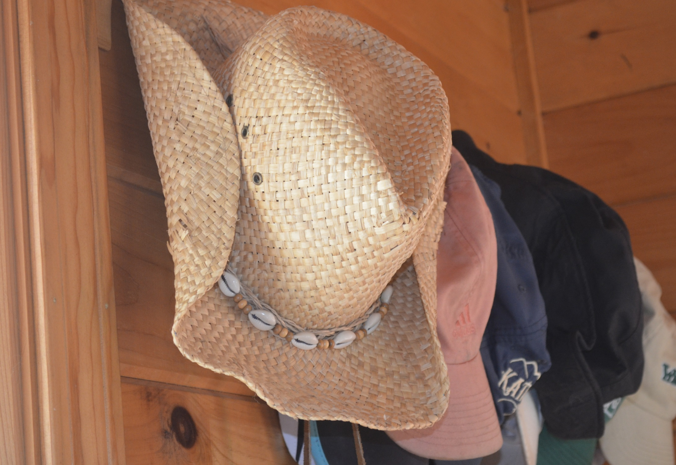
Which Hat Are You Wearing?
Notes:
The Four Hats
Ask: What “hats” do you wear at your camp? Let the participants respond.
State: As camp professionals, we often wear many hats (sometimes at the same time) while running our camps.
The Four Hats of the Visitor Activity OR Discussion (Instructor Choice)
This can be done as an Activity/Exercise OR through Discussion –Instructor Choice.
To run it as an activity: Please see Instructor Resource for materials and additional details. The following activity/exercise provides participants with an opportunity to reinforce the roles and responsibility of the visitor.
Set out four ‘hats’ (which are labeled “ Legal Hat,” “Interpersonal Relationship Hat,” “Educational Attitude Hat,” and “ACA Representative Hat”) using the model provided in the Instructor Resource packet. Or you may use real hats, or create your own. Lay out the hats for the exercise. Ask the group to work together to put all the items properly into one of four hats.
**** See Instructor Resource to properly conduct this activity . It includes a list of the items for the Visitor actions and roles with the appropriate hat.
To run as a discussion, proceed with the slides and add your own instructional approach to keep it interesting.

Slide 18
Many Hats: Which Are You Wearing??
Educational Attitude Hat
Interpersonal Relationships Hat
ACA Representative Hat
Legal Implications Hat
Notes:
Introduction and Online Course Review
ACA visitors, too, wear many hats during the course of a visit, including:
Educational attitude Hat
Interpersonal relationships Hat
ACA representative Hat
Legal implications Hat
Let’s review what it means to wear each of these hats—discuss differences and multiple possibilities.
Which hat(s) do you wear?

Slide 19
Educational Attitude Hat
Recognize the uniqueness and integrity of each camp.
Use non-judgmental language in discussion with camp personnel.
Share information and resources.
Consider the visit a personal learning experience as well as an opportunity to share.
Notes:
Educational Attitude Hat
Recognize the uniqueness and integrity of each camp.
Use non-judgmental language in discussion with camp personnel.
Share information and resources.
Consider the visit a personal learning experience as well as an opportunity to share.

Slide 20
Interpersonal Relationship Hat
Establish rapport with the director.
Understand the dual role of standards: education and accreditation.
Do not express an opinion as to whether the camp will or will not pass.
Inspire confidence on the part of the director that the visit is fair, thorough, positive, and confidential.
Be as unobtrusive as possible in interviewing staff and observing the program.
Follow ethical practices in relation to information obtained on the visit.
Notes:
Interpersonal Relationship Hat
Establish rapport with the Director.
Understand the dual role of standards: education and accreditation.
Do not express an opinion as to whether the camp will or will not pass.
Inspire confidence on the part of the Director that the visit is fair, thorough, positive, and confidential.
Be as unobtrusive as possible in interviewing staff and observing the program.
Follow ethical practices in relation to information obtained on the visit.

Slide 21
ACA Representative Hat
May be the only “ACA person” with whom the director has face-to-face contact
Should convey a positive attitude about the standards and accreditation process
Should have a professional attitude
Have a COMMITMENT to the role of Visitor
Notes:
ACA Representative Hat
May be the only ACA person with which the Director has face-to-face contact.
Should have a positive attitude about the standards and the accreditation process.
Should have a professional attitude and
Have a COMMITMENT to the role of ACA Visitor!

Slide 22
Legal Hat
The visitor is the official representative and legal agent of the Association.
Visitors must act in ways consistent with their training and the ACA Code of Ethics.
Visitors represent a national program that is administered uniformly across the country.
The visitor’s signature on the score form indicates that s/he has confirmed that the camp does or does not comply with the standards as written.
Notes:
Legal Hat
The Visitor is the official representative and legal agent of ACA.
Visitors must act in ways consistent with their training and the Code of Ethics of ACA.
Visitors represent a national program that is administered uniformly across the country.
The Visitor’s signature on the score form indicates that s/he has confirmed that the camp does or does not comply with the standards as written.

Slide 23
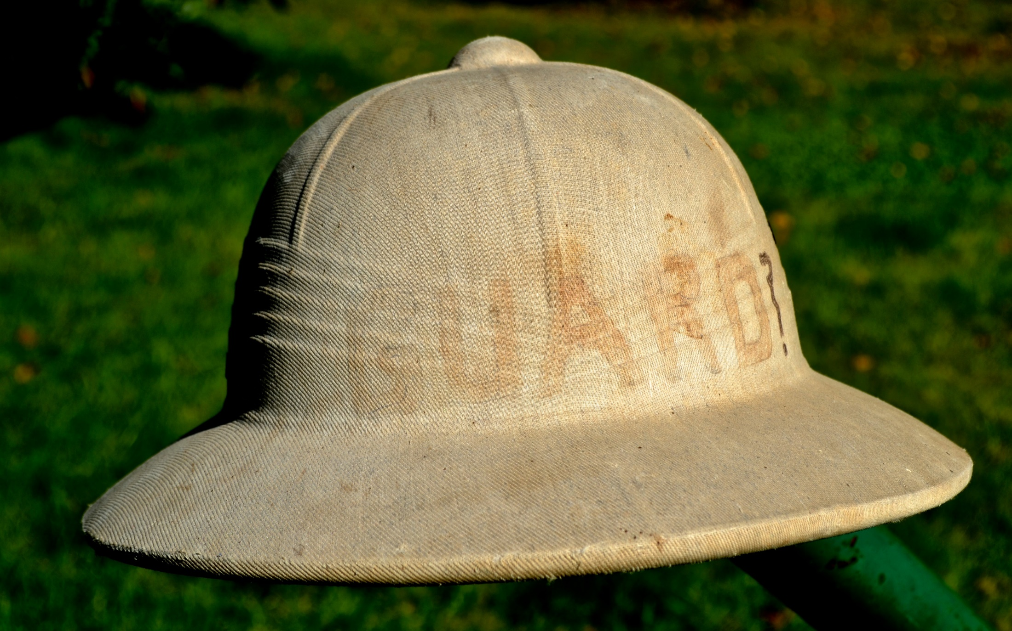
Review
Notes:
Put Closure to the Four Hat exercise as you best see fit.
Reinforce importance of visitors being committed to the accreditation process and recognizing how valuable their role is.

Slide 24

Information Gathering
Notes:
Information Gathering
This next section provides experiences and models for the Visitor to emulate in order to gather information that will be beneficial in the accreditation process. Data gathering techniques such as thorough observing, asking questions, gathering information on what cannot be seen, and creating a climate of educational awareness are stressed.
Explain that this next segment of the course is going to focus on a critical skill that ACA Visitors must develop - Information Gathering, which includes:
Develop standards-related observation skills
Formulate the right questions
Understand how to score programs and modes not seen
Engage campers and staff as good sources of data

Slide 25
Information Gathering Skills
Develop standards-related observation skills
Formulate the right questions
Understand how to score programs and modes not seen
Engage campers/staff as good sources of data
Notes:
Gathering information through observation
Explain that through observation and questioning, a visitor can obtain information needed to score the standards in each camp area.
ACTIVITY
As a large group, think about the area of Food Service for a resident camp operation.
Ask the group to list all the things a Visitor needs to see or ask of a Director or food service staff while on their tour of the camp. Record group responses on a flip chart.
How is this data important? What questions might we need to ask in gathering data for the food service?
Divide into small groups to do a similar exercise for other areas. Assign each group one of the following areas in a resident camp:
1. Living areas 2. Horseback riding areas 3. Ropes Course 4. Health Center
Ask groups to develop a list of what information they need about their assigned area to make compliance decisions. Further, they should identify if that information is best gained through observation or through asking questions. Groups will need to refer to their ACA Accreditation Process Guide while working on this task.
Give the groups 15-20 minutes to complete the task. Remind them that all applicable standards may not be grouped together in the ACA Accreditation Process Guide. Have the groups report back to the full group and discuss what must be observed in each area. Remind them that the goal is to be familiar enough with the standards to provide a valid and reliable accreditation visit.
Provide each participant with a SAMPLE copy of the Standards Visitor Reference Guide and review how to use it. Inform the group that this guide is updated when new/revised standards are released.

Slide 26
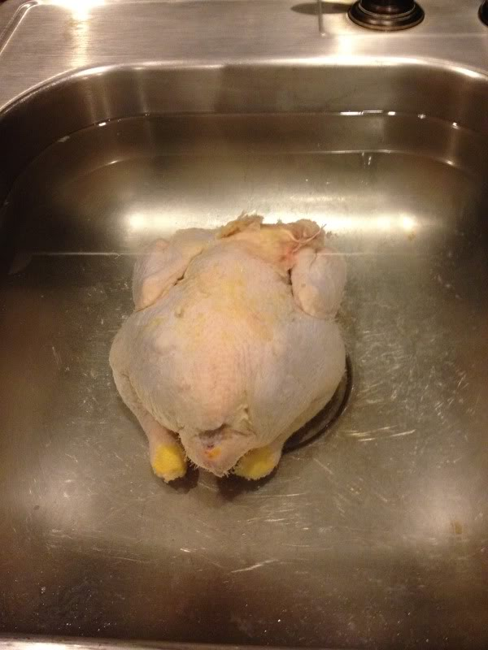
Information Gathering
Chicken defrosting in sink full of water.
Notes:
Gathering Information Through Questioning
Look at the photo of chicken defrosting on in a sink full of water.
ACTIVITY
Ask participants to think of questions that one might ask if you found this scenario in the kitchen. Have participants individually write down a question or questions they might ask in this situation.
(Note: You will review the questions in conjunction with the next slide)
Explain that the way you ask the question will help set a climate of trust and helpfulness. Some of the information you need may be simple facts that can be answered in a few words. Other situations require that you search for information and may require in-depth questioning.

Slide 27
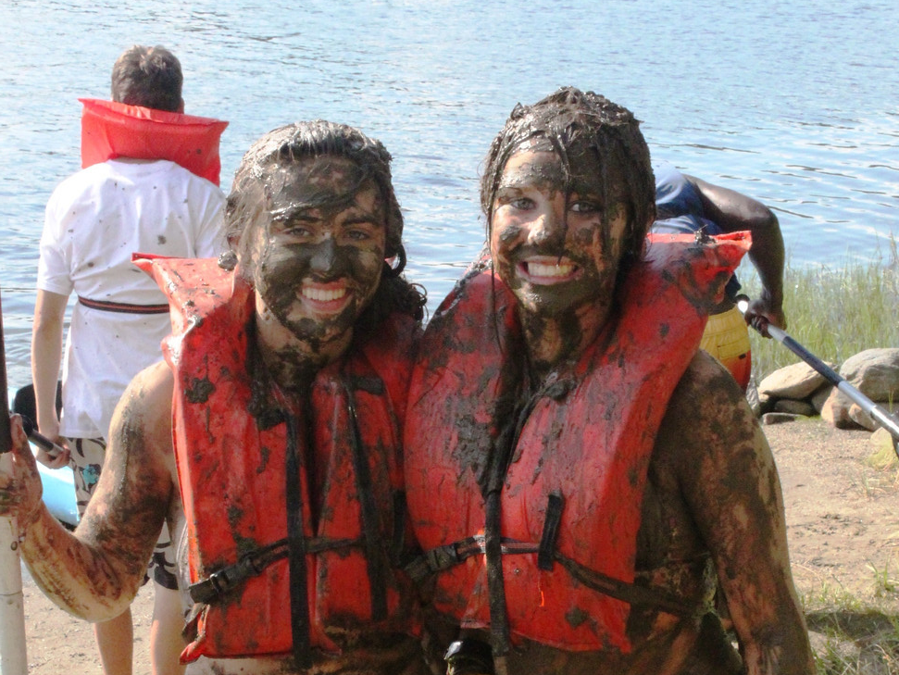
Asking Questions
Closed-ended questions
Open-ended questions
Threatening questions
Effective questions
Notes:
Asking Questions
Introduce and challenge participants to think about what it means to ask effective and non-threatening questions. Discussion should center on types of questions and possible responses. Use the sample questions below to start a discussion of closed-ended questions and open-ended questions
1. Describe the process your camp went through to decide whether or not to obtain an AED? OR Will your camp get an AED?
2. Share with me your system for providing training for mid-summer staff hires. OR Did your mid-summer staff hires get trained?
Have participants share the questions that they wrote down for “thawing the chicken slide”.
What kind of question is it? (open or closed)
What additional questions might we need to ask?
Threatening Questions
Now turn the focus to a discussion around questions that may be threatening and may not produce the information needed.
Using the examples above (AED and mid-summer training), have the participants think about how these questions might be asked in a way that might create a confrontational or threatening environment?
Why might someone feel threatened by a question from a visitor?
Threatening questions tend to put people on the defensive and may cause the Director to feel that you are an inspector.
Use the following examples or ask the participants for examples of threatening questions.
When was the last time you checked the thermometers?
Why haven’t you fixed these stairs?
What’s wrong with your septic system?
Why don’t your go-karts have roll bars as they ought to?

Slide 28
Closed-ended Questions
Leads to “YES” or “NO” answers
Gathers limited information
Puts people on the defensive
Notes:
Closed-ended questions
Usually a single or simple response such as “yes” or “no”
May gather limited information
May put people on the defensive
DISCUSSION:
Gathering information with probing questions
Remind participants of the value of probing. It is important to keep asking questions: “Tell me about…” “Explain how you…” “Describe the camp’s procedure for…” Ask the participants when probing questions might be necessary.
GROUP ACTIVITY:
When participants seem to understand the principles involved, have them break into four groups and assign each group one of the following situations, giving them 5-10 minutes to develop both poorly stated and acceptable questions that might be asked during a visit. - These can be role played.
You arrive at the waterfront and see campers putting canoes into the water. No staff member is in sight.
Walking by the camp health center and you hear the nurse say, “That’s OK honey, you can take that medicine back to the cabin with you.”
As you are touring the camp, you note that there are hiking trails and signs to the Blueberry Patch right behind the target area of the rifle range.
While touring the camp, you see a group of day campers using a permanent climbing wall in the middle of camp. You know this camp operates many rental-group programs in the spring and fall. You see no fencing or signs about use.
Have each group share their questions and discuss any concerns that may arise.

Slide 29
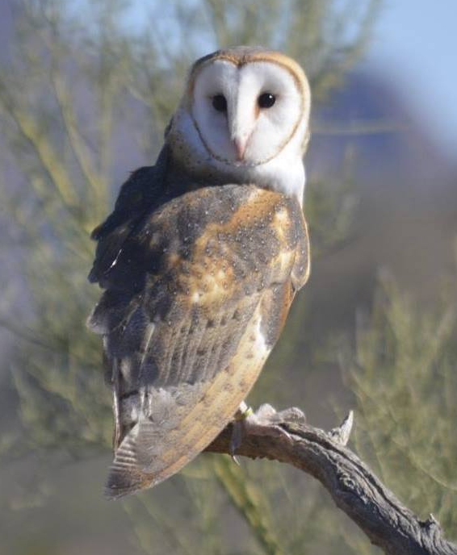
Open-ended Questions
Who, what, where, when, why or how
Tell me about…
Explain how you…
Describe your….
Discussion starter
Notes:
Open-ended Questions
Discuss with the group that the type of response received is in many ways a reflection of the type of question asked.
One classification of questions is to be closed or open-ended. Consider the attributes of each.
Open-ended questions
Use of who, what, where, when, why or how
Discussion starter
Concisely worded
Easily understood
Answer requires thought
Requires more than a one word answer

Slide 30
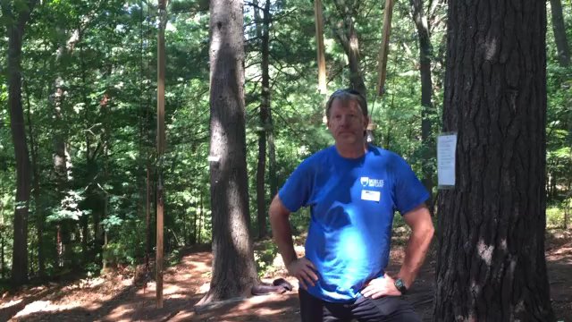
Open Ended
“HOW do you control access to the ropes course?”
Notes:
4 second video of “visitor” asking an open ended question:
“How do you control access to the ropes course when you are eating lunch or it is off hours for activities?”
The question asks HOW. Additionally the “visitor” adds specific examples to the question

Slide 31

Open Ended
Leads to a Descriptive responses
Notes:
Open ended questions lead to descriptive responses
Click on video to find out the answer to “How do they control access to the ropes course”

Slide 32
Gathering Information on Areas NOT Seen
Campers go horseback riding at a private stable 10 miles away.
Campers take a field trip to a nearby amusement park.
Campers take a whitewater rafting trip with a commercial outfitter.
A rental-group in the off-season rents the camp and does their cooking in the camp kitchen.
Notes:
Explain ACA Visit Procedures for Gathering information on activities, services, and modes not seen
Consider the standards that deal with food service. When visiting a camp, there are likely to be some modes of operation or services that you will not encounter or observe on the day of the visit. What type of questions do we need to ask to score these unseen modes, services, or programs? How do we find out about the food service during other modes (esp. rental groups)?
Solicit from the group some possible open-ended questions to find out about other seasons or modes of use. In addition, remind participants that under the standards program, some specialized activities will be scored without being seen and with perhaps very little contact with the staff responsible for the activity (e.g. tripping, rock climbing, rental groups, etc.).
Group Activity (From Slide)
Have the participants work in the same groups as above and consider questions for those specialized activities and other modes of operations that can’t be seen at the time of the visit. Also, have them consider how to gather information about activities or situations unfamiliar to them. Give the groups 10-15 minutes to discuss these and come up with questions to use and then come together to share what each group developed.
Divide the group into pairs to develop questions for the following situations on the slide. The point is to solicit enough information about these situations to be able to score appropriately.
Different Situations
Campers go horseback riding at a private stable 10 miles away.
Campers take a field trip to a nearby amusement park.
Campers take a whitewater rafting trip with a Commercial Outfitter.
A rental group in the off season rents the camp and does their cooking in the camp kitchen.
Share the questions generated with the whole group. Ask the group what was challenging about asking these questions. What kinds of information would be gathered in asking these questions? Are the questions threatening or non-threatening? Open – ended or closed? Instructors should evaluate the questions and make suggestions for improvement.

Slide 33
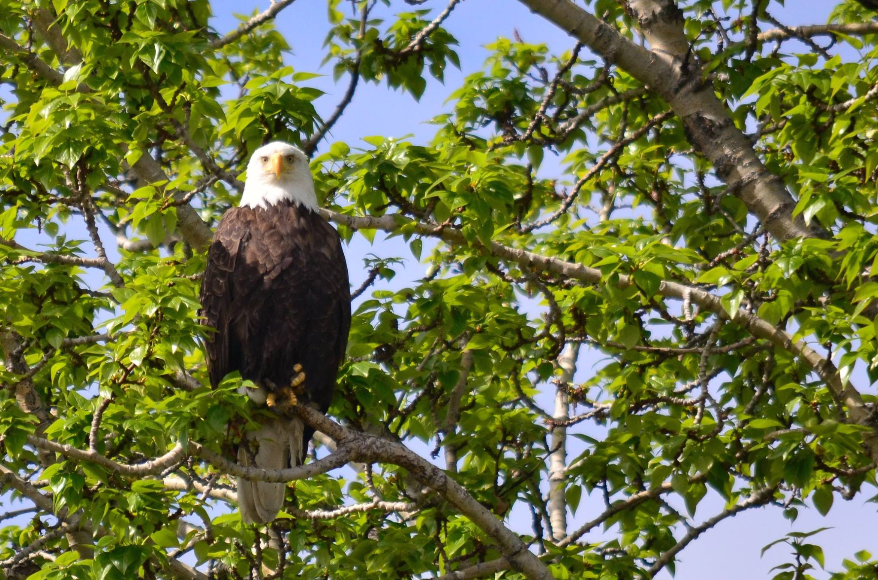
Observation
Notes:
Review the handout: “Developing Your Observation Eyes”
Questions to Ask When You Can’t See an Activity in Operation
Sometimes an activity is not occurring on the day of the visit. For example, it could be a program offered on a different day or even a different session, or it could be that the activity is a part of the non-summer operations.
ACTIVITY
Participants should find a partner and practice asking the following kinds of questions have them each think of another question to add to the list with their partner.
On-site activities:
Tell me a little bit about how you offer (activity).
Is (activity) available to all your users throughout the year, or do you have specific times when you offer it?
Who is “in charge” of (responsible for) the instruction and oversight of the activity? What are their qualifications?
Who gets to participate in (activity)? Any special requirements or equipment?
What kinds of emergency procedures are followed?
Is (activity) available to rental groups? Can they bring their own “Leaders/Instructors?
Off-site activities:
Who is “in charge” of (activity)? What are their qualifications?
What emergency procedures are in place if something should happen?
How and by whom are the campers supervised during the off-site trip?
What role does the camp staff play in supervision of campers when others are in charge of the off-site activity?
How did you share the standards related to (activity) with them and what kinds of things did you talk over with them?
Describe the facility/site where (activity) occurs.

Slide 34

Practice Gathering Information
Role Play Situation Assignments
Archery Range
Waterfront
Horseback Riding
Trip and Travel
Maintenance
Notes:
Gathering Information From Campers And Staff
During the course of the visit, the Visitor needs to gather information from staff and campers. Select volunteers to role play the following situations, and ask the rest of the group to determine what information is needed, developing appropriate questions to gather information.
ACTIVITY
Role Play Situations:
Have participants divide into small groups of 2-3 people.
Assign a scenario to each small group. Instruct the participants to each select a role from their assigned scenario and play it out.
Be sure to first give them time to write down some of the questions needed to collect the information. (collectively or in their small group)
Archery Range: Talk with campers.
Roles needed: Visitors and one or two campers
The Visitors go to the archery range while the archery instructor is teaching a class. Some campers are waiting their turn. [Hints to Instructors: range commands, how to use equipment, skills gained, etc.].
Waterfront: Talk with staff.
Roles needed: Visitor and Swim Instructor
The visitors go to the waterfront as one swim class is ending. A second class begins in 10 minutes. [Hints to Instructor: emergency communication plan, in-service trainings, skills verification, staff swim policies].
Horseback riding: Talk with staff.
Roles needed: Visitor, Camp Director, trail riding leader
The visitors arrive at the stable as a group returns from a trail ride.
[Hints to Instructor: horse medication, classifying horse, physical soundness, rider classification].
Trip and travel: Talk with campers and staff.
Roles needed: Visitor, campers preparing for three-day backpacking trip, counselor accompanying backpacking trip.
[Hints for Instructor: participant separation from group, medical assistance during trip, environmental impact, equipment repair].
Maintenance: Talk with staff.
Roles needed: Visitor, Maintenance Supervisor
[Hints for instructor: electrical inspections, storage of hazardous materials, use of power tools].
Reflection from Role-play
Have each group share some of the sample questions they generated.
During the role play, did Visitors: Gather the appropriate information? Ask the questions in a non-threatening manner? Ask open-ended questions? Ask age-appropriate questions?
Sometimes it can be challenging to find time during the visit to talk with campers and staff. As a group, brainstorm as a large group some ways to create opportunities to accomplish this.
Some suggestions to be sure to mention to the participants:
Ask the camp Director if you can sit at a camper table during lunch.
Ask the Director if you can arrive at an activity area 10 minutes before the activity starts.
Check your Instructor Tool Kit for more information on role playing.

Slide 35

Resources and Tools
www.ACAcamps.org
Notes:
Take the time to have participants explore the ACAcamps.org website
During course if they can log on, have them get out their devices and go through the pages with you.
If only you can log on- show them the pages.
The pages are shown here in case you are not able to get on line.
Explain
ACA has a wealth of resources available to help with the accreditation process, a key component of which is the website ACAcamps.org
Really encourage the participants to explore the ACAcamps.org website; there is a vast amount of valuable information on the website.
Remind participants that they may be asked as visitors to recommend resources a camp director can use to help with particular standards – visitors should know what’s available or how to find it.

Slide 36
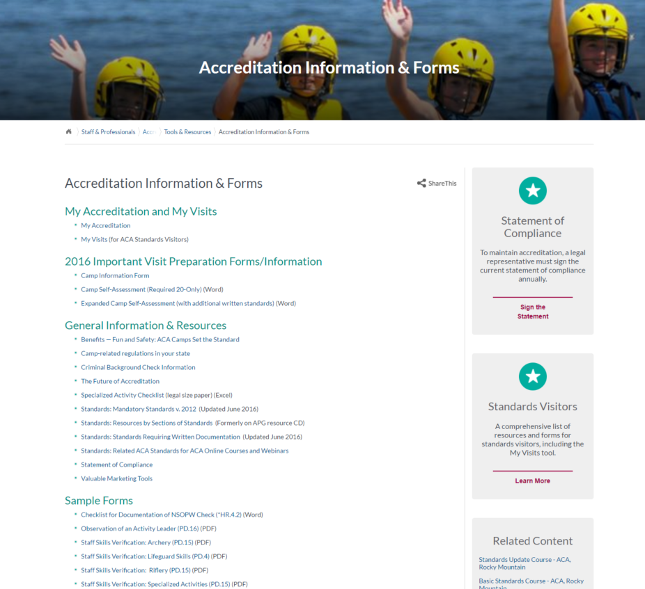
Resources
www.ACAcamps.org
Accreditation Information & Forms
Notes:
Resources
Remind participants to go to the ACA Accreditation Information & Forms resources web page for resources including;
Access the recognized first aid/CPR certifications list
Access the recognized aquatics certifications list
Access the approved horseback riding supervisor training list
Sample skills checklists
Access My Visits (and My Accreditation)
Access Resources by Section of Standards
Also posted on this Web page are any changes to the APG and clarifications from the National Standards Commission (NSC). The NSC routinely reviews standards visit score form issues, comments from the score forms and from ICA forms to pinpoint any problems areas. They may decide to issue a clarification. This is not intended to change the intent of the standard but to clarify questions that arise when applying standards.

Slide 37
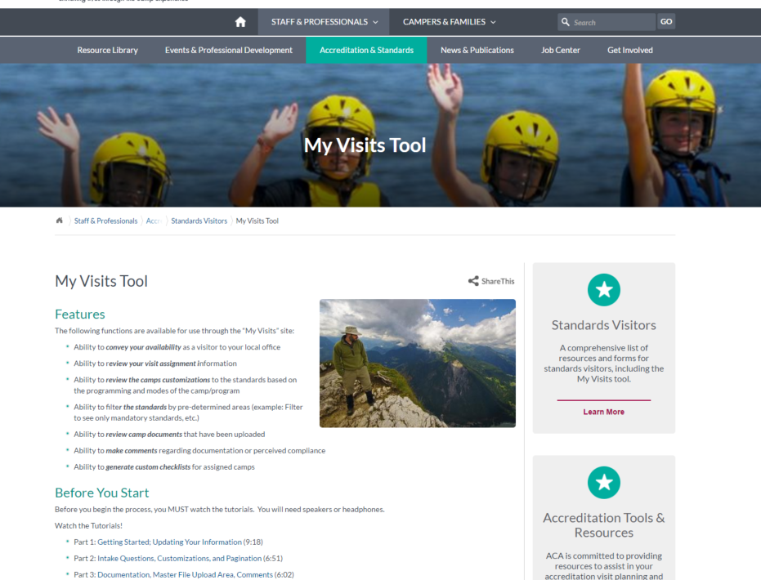
My Visits Tool
www.ACAcamps.org
My Visits Tool
Notes:
My Visits Tool
Before logging on, take time to view the tutorials. (animation arrow)
When you are assigned to a visit, you will also be linked to that camp’s My Accreditation for online sharing of documents.
Remember, it is up to the camp director to decide how to share written documents (My Accreditation, printed and organized in notebooks, other cloud based sharing i.e. One Drive, Google Drive, I Cloud)
Next slide shows Log-in link

Slide 38
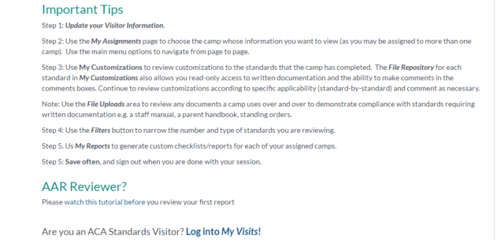
My Visits Tool
Notes:
My Visit Tools
Once they have watched the tutorial, they should then Log in at bottom of page.
Next slide shows Click here to log on

Slide 39
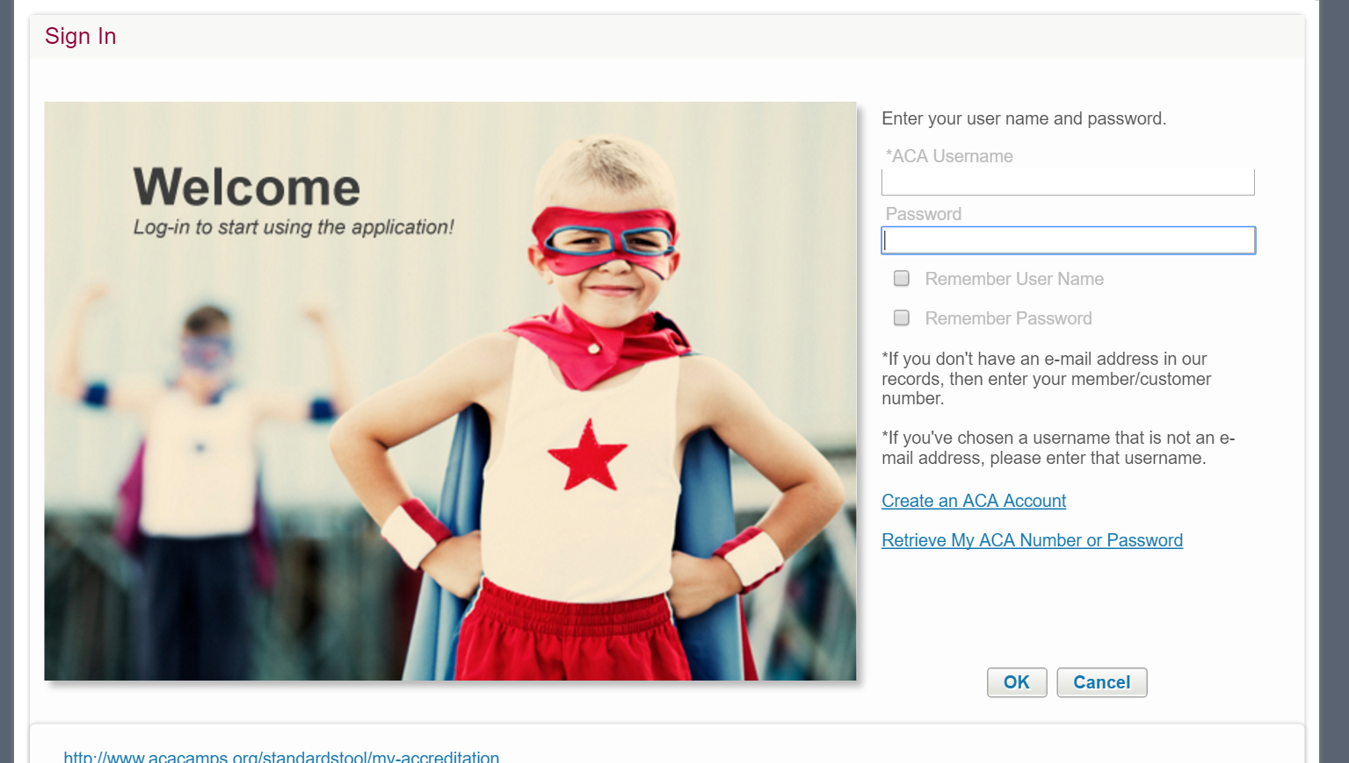
My Visits
Notes:
My Visits
Prompt participants (more than once) to please be sure to watch the tutorials before ever logging in to this app. The tutorials will help you navigate the system.
Note to Instructors: To launch the app and log in to demo the look and feel of the app, you will need to have watched these tutorials yourself and be familiar with the technology.
Note to Instructor: While demonstrating the app you can show your own camp, if you’d like, OR you can use a generic log-in/password combo for ACA’s fake camp “Camp ACA”
Login: Trainer (instead of email address)
Password: 12345
.

Slide 40

Online Tools Reminders
Educational resource for camp professionals
User is responsible
Notes:
On Line Tools
Be sure you understand and may need to help the camp understand the following information (disclaimer).
Note to Instructor: Please read this to the group.
ACA, Inc. has designed the standards online tool primarily as an educational resource for camp professionals.
ACA, Inc. makes no claim that use of this published informational tool will assure a successful outcome.
In determining the applicability of any specific standard, the camp professional should apply his or her own professional judgment to the specific circumstances presented by the particular information/situation.
If using the site to determine what standards will be applicable to obtain accreditation, the user is responsible for scoring any and all standards applicable to their program, whether gathered through the customized version of standards website or not.

Slide 41
Visit-Related Forms To Use
Camp Information Form
Camp Self-Assessment (CSA)
Score Form
Immediate Corrective Action (ICA)
Notes:
Learn To Use Forms Correctly
The following segment looks at various forms that the Visitor will encounter in carrying out his/her work. Emphasize the importance of accuracy and obtaining information in a timely fashion.
This slide introduces important forms in the visitation process. Let candidates know that the following forms will be examined.
Camp Information Form
Camp Self-Assessment
Score Form
ICA Notice Form
Note to Instructors: The details on the use of each form are included here to be shared with the participants.

Slide 42
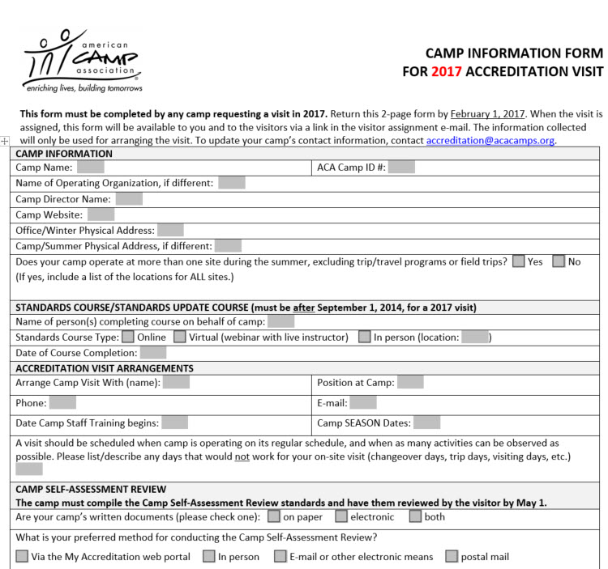

Camp Information Form
Due to ACA
February 1
Used by Visitor
Notes:
The Camp Information Form (CIF)
Tool for creating dialogue between visitor and camp director so visitor can better understand the program.
We will reference this form and fill in all of the sections as practice.
The CIF will be submitted and shared with visitors electronically.
It is due February 1.
The Camp Information Form is a very helpful tool for both the camp and you, as the visitor, to determine what modes and activities are to be scored.
Visitors are given access to view a copy of the camp information form that their assigned camp completed in preparation for the visit.
Explain the front side and examine together:
Camp name and ID number
Contact (specifically for the visit)
Camp Web site address
Addresses – both summer and non-summer
Locations if camp has multiple locations
Information regarding completion of standards course requirements
Self-assessment
Modes of Operations to be scored
Program areas to be scored
Direct them to the bottom third of the first page. Point out and have them take note of the sections regarding the camp self-assessment and modes of operation to be scored.
Point out the section (toward the bottom) on program areas to be scored and that it highlights 3 areas: Specialized Activities, Aquatics, and Trip and Travel (three nights or more)
Review the back side:
Specialized and Aquatic Activities Offered –
List specific Aquatic activities – aquatic activities are not listed specifically on page two of the Camp Information Form. Rather, camps need to list what aquatics activities they provide. As a visitor, it is important that you review this box with the camp director so both of you know whether to score swimming, watercraft, etc.
Explain that as visitors they need to take particular note of page two and how it pertains to specialized activities and scoring. Explain that we will discuss in detail the PD section and how specialized activities are scored, but page two of the Camp Information Form will be your guide in working with the camp on standards to be scored and areas of the camp/activities you need to see during your camp tour.
Camps submit this document electronically via My Accreditation and as visitors you may view it there. Additionally the form is printed and mailed to the Lead Visitor in conjunction with the Score Form.
Regardless of the information available on the form – it is always a good idea to check the camp’s website out prior to reviewing the camp self-assessment and prior to the day of the visit. This will help you verify the activities indicated prior to any reviews or scoring.
This form is an informational tool. It is a great basis for pre-visit conversation.
If you receive the form electronically, you may need to print a copy of the CIF to bring to the visit.
At the beginning of the visit, have the Director review and correct the form so programs and services to be scored, modes of operation and specialized activities have again been verified. After the visit, the Camp Information Form is inserted in the envelope with the score form and returned to ACA, Inc.
REMEMBER TO SEND THIS FORM TO ACA, INC. ALONG WITH THE SCORE FORM!

Slide 43
Camp Information Form
In review. . .
Information collected from the camp in advance to help schedule and conduct visit
Should include information about modes and specialized activities offered
A copy is sent to each visitor
Framework for your conversations with camp
Notes:
Review the main ideas from the Camp Information Form including:
This is information collected from the camp in advance of the camp visit and is intended to be educational for camps and visitors alike
Give visitor idea of when camp will be ready for camp self-assessment and how camp would like to complete this aspect of the visit
Camps and visitors reviewing the form together allows the opportunity to compare to what is actually offered - for scoring purposes and to discuss areas of confusion or concern
Visitor can review the camp web site prior to the visit to become familiar with the camp operation
Return the Camp Information Form with the score form to ACA, Inc. at the end of the visit.
Sometimes, a camp fails to return a completed CIF before visit assignments are made. If you receive a visit assignment without a CIF, the lead visitor should communicate with the camp, ask for the form to be completed, and share the results with you and ACA.
In Review…(additional information if necessary)
The Camp Information Form is completed by the camp in advance of the visit. Its purpose is to collect pertinent information in helping to schedule and conduct the visit. The Visitor should use the information while setting up the visit and will return this form along with the score form.
The Camp Information Form is completed by the person who took the Standards Course. Double check the form that you receive from your local office with the camp to clarify the areas of camp and the activities that need to be seen on the day of the visit.
The information on the Camp Information Form is intended to frame the conversation the lead visitor will have with the camp prior to setting up the camp self-assessment review and the details for the visit. The main purpose of the Camp Information Form is to assure that all programs, components, and aspects that need to be scored are done so.
ACA, Inc. office uses the returned Camp Information Form as a check and balance to assure the score form is completed correctly. The Camp Information Form is not a camp information update form. Any changes a camp has to addresses, phone, email, website, or personnel need to be made through ACA, either online in the membership area of the website, or via phone or e-mail.

Slide 44
The Scene
Camp Have Lots of Fun (CHLOF) operates a two-week session for children who are members of the Lots of Fun Foundation. The camp rents space at Camp Happy Days (CHD), an accredited camp.
Camp Happy Days provides food service, swimming at the pool (lifeguards and swim instructors provided) and a hay ride once per week. Camp Happy Days also provides horseback riding.
Camp Have Lots of Fun brings their own cabin counselors, program staff, health care staff, and administrative staff and uses all the program areas of Happy Days. CHLOF brings their archery and climbing wall Instructors.
Notes:
Resources
ACTIVITY
The following exercise continues with looking at the sample Camp Information Form for Camp Have Lots of Fun handout as it demonstrates the many different structures that may operate in the camp environment and the Accreditation Process Guide.
Look at the camps that rent to others mode, and the different configurations that need to be considered. The scene is described on this slide –
Please review the scene together then ASK
During the CHLOF accreditation visit: How do you score the Site & Facilities (SF) section?
SF is a DNA. The site CHLOF is using is an accredited camp. Write the name of the accredited camp on the comment form.
Which standards in the Aquatics (PA) section should be scored?
If no other aquatics activities are offered to CHLOF besides the swimming and instruction provide by Happy Days, DNA PA.1 through PA.29 and score only the staffed Public Facilities PA.30 through PA.36 as applicable. If CHLOF does have other aquatic activities, i.e. scuba, then the appropriate standards in the PA section would be scored.
What standards in the PD section must be scored related to the adventure/challenge activities that CHLOF offers?
CHLOF must score PD.8, PD.12, PD.13, PD.15- PD.24 and PD.29 in the section. Any standards that relate to maintenance, facility and equipment that Camp Happy Days is responsible for, CHLOF must obtain the written documentation from Camp Happy Days. CHLOF is also responsible for the standards relating to documentation of staff qualifications.
Are there any standards in the Transportation (TR) section that need to be scored (in regards to the description given above)?
TR.2 for the hay ride.
Who is responsible for scores in the Human Resources section?
CHLOF is responsible for this section.
How is the archery activity scored?
PD.20, PD.23 & PD.19 CHLOF must provide documentation for their staff. PD.39 & PD.19 procedures might be provided by Camp Happy Days for use by CHLOF or CHLOF may choose to write their own procedures—in any case, those standards must be scored.
What about Health and Wellness, and Operational Management?
CHLOF must score all the HW sections and all the OM sections. However, OM.14 & 15 would be a DNA.

Slide 45
Camp Self-Assessment
The visitor will:
Review all required written documentation
Mark as Seen, Not Seen, Seen but needs verification on the day of the visit, or the following must be completed
The intent of the standards is that they are in place when the camp opens its doors to staff and campers
Required for all camps
Notes:
Camp Self-Assessment
Participants should be asked to locate the Camp Self-Assessment Checklist handout.
Visitors will review written documentation provided and should check one of the three columns to indicate the ‘status’ of what was provided. Be sure to review instructions on the cover sheet prior to use.
Review the terminology of the Camp Self-Assessment and how to complete the form
Not seen – if this column is checked, then written documentation was not presented. It must be reviewed on the day of the visit.
Seen – if this column is checked, the documentation presented meets the standard and on the day of the visit, after visitor can verify that the policy or procedures are in practice then, the score form may be marked “yes”.
Seen and needs added verification – if this column is checked, some onsite verification must be accomplished prior to marking “yes” on the day of the visit (for instance, ensure that a written policy is actually in practice).
Following must be completed – if this column is checked, the camp needs to create or correct written documentation or verify DNAs, on site verification, etc.
See additional instructions on the checklist
Optional: Visitors can use the same nomenclature in the comment boxes in MY VISITS to complete the review of the Camp Self-Assessment using the app.
Summary of Camp Self-Assessment Slide – for Accurate Completion of the Form
The Visitor will:
Review all written documentation
Mark as” Seen,” Not Seen,” Seen and needs verification on the day of the visit,” or the “Following must be completed.”
The intent of the standards is that they are in place when the camp opens its doors to for staff training
Required for camps – local office may deny on site visit if not completed. Additionally, local office may require more than twenty standards be reviewed.
See Instructor Resource Packet for an Activity related to the Camp Self-Assessment - using the Mock Visit toolkit documentation.

Slide 46
Camp Self-Assessment
Connects
Visitor and Camp
A Tool
Organizes
Evaluates
Reviews
Written Documentation
Compliance Demonstrations
Notes:
Camp Self-Assessment
The Camp Self-Assessment is a required review (by a visitor) of twenty (20) pre-selected standards requiring written documentation. This review is an important element of the educational process of the standards program. Statistics confirm that previewing the written documentation before the camp open, leads to successful accreditation visits!
This is especially important for camps who are preparing for their first visit. The NSC requires that a Camp Self-Assessment is completed and reviewed by the visitor by MAY 1st. Your local office may require the camp self-assessment to be done earlier.
Previewing and evaluating paperwork ahead of time, especially for other modes of operation, will allow much more time during the visit to tour the camp, see activities, and talk with campers and staff.
The primary purpose of evaluating written documentation before the day of the visit is to educate the Camp Director/administrator on the adequacy of the camp’s paperwork before the on-site visit and scoring. This gives the camp ample opportunity to ask questions and make needed corrections prior to the on-site visit. The camp self-assessment can be accomplished in person at a meeting, by a mail, or electronic exchange of documentation, with a phone follow-up or other means.

Slide 47
The Score Form
Observe all things before scoring.
When specialized activities, modes, or other items cannot be observed first hand, be sure to note this in the comment section.
Visitors do not have the authority to make exceptions or to bend things that just don’t seem to fit. Score the standard as it is written, and use the comment form to alert ACA to problems or describe the situation.
Notes:
The Score Form
General Guidelines for Scoring -- Have copy of actual score form available to reference as you are presenting score form materials
Help in scoring the standard is provided in the compliance demonstration. This defines the minimum that is required to be seen by the Visitor or presented by the Camp Director in evaluating compliance with the standard.
Observe all things before scoring. The score sheet is a legal record of your observations.
When specialized activities cannot be observed first hand, talk with the staff involved to learn as much about the program as possible. Note in the comment section that the activity was not observed, but was discussed with appropriate staff.
When other modes of operation cannot be observed, discuss compliance with appropriate staff and review documentation, when required. Again, note in the comment section that the mode of operation was not observed.
Visitors do not have the authority to make exceptions or to bend things that just don’t seem to fit. Score the standard as it is written and utilize the comment form to alert ACA to problems or describe the situation.
Final authority on compliance decisions in case of disagreement rests with the person designated as the Lead Visitor.

Slide 48
The Score Form
The Score Form
Is a legal document. It is the official record of the visit
Avoid miscellaneous comments for DNAs or for educational purposes
Use the correct score form. Look for an indication of the year
Make sure all scores, signatures, and comments are written in ink
Notes:
The score form is the official record of the visit – it is a legal document!
Comments are to be written . . .
For any and all “No” scores;
For any problems in scoring a standard or a section of standards; and
For indication that a section of standards was scored but not seen.
Do NOT write miscellaneous comments for DNA’s or for educational purposes. For example: A camp has a written plan for Intruders (OM.7). They have a plan, yet you feel it is weak so the visitor writes on the comment form: “Camp has a plan yet needs to strengthen it by cutting down trees so there is better visibility.” While this may be true and you want to share this info with the camp, please do so verbally or in writing on another document and NOT the score form.
Make sure all scores, signatures, and comments are done in ink. Note: Scores may start in pencil but should have at least one cross hatch of the “X” done in ink
The signature portion of the form MUST be completed for the visit to be official. Score forms without the signatures cannot and will not be processed! Make the visit count – collect the signatures. Please record all signatures in ink.
There are spaces for two visitors’ information on the score form. However, if a visit has more than two visitors, information for the additional visitors should also be written onto the first page of the score form.
Make sure to use the correct score form—do not use leftovers from a previous year.
These forms will be read by a scanner; please do not make any miscellaneous markings in the score boxes.

Slide 49
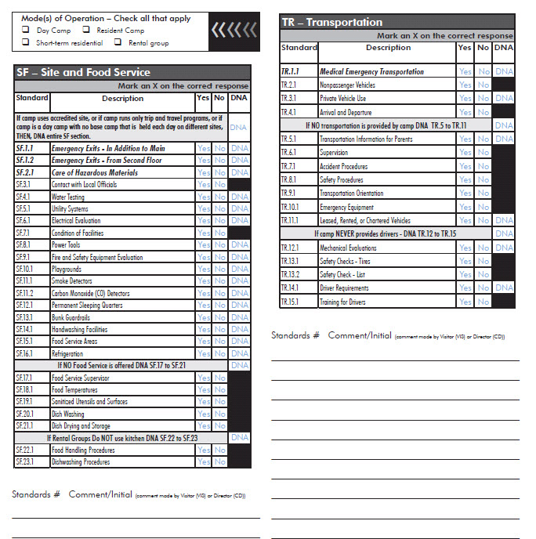
The Score Form
Notes:
Sample Page of a Score Form.
Remind them that each standard has to be scored “yes” “no” or “dna”
It is best to have actual score forms on hand for them to look at – these can then be used in the Mock Visit. Allow time for candidates to look at actual blank score forms.
Note: It is ok to use forms from the previous summer for training purposes.

Slide 50
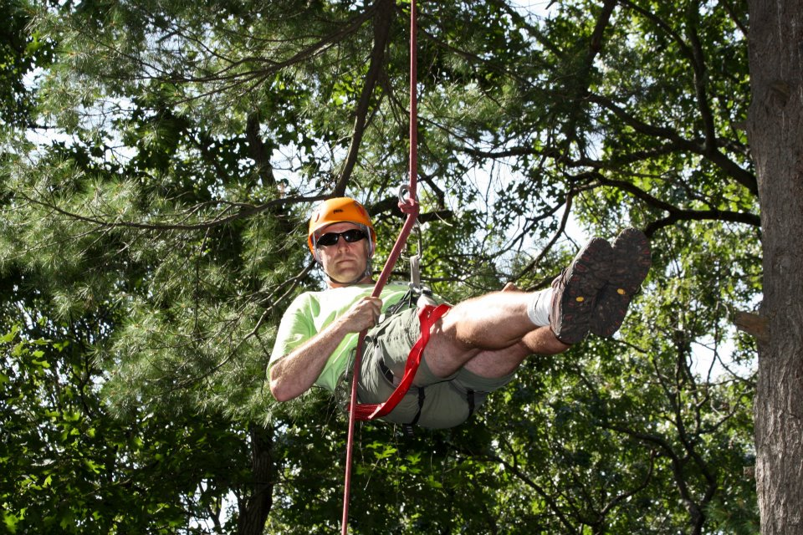
Sample Interview
Ropes Course Sample Interview
Notes:
Sample Interview 2:30 minutes
Go to http://www.acacamps.org/about/leadership/volunteers/standards-instructors
To download the video
Before watching have participants look at the PD Standards. Which standards should be scored for a camp running a Adventure/Challenge Course?
(PD.8, PD.12.1, PD.13.1, PD.13.2, PD.15.1, PD.16.1, PD.17.1, PD.18.1, PD.19.1, PD. 21.1, PD. 22.1, PD. 22.2, PD. 23.1, PD.24.1, PD.29.3)
Let participants know you will play the video which is a sample interview. They are welcome to take notes during the interview.
Play Video
After watching, have them then identify which PD standards might they be able to score, or if not able to fully score, for which standards was information given during the interview?
Review the PD Standards which apply to Adventure/Challenge Courses.
For which Standards was information given? (PD.8, PD.12.1, PD.13.1, PD.13.2, PD.15.1, PD.16.1, PD.18.1, PD.19.1, PD. 21.1,PD. 22.1, PD. 22.2, PD. 23.1, PD.29.3)
After looking at the standards on the score sheet, are there any other questions they would ask?
PD.15.1 You talked about staff training and the skills sequence for their training, who supervises that training? How is that documented?
PD.17.1: What certifications do you and your staff have? Do you have First Aid? Does anyone on staff have first aid? Is a staff with First Aid always present? Where is the nearest First Aid kit? Tell me how you would handle an injury?
PD.19.3: Tell me about your course inspections? By whom? How often?
Use this to help them get a feel for what is like asking questions in the field
Point out that it is okay to go back and ask for more information later, even after you have started to score the standards.

Slide 51
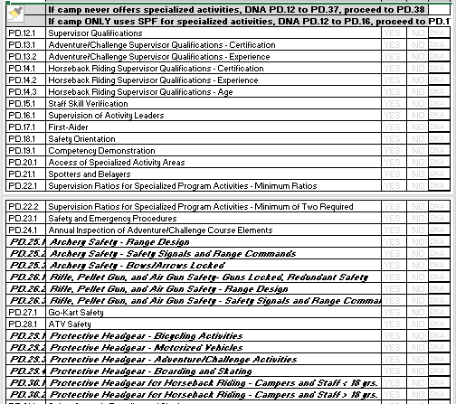
Scoring PD
Notes:
Scoring PD Section
Slide is to provide visual image of PD standards PD.12.1-PD.36.2 for when going over Ropes Interview.
Note: Participants have copy of PD Section of Score Form.

Slide 52
Score Form Information
Do not use names or personal initials for comments; use generic “CD” or “Vis.”
Mandatory Standards are bold and italicized.
Indicate the camp name and number on each page in the spaces provided for you.
Double check score form for blanks.
www.ACAcamps.org
Visitor Resources
Notes:
Score Form Information
The reminders on the next two slides illustrate how to navigate the score form and help visitors to be as accurate as possible. These reminders are typically those that are found on the Score Form Instruction Page and on the volunteer visitor webpage. Visitor Resources
Again, all “No” scores need a comment. Comments for a “No” score can be made in the comment sections following the group/set of standards being scored. Please remember to initial comments using ‘VIS’ for the visitor’s comments or ‘CD’ for the camp director’s comments. No names, no personal initials. Use additional paper if necessary. Please record all comments in ink.
Do not use names or personal initials for comments; use generic “CD” or “Vis”
Mandatory Standards are bold and italicized
Indicate the camp name and number on each page in the spaces provided for you
Double check score form for blanks.

Slide 53
Score Form Information
Indicate all modes you are scoring for the camp being visited.
Director may make a copy of the score form, minus the signature page.
Visitors should not make or keep copies of score forms.
Mark in pencil first, then go back over in pen later;  not !
Mail the score form PROMPTLY
in the pre-paid envelope provided!
Notes:
Score Form Information
Indicate the camp name and number on each page in the spaces provided for you.
Indicate all modes you are scoring for the camp being visited.
Director may make a copy of the score form minus the signature page. Visitors should not make or keep copies of score forms. If the director doesn’t have access to a copy machine, you might suggest taking a picture of each page with a cell phone or tablet camera. It happens only once or twice a year, but when a score form is lost in the mail, it’s much easier to handle when the director can provide a copy of the score form as a back-up.
Mark in pencil first, then go back over in pen later. A flair pen works great for marking the form.
Mark an X over “Yes,” “No,” or “DNA” to indicate your compliance decision. Please do not fill the box with color.
Mail promptly in the envelope provided.

Slide 54
Sample Comments
The camp has no written policy for Criminal Records checks for volunteer staff. (HR.5.1)
Policy is being implemented, however it is not in writing. (PD.8)
Although the camp has a written safety procedure, they are from their national organization and are not specific to the camp. The director feels this is sufficient. (OM.8)
Our camp has no need for a written system since the camp caretaker does excellent work. (SF.8)
While activity was scored, it was not seen.
DNA (SF) because the camp being visited is using an accredited camp – Camp ACA #12345
Notes:
Resources
Listed on the slide are sample comments that might be found in the comments section of the score form.
Reinforce:
Comments are indicated whenever the Visitor needs to document reasons concerning non-compliance or where clarification is needed.
The Comment Form may also be used to capture information from the camp administration

Slide 55
Comment Guidelines
Are written in ink, with no personal initials; use “CD” or “VIS”
Explain why a standard was scored “No”
Explain any differences of opinion
May reflect the director’s point of view
Reflect difficulty in applying a standard to a camp
Reflect any activities or modes scored but not seen
Notes:
Resources
Make comments in ink. Use only the initials CD (Camp Director) or VIS (Visitor) to indicate source of comment. No personal initials should be indicated. There must be a comment for any standard or part of a standard marked “No”.
The comment should be an explanation of why the standard is scored “No”. For example, HR.5: The camp has no written policy for Criminal Records Checks for staffs who are volunteers (there is a policy for paid staff), operating procedures do not include camper staff supervision ratios, or the Camp Director is not 25 years old.
To explain any differences of opinion between the visitor and the Director. For example, on OM.8, it may be indicated in the explanation “Although the camp has a written emergency procedure, they are from their national organization and are not specific to the camp. The Director feels this is sufficient.”
The Director may make any comment s/he prefers in regards to standards marked “No.” For example, commenting on SF.8, the Director may write, “Our camp has no need for a written system, since the camp caretaker does excellent work.”
Notate any difficulty you have in applying the standard to the camp
Make a note of any activity or mode of operation scored but not observed.

Slide 56
Comments
Sometimes a camp director might choose to score a “No”.
NO?
What are some examples of standards where this may be true?
Notes:
Resources
Through comments on the score form from camp directors, we’ve learned that sometimes a camp director may choose a “No” score.
ACTIVITY
Brainstorm why a camp might intentionally take a “No” to a standard.
These ideas will be used later in the course in the section “The Positive Aspect of No.”

Slide 57
Did You Know?
All score forms are hand-checked for errors, omissions, and information regarding:
Camps
Date of visit, correct camp number, correct camp name
Visitors
The Form Itself
All signatures present
Camp name and number on each page
Membership status of camp is verified
Member number verified
Membership verified – A visitor must be a current member
Date-stamped when received
Accuracy will save you getting a call!
Notes:
Resources
FYI . . . Before they are even scanned in for data entry; ALL score forms are hand-checked when they arrive at the administrative office for errors, omissions, and information regarding. ACA processes between 800 and 1,000 score forms each summer. Each score form has 344 scoreable items (if a camp were to score all modes and all programs).
Accuracy will save you a call!

Slide 58
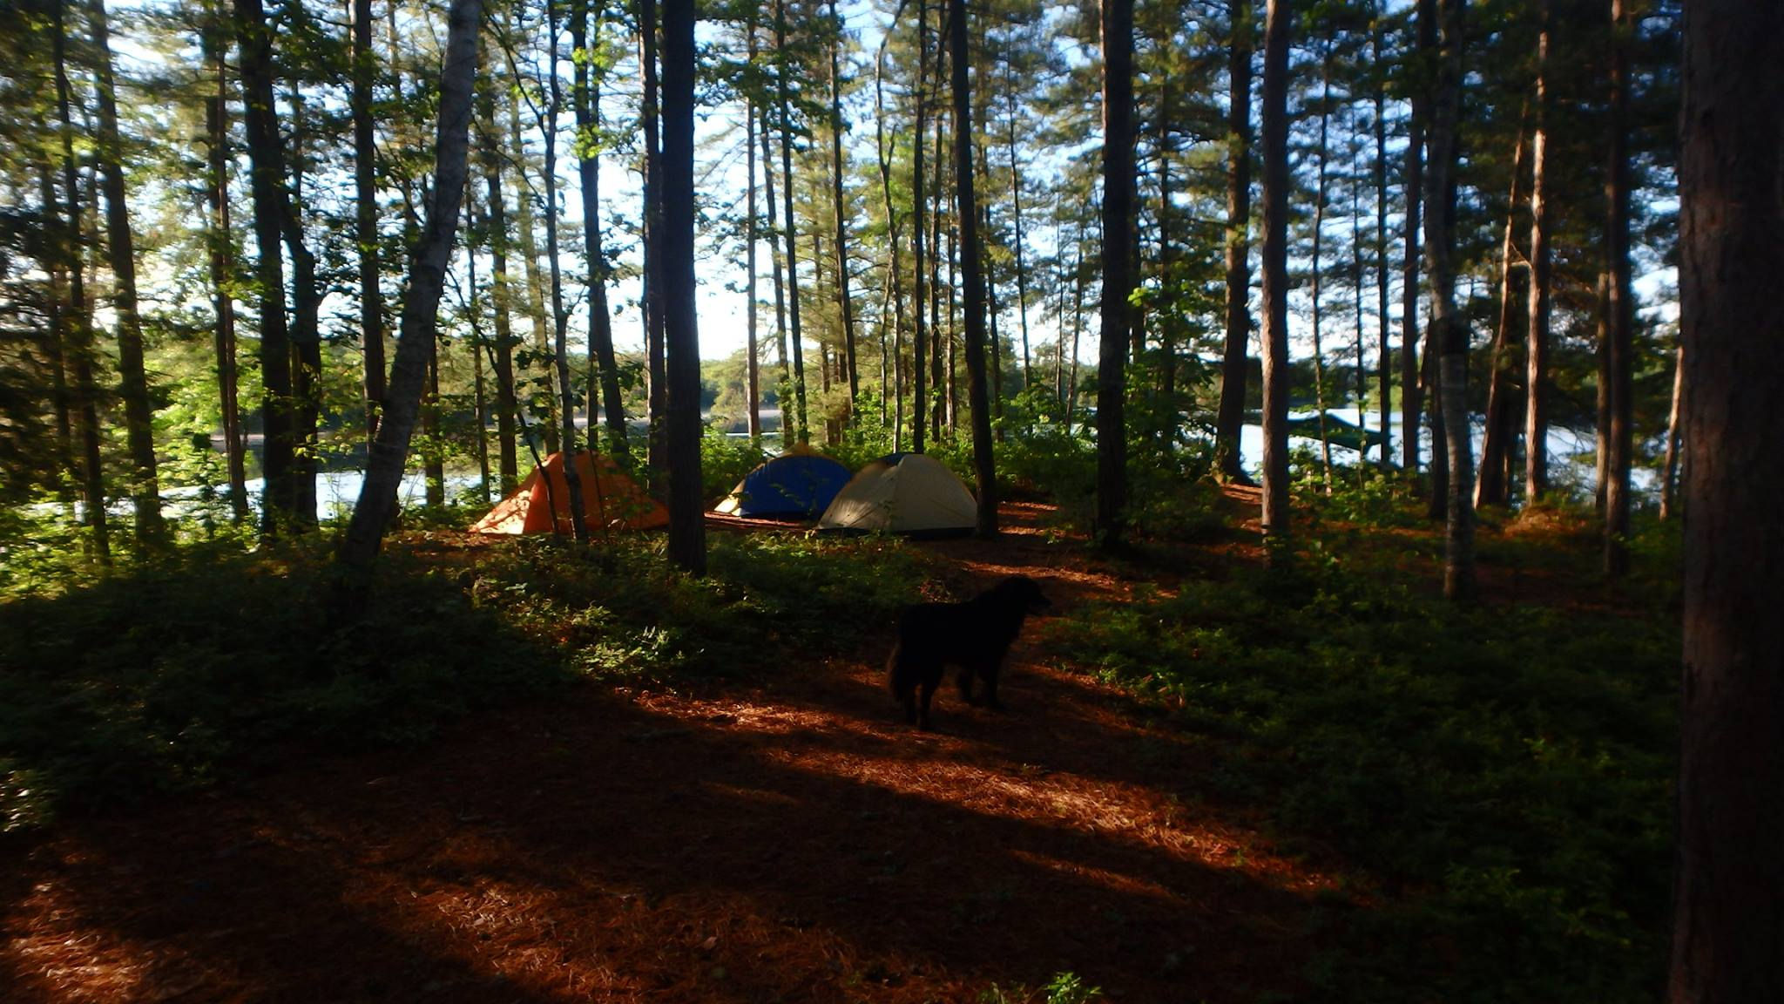
What Are the Scoring Errors?
How many can you find?
Notes:
Scoring Errors
Using the handout--“What Are the Scoring Errors on This Score Form?”
Have participants review this handout, individually. Come back together after 10 minutes and see how many errors each person found, review the errors on the form, and what needs to be done to correct those errors. Use Instructor Handout--“What Are the Scoring Errors on This Score Form?” for your answers.
NOTE: Have FUN with this activity. Keep it lighthearted.
Answers for Scoring Errors Exercise
SF Section
SF.1.2 Scored incorrectly both “YES” and “DNA” are indicated
SF.4.1 Needs “No” and white out/erase incorrect answer
(mention using pencil first, then write over it in pen to avoid this)
SF.4.1 Comments need to be initialed “VIS” – do not include personal initials
SF.13.1 Since the standard was scored “NO” there needs to be a comment
SF.17.1–SF.21.1 Need to be scored with “X” not scribbles
SF.22.1–SF.23.1 Scored incorrectly both “YES” and “DNA” are indicated
TR Section
Cannot “DNA” TR.5.1–TR.11.1, if TR-12.1–TR.15.1 are scored.
HW Section
HW.1.3 Scored incorrectly both “YES” and “NO” are indicated
HW.2.3 and HW.1.4 HW1.4 Scored as “DNA” Indicates camp does not operate as a nonmedical religious camp while HW2.3 Scored as “YES” Indicates camp does operate as a nonmedical religious camp.
HW.5.1 Not scored. Blank. If to be scored as “No” will need ICA as it is a mandatory.
HW.8.1 Scored as “YES” indicating camp is a day camp, however, modes of operation as indicated at the top of the score form are Resident Camp and Short Term Residential
HW.8.2 Scored as “YES” which indicates camp operates as nonmedical religious camp.
HW.11.1 Has an editorial comment that is not needed.
HW.11.1 Also has personal initials, if valid, comment would be initialed “VIS.”
HW.13.1 Blank, needs score.
HW.12.1 Scored as “DNA” which indicates camp operates as a nonmedical religious camp.
HW.17.1 May only be scored “DNA” if camp is non-medical religious.
HW.19.1 Cannot “DNA.” It is very likely that resident camps will have medications on site.
HW.26.1–HW.28.1 Should be “DNA.” Because modes of operation as indicated at the top of the score form are Resident Camp and Short Term Residential
OM Section
OM.3.4 Because TR is scored, this standard must be scored. May not be “DNA.”
OM.4.1 Should be scored “NO,” Comment indicates that director created documents on day of visit – or for 72-Hour Rule
OM.6.1 Mandatory scored “No.” Needs ICA. Comment should reflect this
OM.10.1–OM.13.2 Scored incorrectly both “YES” and “DNA” are indicated
OM.12.1 Scored incorrectly both “YES” and “DNA” are indicated
OM.14.1–OM.15.1 Needs to be scored (because of modes being scored).

Slide 59
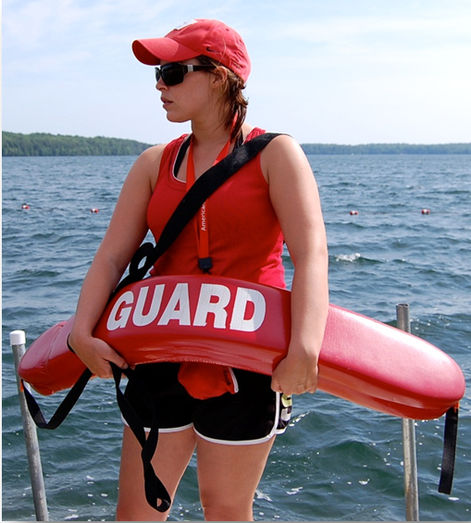
Mandatory Standards
Notes:
Mandatory Standards are:
Critical to health and safety of campers, staff and participants - therefore, compliance is mandatory to earn accreditation
Camps MUST be in compliance with all applicable mandatory standards!
When a camp misses a mandatory standard, we use the ICA process.
Accreditation can be removed (or denied) if a mandatory standard is not met!
Most sections have mandatory standards
Marked in the upper right corner of the standard
If more than one part is mandatory, it will be noted
Sometimes the entire standard is mandatory, and other times only part of a standard is mandatory
All the mandatory standards are tabbed and listed in the APG beginning on p. 247
Sometimes a camp will miss a mandatory standard – when this happens, use the ICA process.

Slide 60
Missed Mandatory Standards
Any camp that misses four or more mandatory standards will be required to have a complete visit the following summer (even if the ICAs are accepted).
Notes:
Missed Mandatory Standards
Any camp that misses four or more mandatory standards will be required to have a complete visit the following summer (even if the ICAs are accepted).
Discuss as necessary.

Slide 61
Missed Mandatory Standards
The National Standards Commission feels that as camps are fully aware of all mandatory standards and the need for these standards to be continually met, this is an appropriate action to help maintain and strengthen the integrity of ACA accreditation.
Notes:
Missed Mandatory standards
Why the change?
The National Standards Commission (NSC) feels that as camps are fully aware of all mandatory standards and the need for these standards to be continually met, this is an appropriate action to help maintain and strengthen the integrity of ACA accreditation.

Slide 62
Immediate Corrective Action (ICA))
ICA
Must be taken for any and all missed mandatory standards.
Some activities or situations will need to cease until compliance is met
Used ONLY for missed mandatory standards
Camp has 7 days to document their immediate compliance with the standard
ANY and all documentation gets sent to the ACA, Inc.
Notes:
Mandatory Standards
Immediate Corrective Action(ICA)
Visitors MUST complete an ICA notice form for any missed mandatory standards (even if they are resolved during the course of the visit). Please note the ICA procedure:
Is ONLY for missed mandatory standards and allows camp to submit documents that may be necessary to meet the standard;
Gives the camp 7 days to document their immediate compliance with the standard – or accreditation will be removed/denied.
The ICA notice form clearly defines how the camp can come into compliance with the standard—Visitors will also indicate if an activity or situation must cease until compliance is met.
ANY and all documentation gets sent to the ACA, Inc. who will forward to the correct people.
Note: Be sure to complete an ICA notice form even if the standard is corrected during the visit. Then, either send in the documentation with the score form or have the camp send it in. It gets forgotten sometimes because everyone thinks it has been taken care of—but there must be a paper trail.
Be sure to review the ICA Examples of Corrections Handout before each visit. Let participants know that it is also available on the ACA Visitor Resource page www.acacamps.org/volunteers/standardsvisitors
Instruct participants to keep their corrective action relevant to the situation, address the specific standard, and give clear simple, step-by-step instructions.

Slide 63
ICA Procedures
Score Form
Mark the missed mandatory standard “NO”
Include a comment on the score form
ICA Form
Specify action required to come into compliance with the standard
Specify the documentation required to verify action taken
Explain
Explain to the director the action and documentation required to verify compliance with the missed mandatory
Have all parties sign the form; leave a copy with the camp director
Follow-up
Mail the ICA form along with the score form immediately to national office
Camp completes action and sends verification to ACA national office within seven days
Lead Visitor will verify compliance with standard
Complete and return the form even if standard was fixed during the course of the visit
Notes:
Mandatory Standards
Participants should locate the sample (ICA) notice form located in the participants package. The following will provide an overview on completing the ICA.
This slide illustrates the steps for completing the ICA notice form. Be sure to provide a sample form for participants to view.
Steps
Mark the missed mandatory standard “NO” and include a comment on the score form.
Complete the ICA notice form. Return the form even if standards was fixed during the visit.
Specify action required to come into compliance with the standard
Specify the documentation required to verify action taken.
Explain the action and documentation required to verify action to the director.
Have all parties sign the form; leave a copy with the camp director.
Mail the ICA form along with the score form, immediately following the visit.
Camp completes action and sends verification to ACA national office within seven days.
Lead Visitor will eventually need to verify compliance with standard

Slide 64
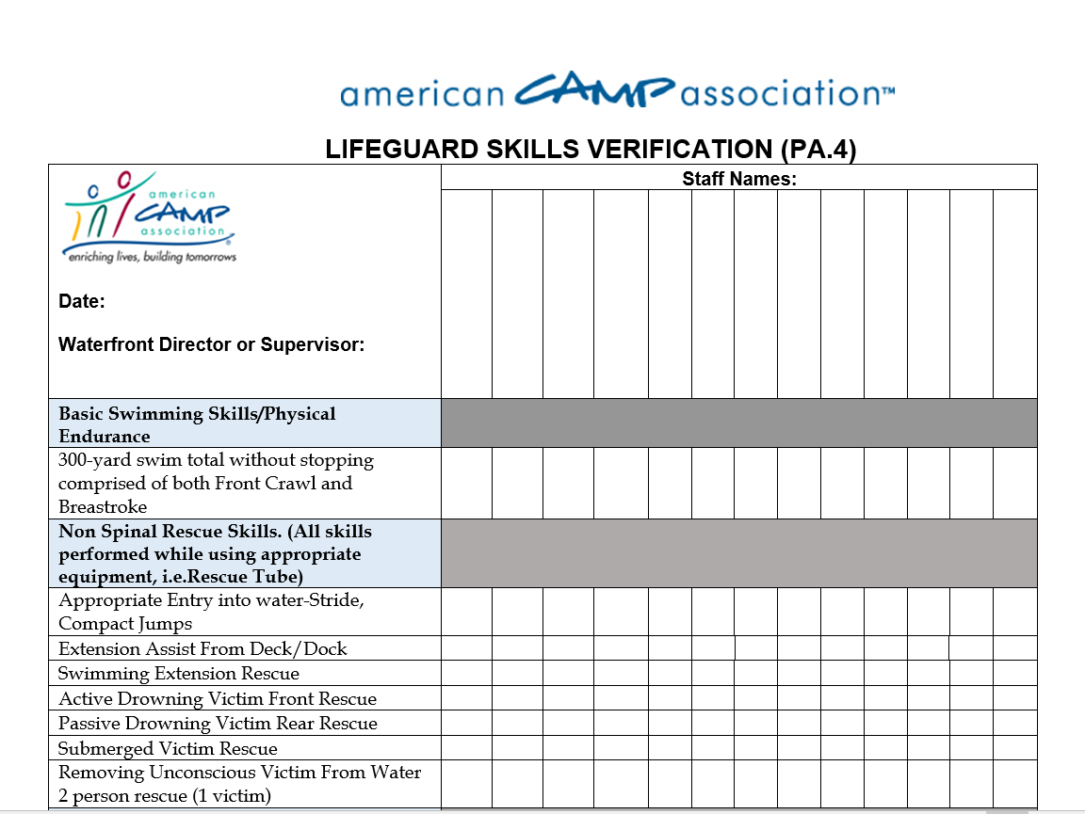
ICA Scenario
www.ACAcamps.org
Accreditation Information & Forms
Notes:
An example to share
For example, PA.4.1 − The camp did not document that the lifeguard has demonstrated skill in rescue and emergency procedures specific to the aquatic area and activities guarded.
Visitor might indicate:
“Immediately cease swimming activities until the lifeguard can be observed demonstrating skill in Camp Happy Days rescue and emergency procedures at Camp Happy Days Pool. Within 7 days, submit the following to the ACA office address listed on ICA form: a form to identify the skills to be observed that is signed and dated by the lifeguard and the observer on the date the observation took place, or a letter signed by the Director indicating the activity has been stopped if unable to conduct the observation.”
Additional steps to completing the ICA form include:
Fill in section name, date, camp name, and camp number
Obtain camp Director’s signature
Obtain signature of both Visitors and member numbers
Send white copy with score form in envelope
Send canary copy to section standards chair
Pink copy is kept by Camp Director
Gold copy is kept by Lead Visitor
(These steps are also reviewed in the Standards Visitor Reference Guide)

Slide 65
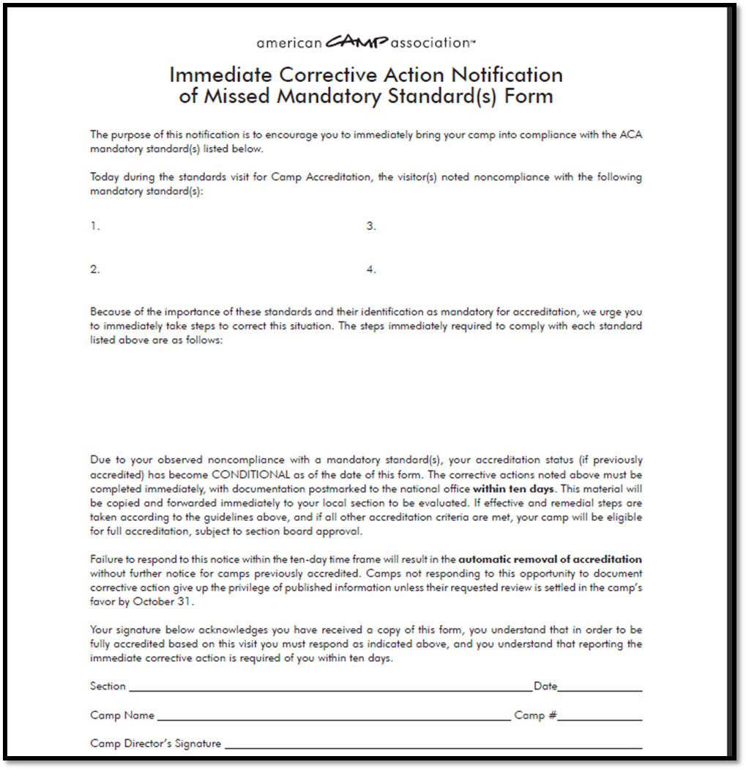
Sample Form
Notes:
Mandatory Standards
If possible have a few actual forms available for them to see. There is sample form for an activity in the participant handout packet.
Major points to make about the ICA notice form:
Mark the missed mandatory standard as a “No” on the score form-even if the correction takes place while the Visitors are still at camp.
Make a comment in the comment section as to why it is a “No” and reference the ICA form.
Fill in the ACA local office name at the top.
Identify missed mandatory standard by number and title.
Describe in detail what the camp is expected to do in order to come into compliance with the mandatory standard(s) and how the camp is to document that compliance.

Slide 66
Immediate Corrective Action
Mandatory standards
Submit within 7 days
Send to ACA, Inc.
Clearly define what the camp must do
Clearly define/prescribe how the camp must document the correction/compliance
4 copies of the form
Notes:
Immediate Corrective Action
Review the ICA process from the slide with the participants
Only mandatory standards can be corrected
Time frame to submit documentation of immediate compliance--7 days and
Where to send documentation
Clearly define what the camp must to meet the missed mandatory standard
Clearly define how the camp must document the correction
What to do with 4 the copies of the form

Slide 67
Other Forms You May Use
Return envelope
Standards Visitor Reference Guide (booklet)
Research questions
Thank-you notes
Visitor evaluation
Other forms requested by local leadership
Notes:
Other forms or documents a Visitor will use.
Postage paid return envelope
Show a sample of the postage-paid, pre-addressed envelope designed to mail the score form, camp information form, and ICA form (if necessary) back to ACA, Inc. The form should be mailed the day of or the day after the visit.
Standards Visitor Reference Guide (Booklet)
Show a sample of the booklet that is prepared each year by ACA and distributed to all Visitors. This guide gives Visitors reminders on things to look for during the camp tour.
Research Questions: From time to time, ACA asks additional questions for research purposes that relate to the operation of the camp or the application of the standards.
E-mail: Be sure to let your Standards Chair and ACA staff member know that the visit has taken place.
Send a thank- you note to the Camp Director
Complete the Visitor evaluation when requested
Complete any forms that your local office uses during the visitation process (Visitor roster, Mileage Reimbursement form, etc.)

Slide 68
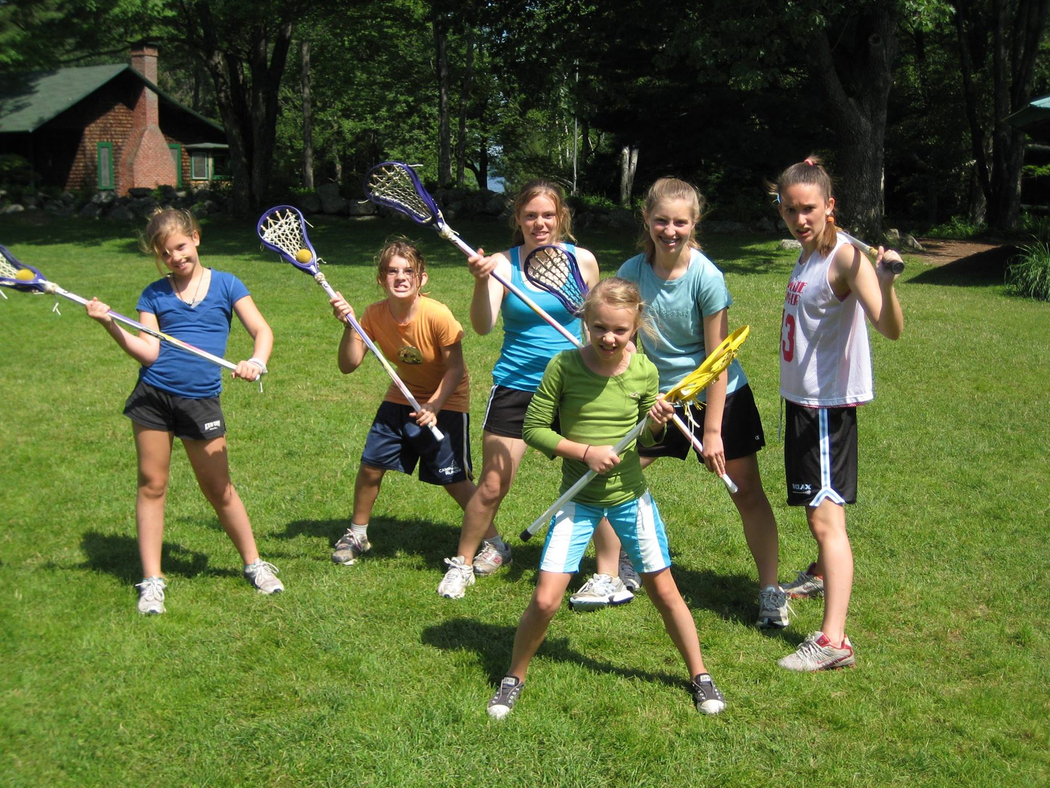
Compliance Decisions
Notes:
Compliance Decisions
This unit directs attention to the various elements that contribute to verifying compliance with a standard. Bringing together the concepts of the prior units (gathering data, reviewing written documentation, reviewing interpretations, etc.), the unit focuses on the critical decisions that must be made in determining compliance.
Share that you are now going to take a closer look at the following areas that are critical for Visitors to know and be confident with:
Evaluating written documentation
Determining compliance/non-compliance (scoring)
Using information gathered from observation & communication
Being familiar with standards in a variety of camps settings

Slide 69

Written Documentation
“Written documentation required” (in the margin notes)
Indicated as part of the Compliance Demonstration
Notes:
Written Documentation
Standards requiring written documentation are clearly identified with the statement Written documentation required in the margin notes of each standard—as applicable.
Additionally, written documentation is specifically indicated as part of the Compliance Demonstration—where applicable.
There are two appropriate times to evaluate written documents:
1. Prior to the visit during the Camp Self-Assessment and/or other written document review
2. During the visit – viewing documentation when it is required.

Slide 70
Written Documentation Rationale
Consistent quality
Orientation and training material
Analysis of practices and procedures
Verifies practices
Preserves history and tradition
Paper trail
Notes:
Rationale for Requiring Written Documentation
Consistent quality – Helps provide consistent quality of programs and services, even when staff changes from year to year
Provides good orientation and training material- for new staff, to be sure good procedures are carried through
Often assures a thorough analysis of practices and procedures, by key staff, the board, insurance personnel, etc.
Helps verify practices, an important step in risk management for the camp to be able to show evidence of your practices – should you be called on to do so (as in court!) in the future. For accreditation purposes, written documentation verifies policies and practices to visitors for activities, camp operations, and modes of operation that may not be observable on the day of the visit.
Preserves history and tradition of the camp
Paper trail in the event of litigation

Slide 71
Written Documentation Compliance
Pertinent Content
Inclusive of all parts
Current
Dissemination
Practice/rehearsal
Location of document
Communication
Notes:
Written Documentation Compliance
Explain/remind participants that Visitors will not score the standard based on “how good” they think the document is, but by the following criteria:
Pertinent content: Does the document presented by the camp deal with the subject of the standard? In OM.12 the written document must refer directly to ratios, supervision behavior guidelines and emergency procedures for times when campers are in public locations.
Inclusiveness of all parts: Does the document cover all points required in the standard? TR.13.2 includes a list of items (lights, windshield wipers, emergency flashers, horns, brakes, mirrors and fluid levels). Each item must be covered in the document.
Current: Does the standard require a date or indication if the document is current? (meets the time frame)
Dissemination: Does the standard require dissemination to specific people (posting, inclusion in a manual, review, sharing, etc.)? If so, has the document been distributed in compliance with the standard? HR.6 refers to staff having job descriptions.
Practice/rehearsal: Does the standard require not only writing the document, but also specify practice or rehearsal of the procedures stated in the document? PA.9.1 and PA.9.2 requires emergency procedures in the aquatics areas to be rehearsed periodically. These rehearsals should be described by camp staff.
Location of document: Does the standard specify where the document must be located? If so, is the document properly located? SF.5 asks for blueprints or charts on site or a posted telephone number for a non-owned site?
Communication: Does the standard require communication with specific people? (It must be communicated with appropriate audience.)
Campers — must receive policies for use of the challenge course
Staff — must receive time-off policies
Rental groups — must receive refund policies
Remind Visitors that documentation should be useful to the camp. The document may or may not present the information in the same order as listed in the standard, or information may appear in more than one document. As long as the camp can present the information and/or written documentation appropriately, the standard can be met.

Slide 72
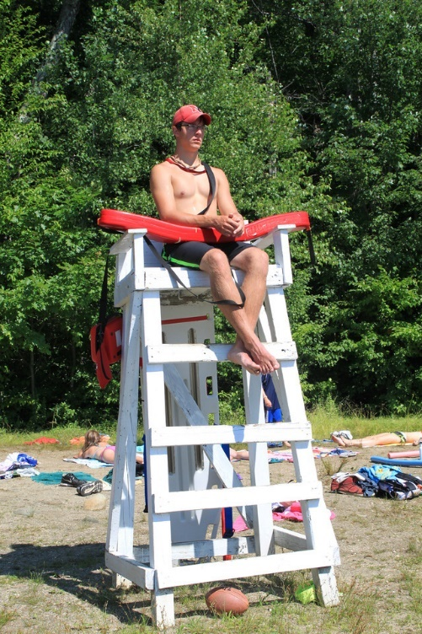
Documenting Staff Qualifications
Job reviews from former employer
Job performance reviews from the camp for years of service
Letters of recommendation
Course record sheets
Certification or training cards
Notes:
Documenting Staff Qualifications
Regarding Documentation Needed to Verify Staff Qualifications – we need to be very certain that the documentation provided IS VERIFIABLE. In some cases it may only be logical that it has come from the individual. Use common sense, ask questions, and accept those things that—if required—could be verified.
Review and clarify what qualifies as documentation to verify staff qualifications – specify that this is what the Visitors will expect to see on the day of the visit –things that come from a third party such as:
Job reviews from former employers
Job performance reviews from the camp for years of service
Letters of recommendation
Transcripts
Course record sheets
Certification or training cards
BE SURE that participants know and understand that: In general, resumes, employment applications, vitas and other sources generated by the individual staff person are NOT acceptable forms of documentation regarding an individual’s qualifications − unless they are verifiable.
Ask: If necessary, could this documentation be verified by a third party.

Slide 73
Compliance Demonstration
Identifies the minimum expectation for how compliance with a standard should be met
    Written Documentation
    Visitor Interviews
    Visitor Observations
Note: Visitors may not project their own (or their camp’s) views, nor judge the efficacy of the written materials.
Notes:
Compliance Demonstration
Indicates to both the camp and the visitor what is required to show compliance. It identifies the minimum expectation as to how compliance with the standard should be determined. Can include the following:
Written Documentation
Visitor Interviews
Visitor Observations
Instruct the participants that Visitors use the compliance demonstration to determine compliance objectively. Have participants look at several standards and compare what is requested to comply with the standard.
Note: Visitors may not project your own (or your camp’s) views, nor judge the efficacy of what you are shown. Does it meet the standard - not is it good or poorly written?
For instance:
The camp’s emergency procedures, OM.8, are deemed by the Visitor to meet the minimum required by the standard but the Visitor feels that they should include more.
The standard gives the Director the right to determine the type and complexity of the procedures. The Visitor would first score the standard YES and then may choose to discuss the procedures with the Director, giving suggestions that could help strengthen those procedures.
See Instructor Resource Packet for an ACTIVITY

Slide 74
The 72-Hour Rule
72-Hour Rule
Very different from the ICA process
May ONLY be used for standards that require written documentation that can be verified to already be in existence
For some inexplicable reason, the documents are not present at the time of the visit
A courtesy that may be extended at YOUR discretion
Notes:
72-Hour Rule
The 72-Hour Rule is a courtesy that may be extended at YOUR (the visitor’s) discretion and is very different from the ICA process
May only be used for standards that require written documentation that can be verified to already be in existence
For some inexplicable reason, the documents are not present at the time of the visit
In these cases, it is at the discretion of the Visitor whether to accept it within a 72-hour window.
Discuss the types of limited situations one can use the 72-hour rule:
insurance policies
certification cards
licenses
Policies/procedures do not typically meet this criteria as they should be available during the visit.

Slide 75
72-Hour Rule Procedures
Mark the standard a “NO” and comment on the score form.
Indicate WHY the documentation is missing and WHAT documentation needs to be sent to the lead visitor.
Explain to the director what and how things need to be sent to you.
Explain the consequences.
Notes:
72 Hour Rule Procedures
To extend the courtesy of the 72-Hour Rule, follow these steps:
Mark the standard a “NO” and comment on the score form.
Also in the comment section: Indicate WHY the documentation is missing and WHAT documentation needs to be sent to the lead visitor.
Visitor will explain to the director what needs to be sent and how things need to be sent.
Visitor will also explain the consequences if documentation is not sent, is incomplete, or is inaccurate.
Camp sends documentation to the lead visitor within 72-hours.
continued on next slide

Slide 76
72-Hour Rule Procedures
Lead visitor holds the score form for 72-hours.
If documentation received is acceptable:
  Visitor will change the score to “YES”
  Add a comment on the score form related to the changed score
If documentation is not received or not acceptable
visitor will leave the “No” as originally scored
Lead visitor will promptly send the score form to ACA national office after documentation arrives or 72-hours elapses
Notes:
72 Hour Rule Procedures
Continuing the steps:
Lead visitor will hold the score form for 72-hours.
Camp sends documentation to the lead visitor within 72-hours.
If the documentation received is acceptable
Visitor will change the score to “YES.”
Add a comment on the score form related to the changed score
If the documentation is not received or not acceptable
Visitor will leave the “No” as originally scored
Lead visitor will promptly send the score form to ACA, Inc. after documentation arrives or 72-hours elapses.

Slide 77
Staffed Public Facilities
Scoring Activities Run by Camp Staff that Use EQUIPMENT From a THIRD PARTY
Hybrid scoring situation where:
  The visitor will score any/all applicable equipment standards from the staffed public facility standards
  AND
  Will score applicable supervision standards from the program standards (supervision)
Notes:
Staffed Public Facilities
Scoring Activities Run by Camp Staff Use EQUIPMENT From a THIRD PARTY
Visitors need to know how to score those instances when a camp uses EQUIPMENT from a third party (staffed public facility) to provide the activity – yet, they are conducting and supervising the activity with camp staff.
When the above instance occurs, the result is a hybrid scoring situation where:
The Visitor will score any/all applicable equipment standards from the staffed public facility standards
Will score applicable Supervision standards from the program standards(supervision)
Ask for examples: (Here is one to start)
Camp has arrangement to use mountain bikes from local bike shop. Camp staff are supervising and conducting biking activities.

Slide 78
Staffed Public Facilities
Scoring Activities Run by Staffed Public Facilities that Use Camp’s EQUIPMENT
When the above instance occurs, the result is a hybrid scoring situation where:
  The visitor will score any/all applicable equipment standards, AND
  Will score the applicable staffed public facility standards (supervision and conduct of activity)
Notes:
Staffed Public Facilities
Scoring Activities at Staffed Public Facilities that Use Camp’s EQUIPMENT
Visitors also need to know how to score those instances when a camp uses a staffed public facility to provide the activity – yet, they are using the camp’s equipment to do so.
When the above instance occurs, the result is a hybrid scoring situation where:
The Visitor will score any/all applicable equipment standards, AND
Will score the applicable staffed public facility standards (supervision and conduct of activity)
Ask for potential instances/examples of this occurring (here is one to start).
Camp takes campers to local horse farm for riding activities conducted by horse farm staff and camp provides helmets and footwear for campers

Slide 79
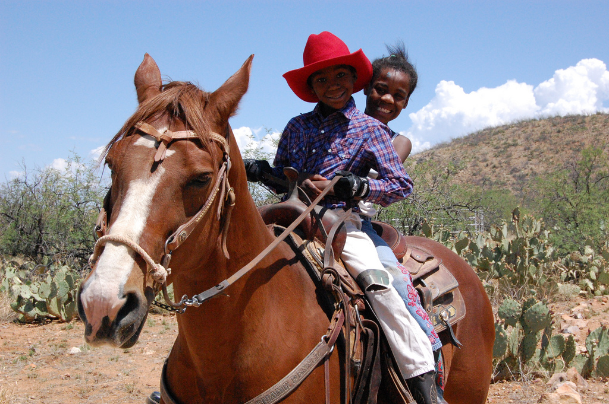
The Positive Aspects of “No”
Notes:
Compliance Decisions
Show Slide and ask: What do you think of this picture? From a Visitor perspective, what questions would you ask the director, or the horseback riding supervisor? How would you score PD.31.2, PD.31.3, how about PD.30.1?
NOW explain that we are going spend some time discussing the positive aspects of “No”

Slide 80
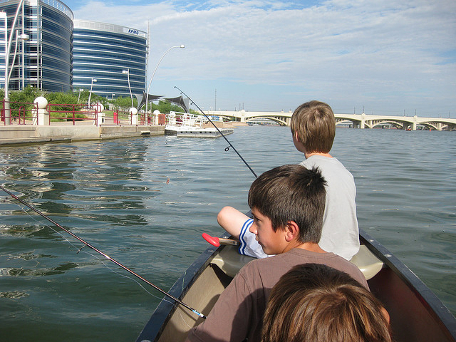
Compliance Decisions
Notes:
Compliance Decisions
What do you think of this picture? From a Visitor perspective, what questions would you ask the director, or the aquatics supervisor? How would you score PA.24? What other standards may apply?

Slide 81
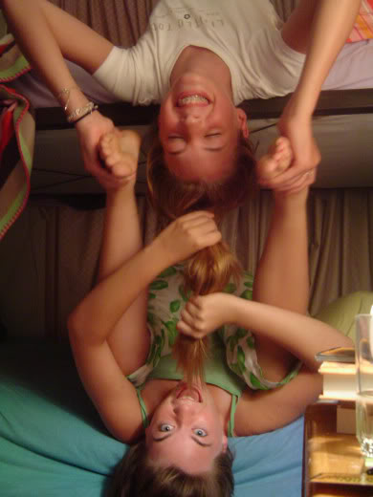
Bunk Buddies
☺
Notes:
What do you think of this picture? From a Visitor perspective, what questions would you ask the director? How would you score SF.13? Would any other standards apply?
Some camps thoughtfully choose to say “no” to some standards that don’t meet their camp’s philosophical ideals. For instance, the camp chooses to takes a “no” to having campers wear boots for horseback riding. This may be due to the income level of most of the camp clientele and inability to afford special footwear. The camp knows in advance it will take a “no” and may be prepared to write a comment to that effect on the score form. Other times a camp simply does not comply with a standard.
Share the following two examples with the group and ask them to respond to the questions:
You are getting ready to score PD.9.1 through PD.9.5 Overnights and Trips. The Director shows you a policy that covers camp stoves, drinking water, food preparation, and food utensil cleaning, but does not address applicable procedures for minimizing environmental impact on campsite or natural areas. The Director does not realize until the point of scoring that the policy is missing one part. What will you ask? If the Director offers to re-write the policy to cover the missing area, what will you say? How will you score the standard PD.9.5? (“no”) What comment will you make?
During the tour of the camp a group leaves the stable for a trail ride. All the campers have on riding helmets, riding boots and long pants. However, one staff member is not wearing a helmet. Later at the stable, everyone, campers and staff, are wearing helmets. When asked about helmets, the Camp Director, and the riding Director both say that the policy is enforced for everyone. When the time comes to score PD.30.1 and PD.30.2 what would cause you to score “no” to PD.30.2? In the case of a “no,” what will you say to the Director and what comment will be made on the score form?

Slide 82
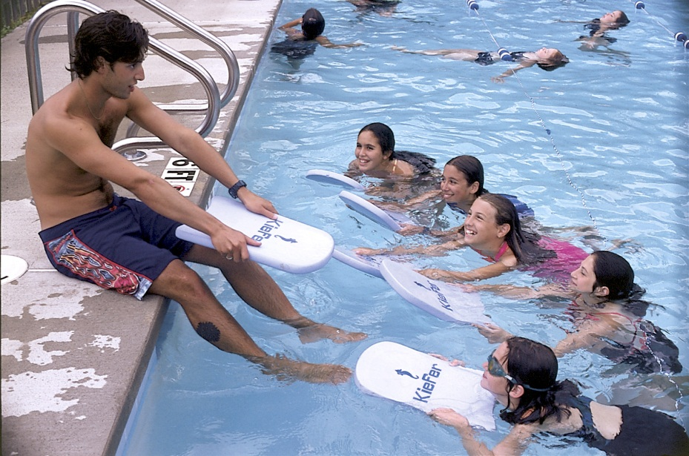
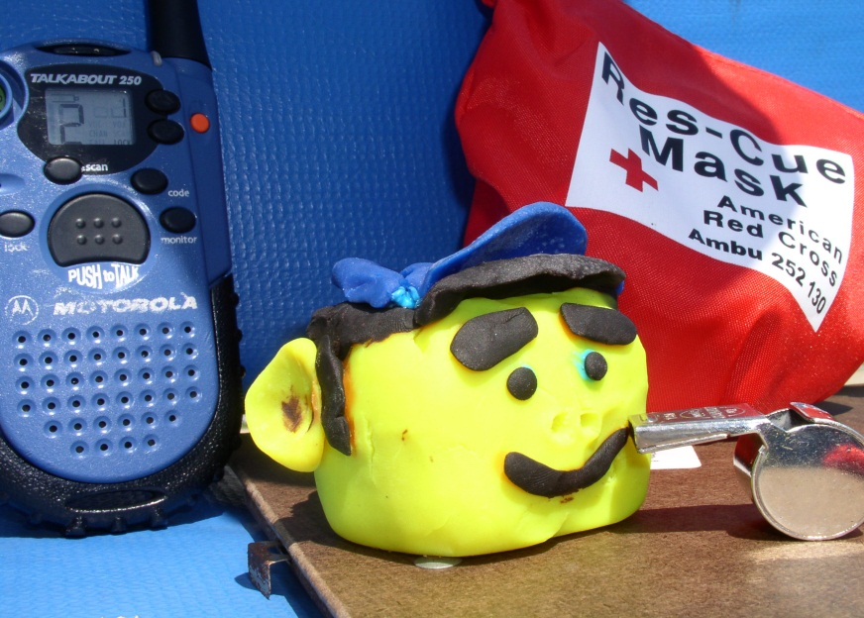
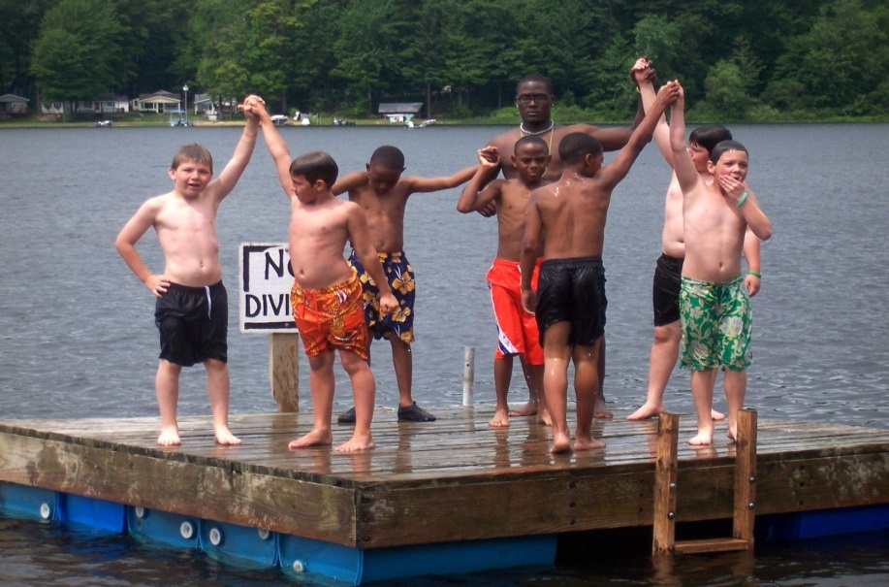
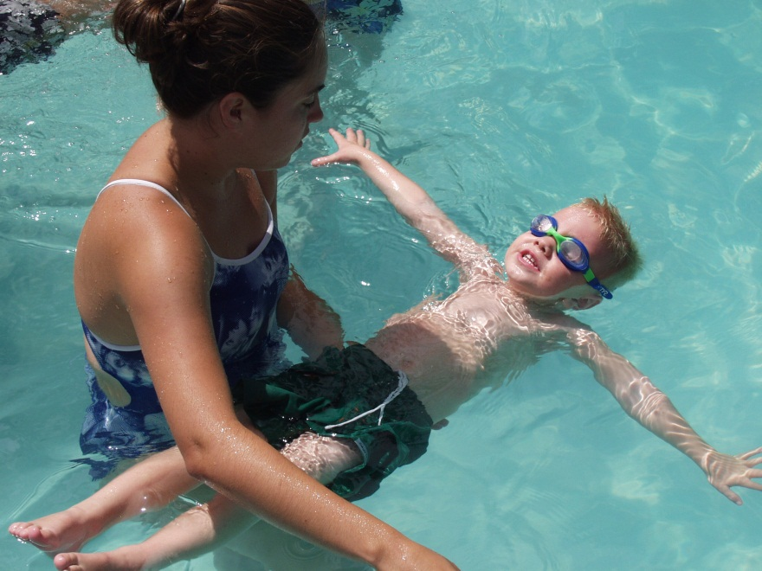
Scoring Exercise - Aquatics
Notes:
Compliance Decisions
Please use the information in the Instructor Resource to facilitate the Aquatics Scenario and Scoring Exercise!
Please review the information covered in this unit before proceeding with the mock visit.
Unit Summary Assessment
Name six criteria for determining the compliance of written documentation.
On a visit, you are provided the application of an aquatics staff member. Is this sufficient to determine the need for appropriate certification? Why or why not?
When scoring a “No” on a score form, how can you turn this into a positive educational experience?

Slide 83
Preparing for the Visit
Availability
Visitor Update Course if needed
Maintain current ACA membership
Review your visit assignment information
Review ACA Visit Resources
Review the Camp Information & Camp Self-Assessment Forms
Review documents from Camp
Notes:
Preparing for the Visit
The next 5 slides serve as review prior to the Mock Visit.

Slide 84
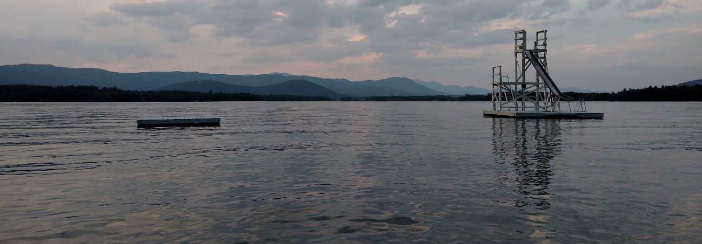
Preparing for the Visit
Acclimate yourself to the camp and its program.
Confirm that camp program and site services are operational so standards can be observed and verified.
Notes:
Preparing for the Visit
Emphasize these points. In setting up the visit, make sure the visitors confirm the operation of program.
Check the camp website for more information about the camp.
Visits are carried out when the camp program and site services are operational and when the greatest number of standards can be observed and verified.

Slide 85
CSA Scenario
You and your co-visitor have received your visit assignment and reach out to the camp director about reviewing the Camp Self-Assessment. The director is reminded of the May 1 review deadline and communication options.
The director states, “I am very, very busy hiring staff and attending camper recruitment fairs and not sure if I can find time to meet the CSA review date”.
Notes:
Discuss this scenario as a group or divide into small groups for discussion and reporting out.
CSA review OR Pair Share

Slide 86
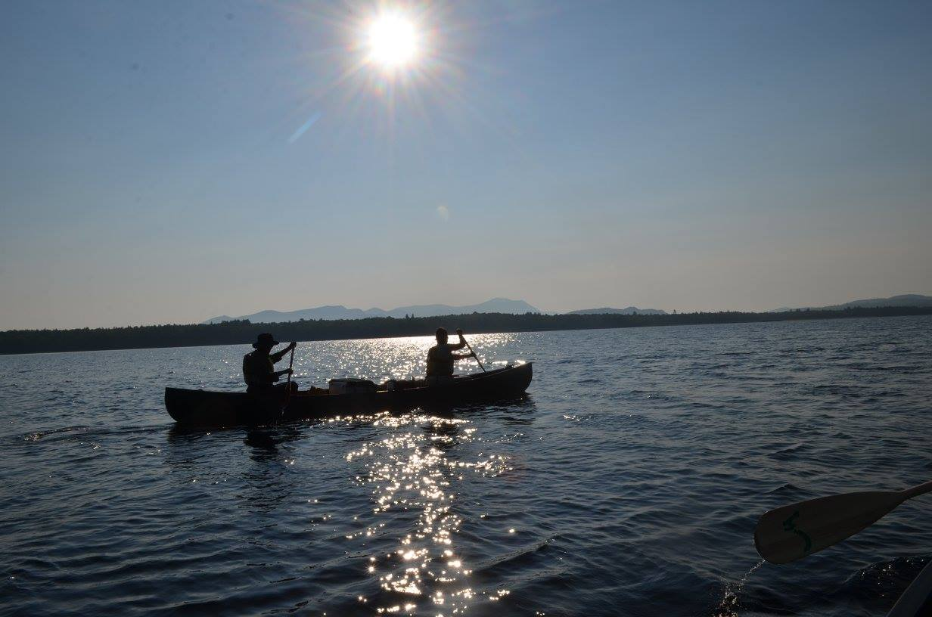
Waterfront Scenario
While touring the waterfront, you see posted signs requiring lifejackets and observe a canoeing class where everyone is wearing a lifejacket. Later in the day, you notice 2 staff canoeing and not wearing life jackets.
Notes:
Scenario is described on this and the next slide.

Slide 87
Waterfront Scenario
As Program Aquatics is scored, the camp director is informed that PA. 22 will be scored NO since staff were observed not wearing life jackets. The director assures you that staff were simply relaxing in the boat on their time off and insists your mark it YES as campers were seen at class time wearing life jackets.
Notes:
Discuss this scenario as a group or divide into small groups for discussion and reporting out.

Slide 88
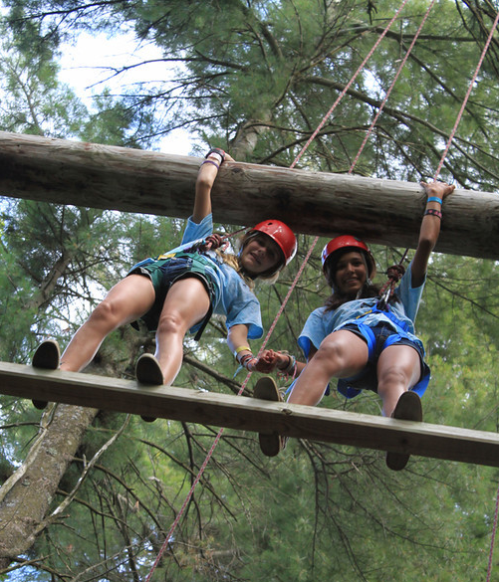
Specialized Activities Scenario
During the tour of camp, the director seems to steer you away from certain activities and staff by saying the activity isn’t being conducted. This happens for archery, ropes course, wood carving, and fire building. At lunch, the director wants you to sit at an administrative staff-only table.

Slide 89
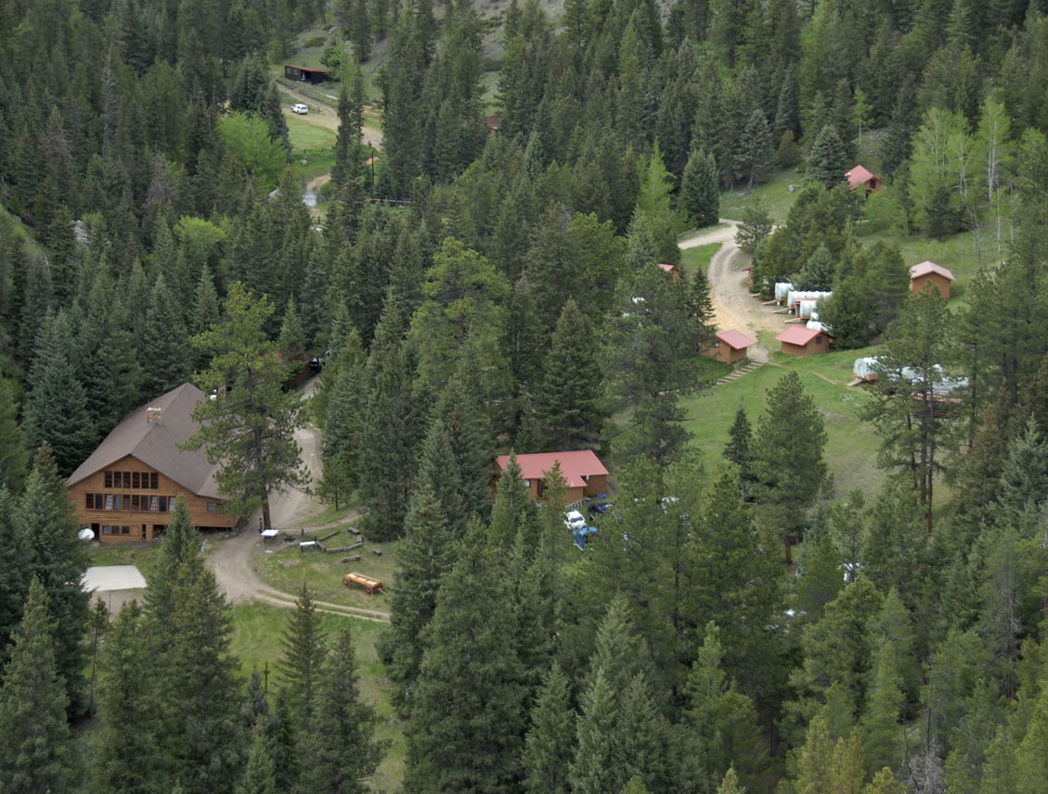
The Mock Visit
Notes:
The Mock Visit is used to help participants understand how the visit will actually take place. This simulation will allow the participants to practice visiting, interactively engage in observing and asking questions of staff (actors) for a camp, and to hear peer comments in a debriefing session. The mock visit will take place on whatever site is used; the paperwork, documentation, and outline of the camp are all established in the Mock Visit packet.
**You are strongly encouraged to solicit additional Instructors or veteran Visitors to come in and assist with the Mock Visit as your actors. They will provide the best experience because of their knowledge of the subject matter and their experience with the ACA accreditation visit process.
Instructors should review the resources available in the Mock Visit Toolkit.
The common information about the camp to be visited is established with the materials provided for each scenario.
The scenarios are:
Kitchen/Food Service
Ropes Course
Canoes
Overnight Camping
Transportation
You must do at least four of the scenarios.
See the Course and/or Instructor Resource for additional information and materials.

Slide 90
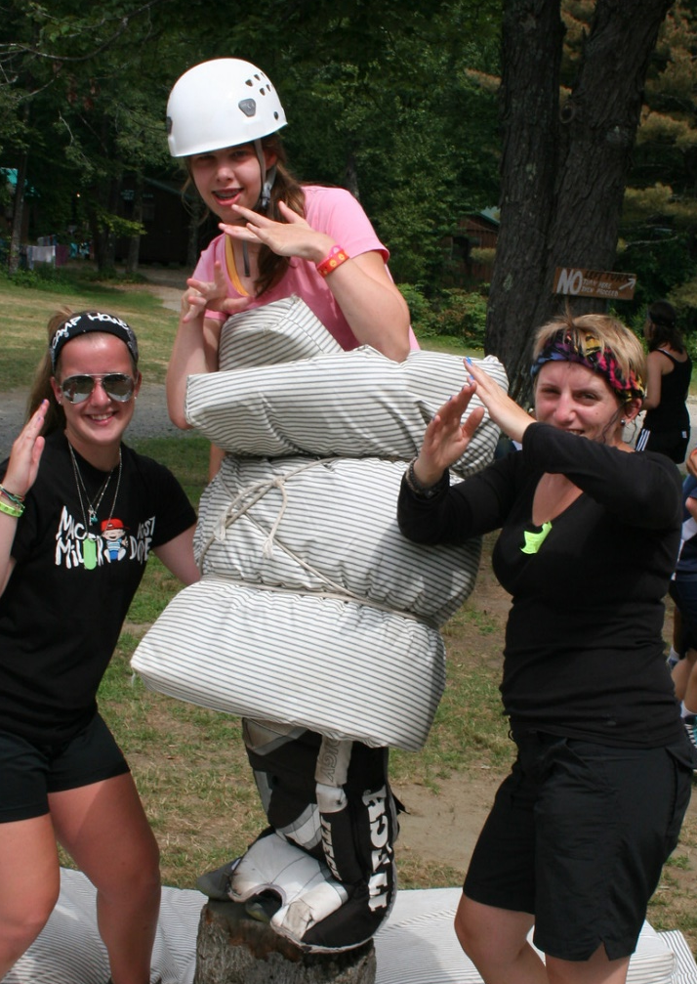
Resources
www.ACAcamps.org
Standards Newsletter
Notifications via E-mail
Notes:
Visitors should also make a point to read the bi-annual Standards Newsletter prior to their summer visits, as there may be directives or other pertinent information necessary for completions of the visits.
Also, pay attention to any messages from the director of standards and/or from your local standards chairs or ACA standards staff members. There may be important last-minute information you need to be aware of for successful completion of your assigned visits.

Slide 91

Review
Notes:
Review
Take the time to reflect on the content and experience of the course. Fill in any gaps or clarifications needed, especially which may have arisen during the mock visit.
(20 minutes)
Take time to reflect back on key points of the accreditation process:
Volunteers, Role of ACA, Inc., Role of LCOL, Educational Process, Role of Visitor, Information Gathering, Observation, Scoring, Compliance Decisions, Role of YOU! Communication, staying up to date, professional connections
“Being an ACA volunteer is important to me because I want children and adults to have the same chance to experience all the wonderful “camp” things I have had and am still having” Vivianne Holmes, ACA Volunteer, Standards Instructor
Use the Associate Visitor Participant Assessment from the participant handout and ask each participant to complete the self-assessment portion.
When they have completed the portion and turned them in, hand out the course and instructor evaluations (there should be an evaluation for them to complete on each Instructor) and ask them to complete them.
Instructors review the Participant Assessments and fill in Instructor Assessment of Demonstrated Skills column using the Disagree/Agree column and making any comments about the participant’s progress through the course.
The Instructors will evaluate the visitor trainees and make recommendations regarding the number of visits required of each candidate as an associate visitor before they will be eligible for visitor status.
Instructors should conduct this evaluation in private. These candidates will receive a copy of their self-assessment with the instructor’s assessment. Instructors may have to mail this copy if a copier is not available.

Slide 92
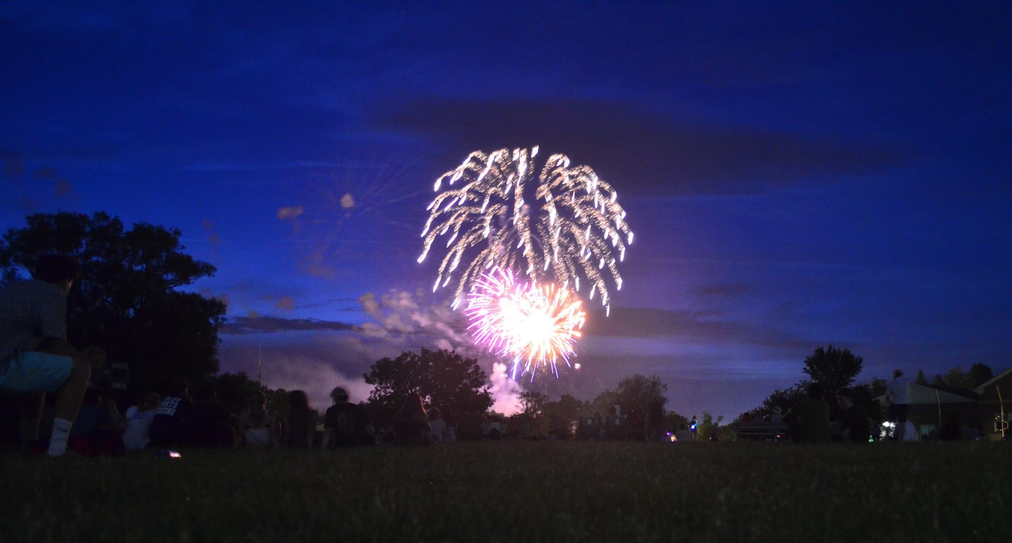
Congratulations!
Notes:
Congratulations
Remind the participants that they must keep their membership up to date to be eligible to visit camps. Let them know that the LCOL/ Board will vote to approve their appointment as an associate visitor at its next meeting. Remind them of the local office procedures for assigning Visitors.
Congratulate them on completing the American Camp Association Associate Visitor Course!!!
Instructor/Trainer: Please complete and return your completed training report and signed applications to the ACA national office as soon as your LCOL/ Board has acted on the results of the recommendation from the Instructors.
Thank you!
Safe travels.

Slide 93
Contact Us
Today’s Instructors:
Local Office
Phone:
Web:
E-mail:
Notes:
Take time to review from the day. Today is a starting point and it is up to them to take the next steps.
Remind participants of the resources available for them:
APG
ACAcamps.org
Other participants from today
You, the instructors.
Local Standards Chair or ACA Standards Specialist
Use this slide to provide them with information about who they may want to reach locally.

